Slide 1



Connect Student Registration
Name of School, Professor, Class info, section info

Slide 2
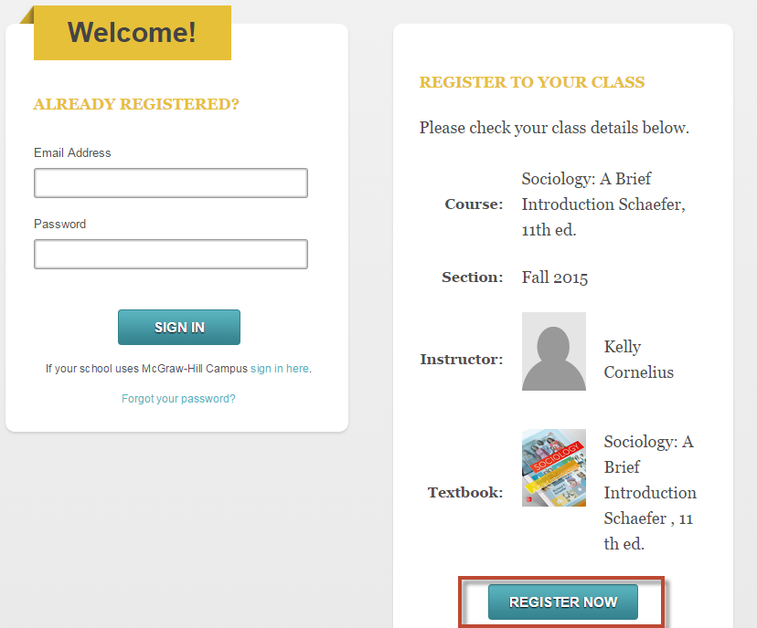
Connect Student Registration
Step 1: Follow Connect section web address provide by Instructor. Click Register Now.

Slide 3
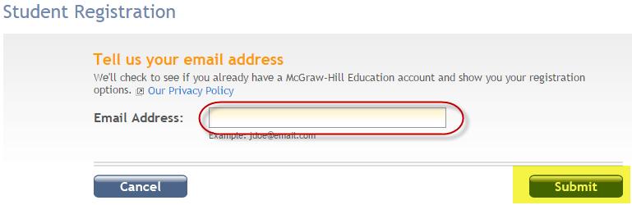
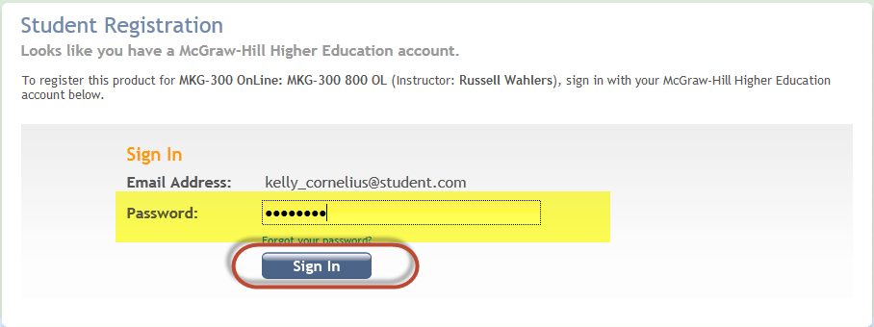
Connect Student Registration
Step 2: Enter your email address and click Submit.
Step 3: Enter your password and click Sign in.

Slide 4
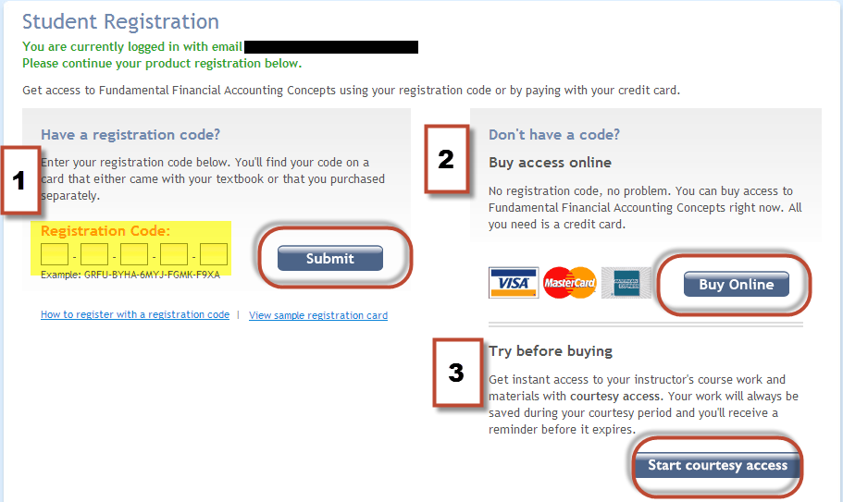
Connect Student Registration
Step 4: Registration options-
1. Connect Student Access Code
Purchase from Bookstore.
Beware of invalid codes if purchased elsewhere.
2. Purchase Connect online
Allows full access to Connect and SmartBook/LearnSmart.
3. Get courtesy access
Two week full Connect access.
Must upgrade when courtesy access expires.

Slide 5
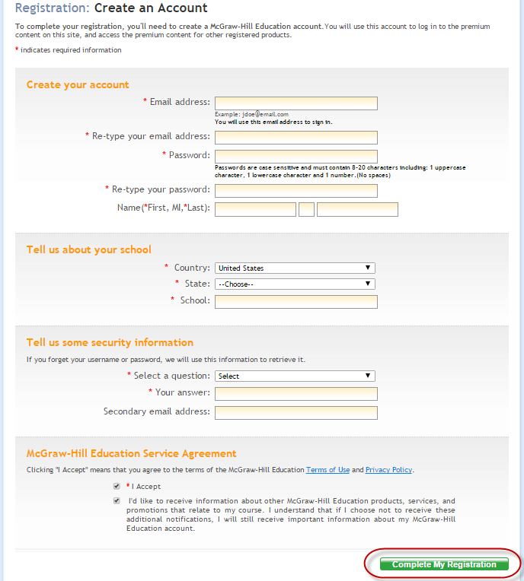
Connect Student Registration
Step 5: Create your McGraw-Hill Education account.

Slide 6
Need Help?
Tech Support & FAQ:
Call: (800) 331-5094
Email & Chat: www.mhhe.com/support
Monday - Thursday ● 7 AM - 3 AM
Friday ● 7 AM - 8 PM
Saturday ● 9 AM - 7 PM
Sunday ● 11 AM – 1 AM
(All times Central)
Find more support at: www.connectstudentsuccess.com
NOTE: If you contact your instructor with a technical question, you will be asked to provide a case number from tech support before your concern is escalated.
Notes:
Our goal is to provide you with the service you need to get the most out of Connect. Our customer support is here to assist you with any technical issues you might be having. If you’re having trouble with anything – accessing a page, submitting an assignment, etc. -- use these resources before going to your professor. We have many people dedicated to helping you with all things technical. Keep the cards/stickers we passed out somewhere you can’t lose them, and use these resources whenever you need.
www.mhhe.com/support has a new chat functionality; You can browse through connect student success for anything else you might need; FAQs, etc.

Slide 7



CONNECT with McGraw-Hill
Higher Education
Like us on Facebook:
McGraw-Hill Education Higher Ed
Follow us on Twitter:
@mhhighered @mhestudents
Subscribe to us on YouTube:
youtube.com/mhhighered

