Slide 1
CREATING AN
INFORMATIVE SPEECH
Prof. Mark J. Grossman
Suffolk County Community College
COM 101 – Fall 2013

Slide 2
Informative Speech
Your speech should be about a person.
Choose someone you know about, care about, or find interesting.
If you have an existing base of knowledge, you will be more comfortable with the content.
There should be an abundance of credible source material.

Slide 3
Informative Speech
Speech length approximately 3 minutes.
Practice and time speech.
Present extemporaneously from an outline (or index cards), not from verbatim text.
Avoid a full biography. Best to focus on one part/theme of the person’s life.
Visual tools/enhancements can help augment your presentation. However, make sure it is not PowerPoint dependent.

Slide 4
Speech Proposal
A Speech Proposal contains the following:
  Topic. (The overarching subject matter)
  Purpose Statement. (The specific goal of the speech)
  Thesis Statement. (Purpose Statement plus your three Main Points)

Slide 5
Elements of a Speech Proposal
Topic: Richie Havens.
Purpose Statement: I want my audience to appreciate how folksinger Richie Havens “saved” the 1969 Woodstock Music Festival.
Thesis Statement: Folksinger Richie Havens is said to have “saved” Woodstock by volunteering to be the opening act, stretching his planned 20 minute set to over an hour, and improvising his on-stage finale into a song that would be the anthem of his career.
(You need to draft Main Points in order to do a Thesis Statement)
Main Points:
  Scheduled to go on fifth, Richie Havens volunteered to be Woodstock’s opening act.
  He stretched his planned 20 minute set to over one hour.
  Having run out of songs, Havens improvised his encore, “Freedom.”

Slide 6
Main Point 1
Richie Havens volunteered to be Woodstock’s opening act.
  Scheduled to go on stage fifth.
  Havens arrived the night before at a nearby Holiday Inn.
  NYS Thruway was closed by mid-day.
  Havens had least amount of equipment and instruments.
  After much pleading by the concert promoter, Havens agreed to open the festival.
  Flown by helicopter from the hotel parking lot to a field backstage.

Slide 7
Main Point 2
He stretched his planned 20 minute set to over one hour.
  Because of traffic back-ups, other acts were delayed.
  Concert organizers kept telling Havens to stall and “kill time,” sending him back for multiple encores.
  Havens said that he wound up playing every song he knew.
    He played one song twice.
    Of his 11 songs, three were covers of Beatles songs.

Slide 8
Main Point 3
Having run out of songs, Havens improvised his encore, “Freedom.”
  The chorus of the song is borrowed from the classic “Negro Spiritual” Sometimes I feel like a Motherless Child.
  Havens inserted the word “Freedom” because, he said, the concert symbolized the independence of the 60’s.
  The song became his anthem throughout a 40-plus year career.

Slide 9
Due November 11
Students will bring two copies of a “Speech Proposal” which contains the following:
  Topic: Name of the person.
  Purpose Statement: “I want my audience to . . . “
  Thesis Statement: Purpose Statement plus your three Main Points.
Students will stand up in front of the class and present their Speech Proposal.

Slide 10
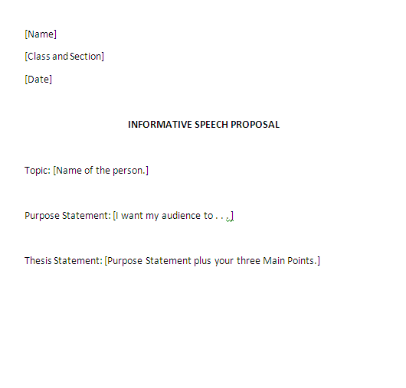

Slide 11
Create Your Outline
Start with an attention grabbing introduction:
  A startling statement that previews one or more of the main points.
  Create a sense of mystery.
  Begin with a question or a quotation.
Continue with the 3 main points plus sub-points.
Close with a “memorable moment” that will help the audience remember your speech.
  A quotation by the person or about the person.
  A dynamic video clip.
  An short anecdote/story from their life.

Slide 12
Speech Day
Students must bring two copies (one for you and one for the instructor) of the following:
  Speech Proposal.
  Speech Outline.
  Works Cited/Bibliography.
  Print out of graphics, visual materials, PowerPoints, etc.
All material must be typed and include your name, class name/section, and date.
Graphics must be pre-loaded onto the computer via a USB memory stick only. (No email downloads.)
Students must arrive promptly to class.

