Slide 1
Communication Ethics
Prof. Mark J. Grossman
Nassau Community College
Suffolk County Community College

Slide 2

What is Ethics?
eth·ic
noun \e-thik\
: rules of behavior based on ideas about what is morally good and bad
ethics : an area of study that deals with ideas about what is good and bad behavior : a branch of philosophy dealing with what is morally right or wrong
: a belief that something is very important

Slide 3
What is Ethics?
mor·al
adjective \mȯr-əl, \mär-\
: concerning or relating to what is right and wrong in human behavior
: based on what you think is right and good
: considered right and good by most people
: agreeing with a standard of right behavior

Slide 4

Excerpts from Code of Ethics
Be honest and accurate.
Act promptly to correct errors.
Preserve the free flow of unprejudiced information when giving or receiving gifts by ensuring they are nominal, legal, and infrequent.
Avoid conflicts between personal and professional interests.

Slide 5
Excerpts from Code of Ethics
Avoid deceptive practices.
To aid informed decision-making.
Investigate the truthfulness and accuracy of information released on behalf of those represented.
Reveal the sponsors for causes and interests represented.

Slide 6
Excerpts from Code of Ethics
To build trust with the public by avoiding or ending situations that put one's personal or professional interests in conflict with society's interests.
Act in the best interests of the client or employer, even subordinating the member's (ie. your own) personal interests.

Slide 7
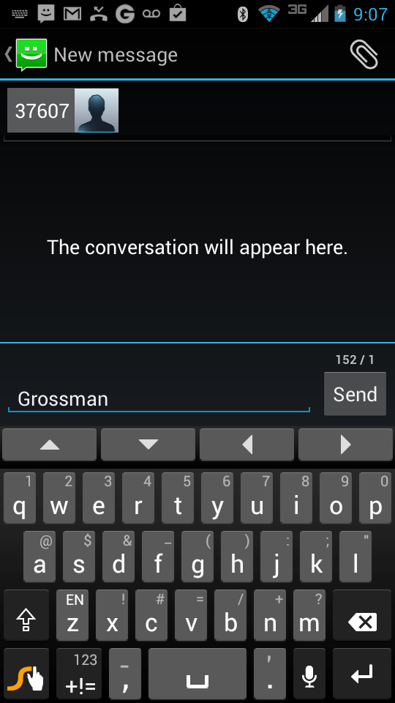
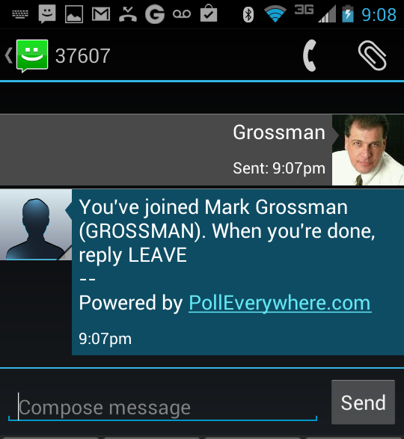
In your web browser: pollev.com/grossman
~ OR ~
Text Grossman to 37607

Slide 8
Two types of ethical dilemmas in communications:
In the business of communications
In the practice of communications

Slide 9
Two types of ethical dilemmas in communications:
In the business of communications
In the practice of communications

Slide 10
Don’t forget: You can copy-paste this slide into other presentations, and move or resize the poll.
Poll: You work at a PR agency and signed a non...
Notes:
Poll: You work at a PR agency and signed a non... Press F5 or enter presentation mode to view the poll In an emergency during your presentation, if the poll isn't showing, navigate to this link in your web browser: http://www.polleverywhere.com/multiple_choice_polls/Y59vkmbcPcJS8El
If you like, you can use this slide as a template for your own voting slides. You might use a slide like this if you feel your audience would benefit from the picture showing a text message on a phone.

Slide 11
Don’t forget: You can copy-paste this slide into other presentations, and move or resize the poll.
Poll: You work as an in-house PR manager. The...
Notes:
Poll: You work as an in-house PR manager. The... Press F5 or enter presentation mode to view the poll In an emergency during your presentation, if the poll isn't showing, navigate to this link in your web browser: http://www.polleverywhere.com/multiple_choice_polls/SEzKMX1kq0nWdBN
If you like, you can use this slide as a template for your own voting slides. You might use a slide like this if you feel your audience would benefit from the picture showing a text message on a phone.

Slide 12
Don’t forget: You can copy-paste this slide into other presentations, and move or resize the poll.
Poll: You had a productive week, but when fill...
Notes:
Poll: You had a productive week, but when fill... Press F5 or enter presentation mode to view the poll In an emergency during your presentation, if the poll isn't showing, navigate to this link in your web browser: http://www.polleverywhere.com/multiple_choice_polls/N4m6FwYj1w5XsUS
If you like, you can use this slide as a template for your own voting slides. You might use a slide like this if you feel your audience would benefit from the picture showing a text message on a phone.

Slide 13
Two types of ethical dilemmas in communications:
In the business of communications
In the practice of communications

Slide 14
Don’t forget: You can copy-paste this slide into other presentations, and move or resize the poll.
Poll: You work for a Town Supervisor who recei...
Notes:
Poll: You work for a Town Supervisor who recei... Press F5 or enter presentation mode to view the poll In an emergency during your presentation, if the poll isn't showing, navigate to this link in your web browser: http://www.polleverywhere.com/multiple_choice_polls/bkdXdm17cbxiS8F
If you like, you can use this slide as a template for your own voting slides. You might use a slide like this if you feel your audience would benefit from the picture showing a text message on a phone.

Slide 15
Don’t forget: You can copy-paste this slide into other presentations, and move or resize the poll.
Poll: Your boss, a well-known CEO, is going to...
Notes:
Poll: Your boss, a well-known CEO, is going to... Press F5 or enter presentation mode to view the poll In an emergency during your presentation, if the poll isn't showing, navigate to this link in your web browser: http://www.polleverywhere.com/multiple_choice_polls/AsEbiqs35uXfoSH
If you like, you can use this slide as a template for your own voting slides. You might use a slide like this if you feel your audience would benefit from the picture showing a text message on a phone.

Slide 16
Don’t forget: You can copy-paste this slide into other presentations, and move or resize the poll.
Poll: You do PR for a developer who is proposi...
Notes:
Poll: You do PR for a developer who is proposi... Press F5 or enter presentation mode to view the poll In an emergency during your presentation, if the poll isn't showing, navigate to this link in your web browser: http://www.polleverywhere.com/multiple_choice_polls/p0rI82JJZ33ASFo
If you like, you can use this slide as a template for your own voting slides. You might use a slide like this if you feel your audience would benefit from the picture showing a text message on a phone.

Slide 17
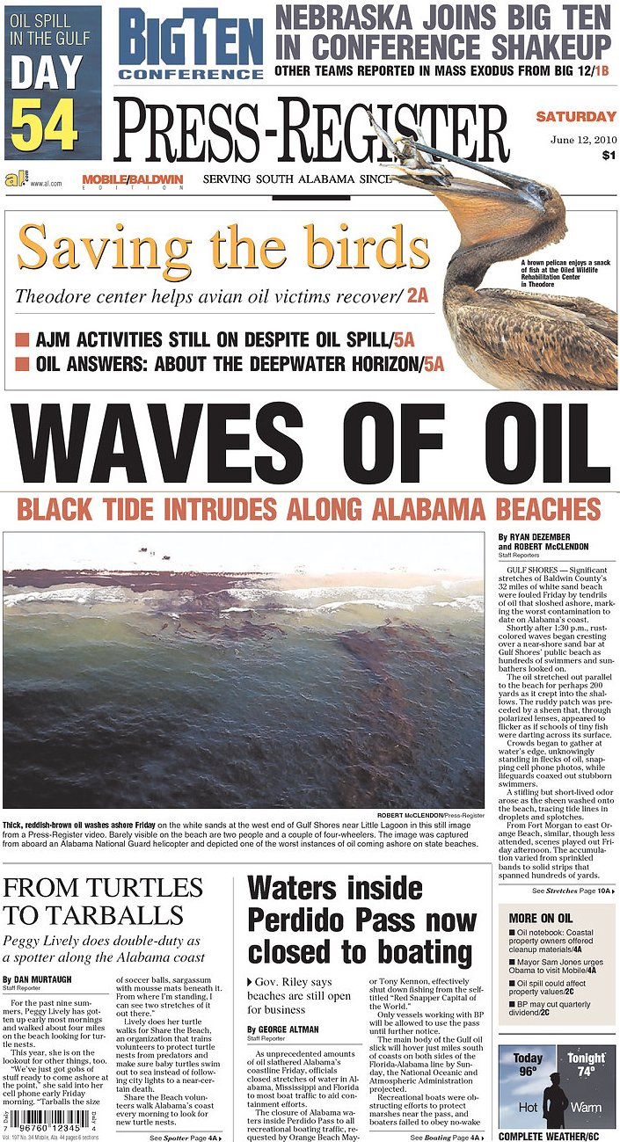


Slide 19
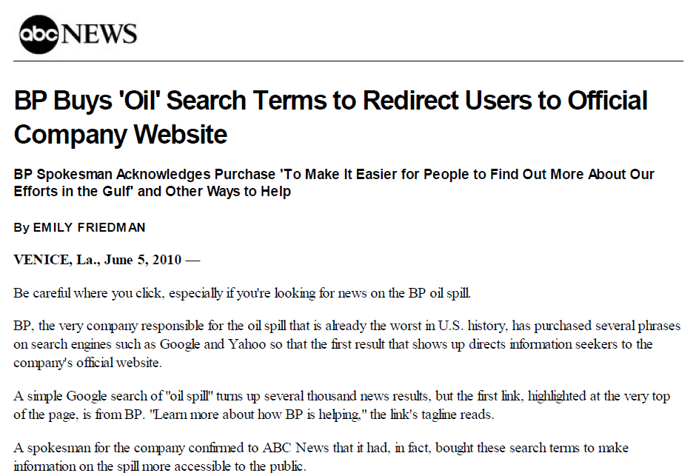

Slide 20
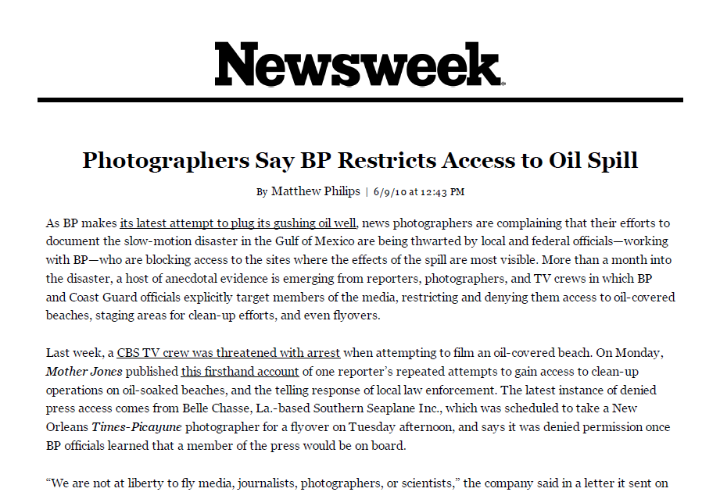

Slide 21
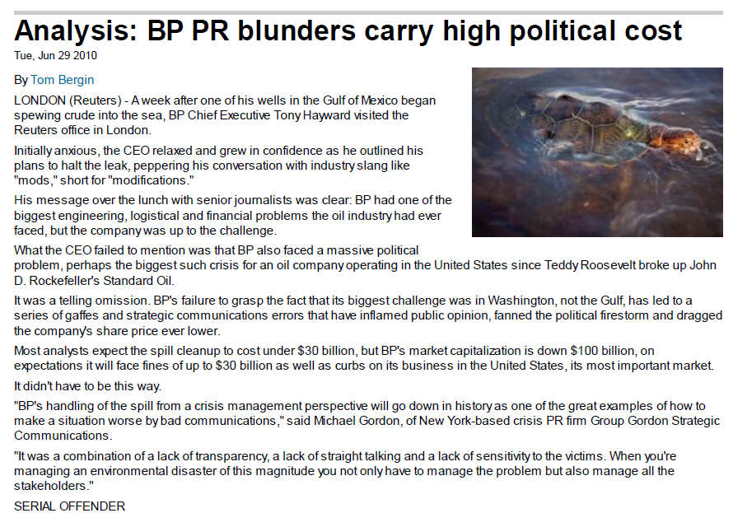
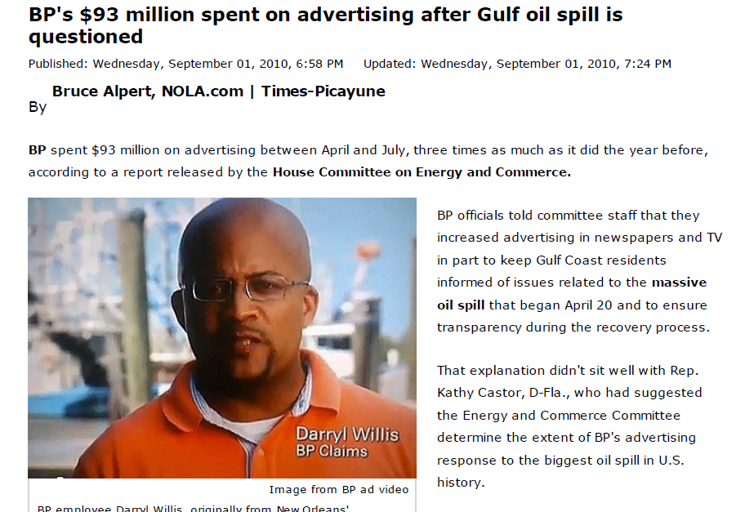

Slide 22
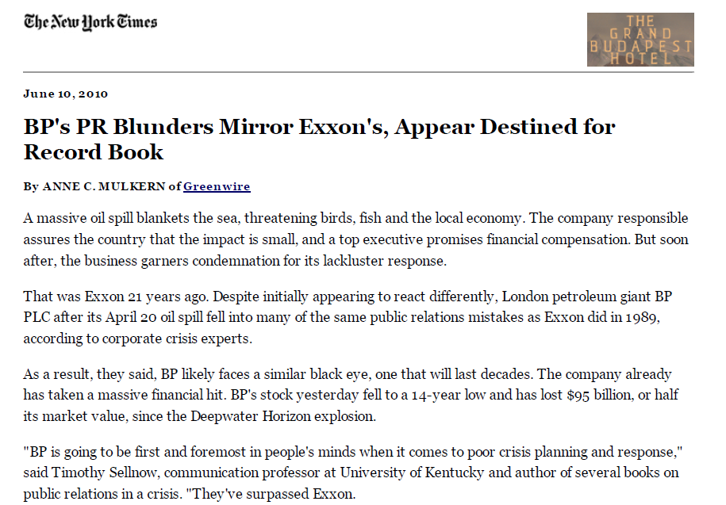

Slide 23
Discussion Topics
Ethics of buying Google search words and phrases. What are some more ethical ways they could have used social media in a crisis?
Ethics of restricting media access. Was there a way they could have provided safe, organized press access without seeming to “cover up?”
Ethics of spending on “self-aggrandizing” advertising. What better role can paid media play in providing public information?
Ethics of BP’s lack of corporate transparency and honesty. Could they have better managed the initial response?

