Slide 1
Managing Speech Anxiety

Slide 3
What is Speech Anxiety?
The level of fear or anxiety you experience when anticipating or actually speaking to an audience.
Trait apprehension
State apprehension

Slide 4
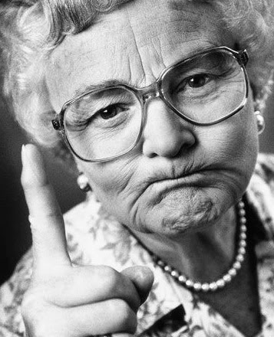
Causes of Speech Anxiety
Inborn
Negative reinforcement
Underdeveloped skills

Slide 5
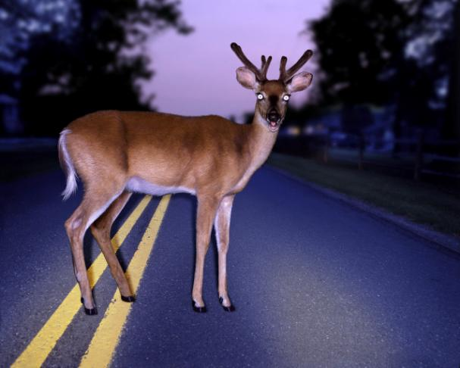
Stage Fright
Ever feel like a deer in the headlights?

Slide 6
King George VI

Slide 7
“The King’s Speech”

Slide 8
Stage Fright
Stage fright is a form of stress
Psychological effects
Public speaking anxiety
Anticipatory anxiety

Slide 9
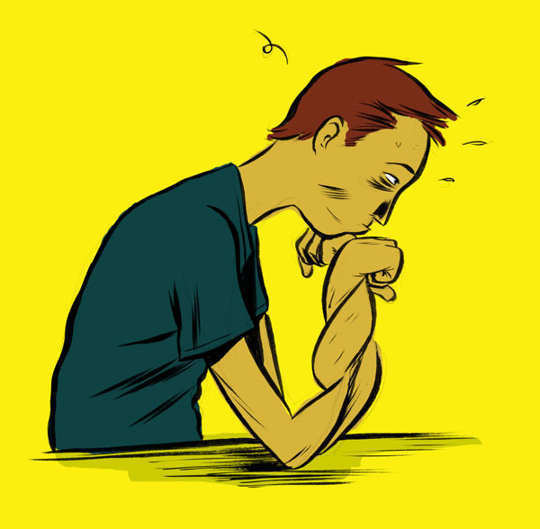
Stage Fright
Anticipatory Anxiety Phases
Anticipation
Confrontation
Adaptation

Slide 10
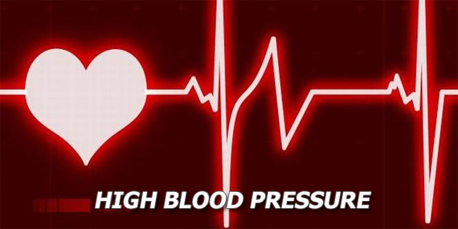
Stage Fright
Physical Effects (Internal)
Elevated stress hormones
Increased heart rate
Elevated blood pressure

Slide 11
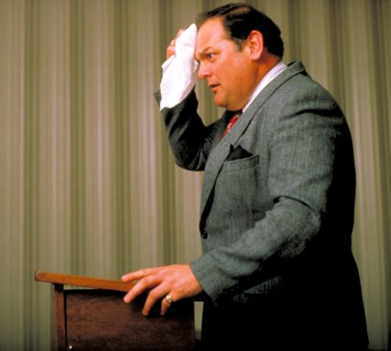
Stage Fright
Physical Effects (External)
Voice
Mouth and throat
Facial expression
General movement
Verbal behavior
Perspiration

Slide 12
Stage Fright
Emotional effects
Shame
Embarrassment
Feeling of low self-worth

Slide 13
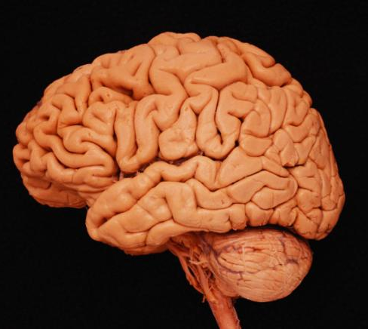
Stage Fright
Cognitive effects
Stage fright can be debilitating.
Mind goes blank.
Strong urge to escape the situation.

Slide 14

Stage Fright
Making stage fright an advantage
Accept stage fright as normal
Focus your nervous energy
Visualize success
Desensitize yourself
Stay positive

Slide 15
Getting Through It
Realize that your audience probably doesn’t perceive that you are anxious or nervous . . . really!

Slide 16
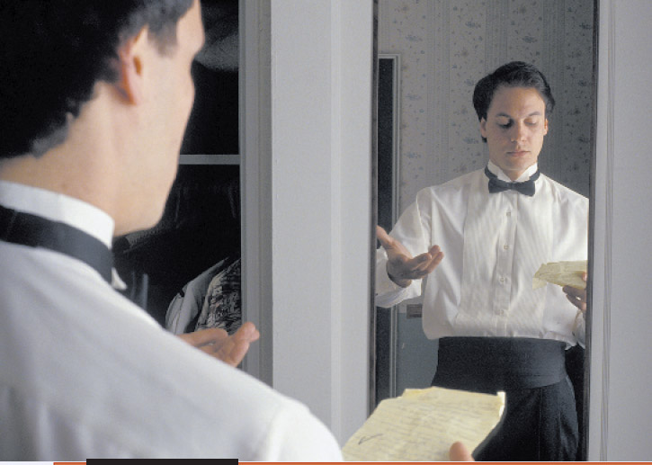
Getting Through It
Understand that with careful preparation and rehearsal, apprehension will decrease.

