Slide 1
Educational Resources Committee
Nassau Community College
ERC Day
March 20, 2015
“Teaching with Technology:
The Basics and Beyond”
Prof. Mark J. Grossman
Using Web-Based Polling Systems in the Classroom

Slide 2
Please set-up your cell phone…
Use SMS (text) “short code” 37607. Get confirmation text.
Web browser: www.pollev.com/grossman
Download app from iTunes or Google Play.
  (Search for “Poll Everywhere” app.)

Slide 3
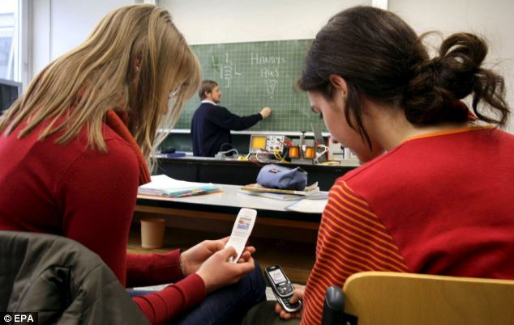
Battling Cell Phone Use?

Slide 4
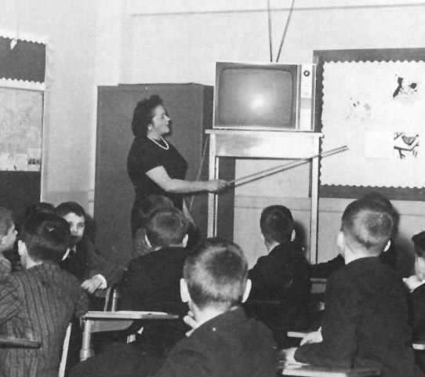
Did you go to school in 60’s?

Slide 5
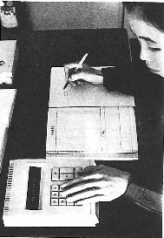
Did you go to school in 60’s?

Slide 6
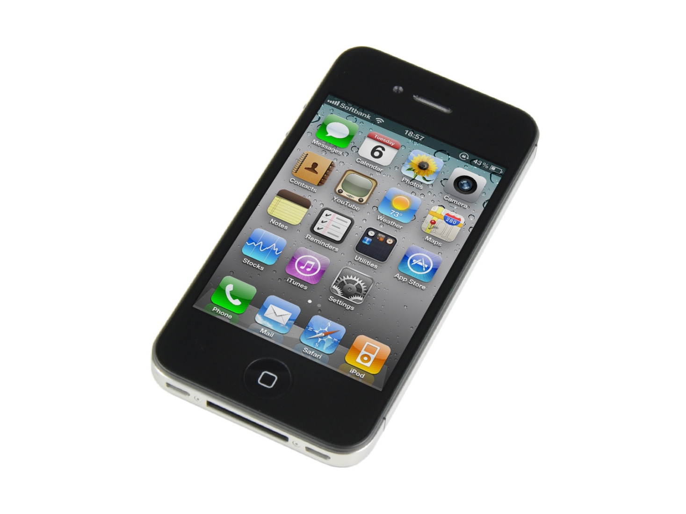
Today’s technology of choice

Slide 7
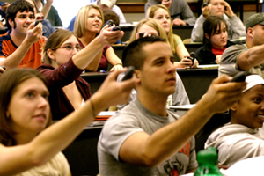
Web-Based Polling Systems
a.k.a. Audience Response Systems
Same technology voting systems used on TV shows : America’s Got Talent, Dancing with the Stars, etc.
Systems are used in
corporate and education
settings, but can be
costly.

Slide 8
Web-Based Polling Systems
Advantages
  No cost (user limits placed on free plans)
  Fully transportable
    Not restricted by location/classroom
    Adjunct-friendly
Disadvantages
  Requires internet access
  Requires students to have a cell phone
    Smartphone not needed (with most services)
    Can allow multiple votes from same device
    Repurpose an old smartphone with WiFi (Blackberry?)

Slide 9











Many Options Available

Slide 10
www.polleverywhere.com

Slide 11
Poll Everywhere
User friendly
Allows responses from multiple sources:
  SMS (texting)
  Web browser
  Dedicated app (iPhone and Android)
  Twitter (not recommended)
Free plan allows up to 40 responses per-poll
Tech support: real human being on phone

Slide 12
Icebreaker Exercise
Three Truths
and a Lie

Slide 13
Go to PE (Three Truths)

Slide 14
Ideas for a quick daily poll?
Question of the day.

Slide 15
Types of Polls
Open Ended √
Multiple Choice √
Clickable Image
Discourse
Ranking

Slide 16
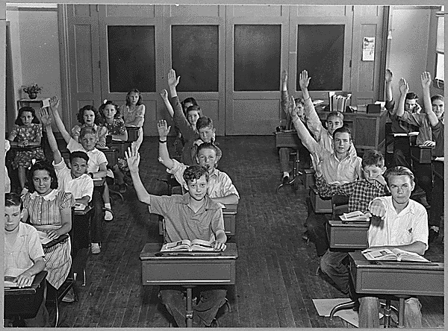
Benefits?
Engages students where they are.
Reduces cell phone distraction.
Helps those students who
have communication
anxiety.
Student participation
numbers rise sharply

Slide 17

Benefits?
Engages students where they are.
Reduces cell phone distraction.
Helps visual learners.
Helps those students who
have communication
anxiety.
Like I did!

Slide 18
Clickable Image
What is your favorite place?
Where have you traveled?
What part of the body….?
Which person…?
Caution
Can’t use SMS (text) response
Might be best to hide results until the end

Slide 19
Go to PE (NCC Map)

Slide 20

Who won? Radio vs. TV

Slide 21

Who won? Radio vs. TV
Half face screen
Half face rear

Slide 22
Go to PE (Clickable image)

Slide 23
Discourse Poll
An open-ended poll where students submit responses, and can anonymously agree or disagree with other responses by upvoting or downvoting.

Slide 24
Backchannel Communication
noun
1.“a secondary or covert route for the passage of information.”

Slide 25
Educational Resources Committee
Nassau Community College
ERC Day
March 20, 2015
“Teaching with Technology:
The Basics and Beyond”
Prof. Mark J. Grossman
Using Web-Based Polling Systems in the Classroom
mark.grossman@ncc.edu

Slide 29
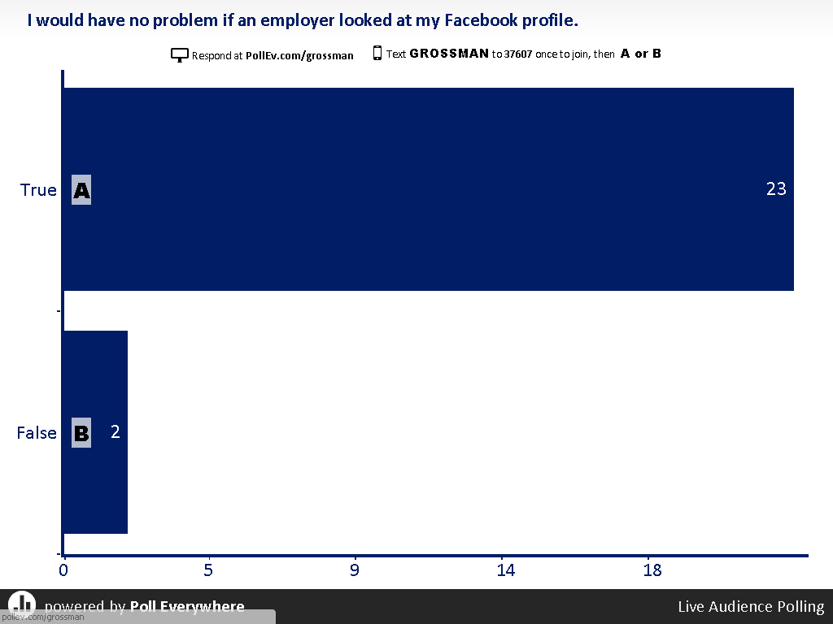

Slide 30
