Slide 1
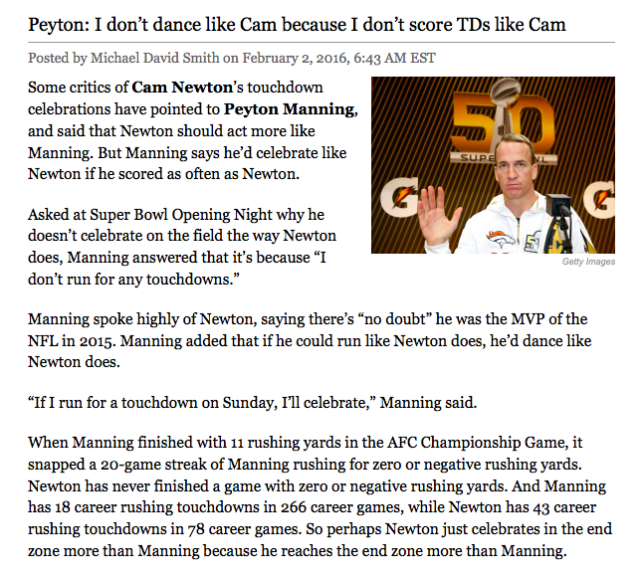
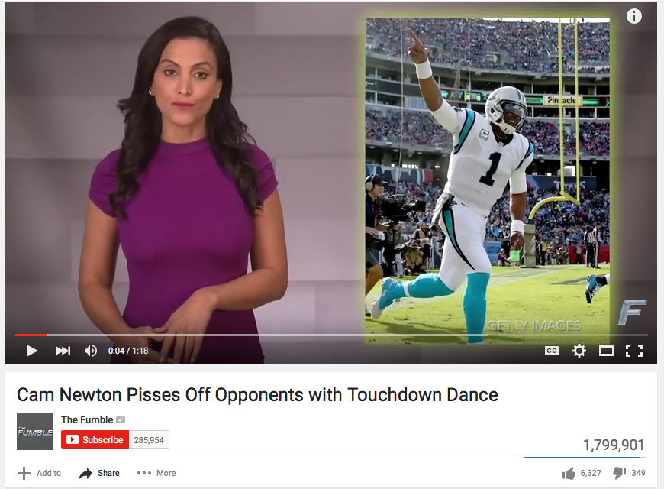
Jessica Granger PR103, Sec 21268, January 31st 2016
Controlled
Uncontrolled

