Slide 1
Part I: Evolution
Chapter 1: Defining Public Relations

Slide 2
Learning Objectives
To define the practice of public relations and underscore its importance as a valuable and powerful societal force in the 21st century.
To explore the various publics of public relations, as well as the field’s most prominent functions.
To underscore the ethical nature of the field and to reject the notion that public relations practitioners are employed in the practice of “spin.”
To examine the requisites - both technical and attitudinal - that constitute an effective public relations professional.

Slide 3
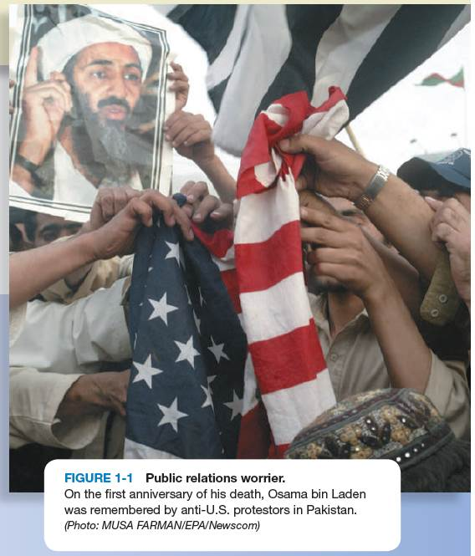
Opening Example: Bin Laden’s Public Relations Concerns
Improve news media coverage
The accuracy of his place in history
Al Qaeda’s image (contemplated name change with religious ring)
Al Qaeda attacks on Muslims in Muslim countries

Slide 4
Learning Objective 1
To define the practice of public relations and underscore its importance as a valuable and powerful societal force in the 21st century.

Slide 5
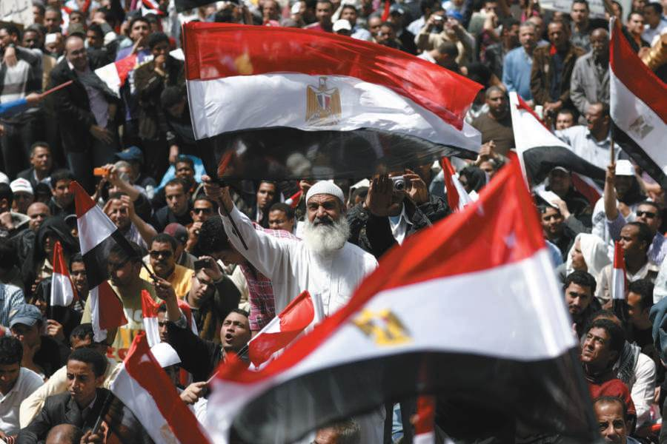
Prominence of Public Relations
Social media and public relations have revolutionized communications with publics.
Example: “Arab Spring” of 2011
Figure 1-2 (Photo: ZUMA Press/Newscom)

Slide 6
Prominence of Public Relations
Multibillion-dollar business in the United States
320,000 professionals; 21% employment growth expected from 2010 to 2012
International Public Relations Association – strong membership in 80+ countries
250 U.S. colleges and universities offer public relations sequence/degree
U.S. government has thousands of communications professionals
Trade associations have strong membership

Slide 7
What is Public Relations?
PRSA’s 2012 definition
“Public relations is a strategic communication process that builds mutually beneficial relationships between organizations and their publics”

Slide 8
What is Public Relations?
Seitel’s definition
“Public relations is a planned process to influence public opinion, through sound character and proper performance, based on mutually satisfactory two-way communication.”

Slide 9
What is Public Relations?
Research, planning, communications dialogue, and evaluation, are all essential in the practice of public relations

Slide 10
Planned Process to Influence Public Opinion
Marston’s R-A-C-E
  Research-Action-Communication-Evaluation
  PR = Performance Recognition
Crifasi’s R-O-S-I-E
  Research-Objectives-Strategies-Implementation-Evaluation
R-P-I-E
  Research-Planning-Implementation-Evaluation
What do the models have in common? How do they differ?
Management and Action

Slide 11
Planned Process to Influence Public Opinion
Sharpe’s Five Principles
  Honest communication (credibility)
  Openness and consistency of actions (confidence)
  Fairness of actions (reciprocity and goodwill)
  Continuous two-way communication (prevent alienation, build relationships)
  Environmental research and evaluation (determine actions or adjustments needed for social harmony)
Jenny’s description: “the management of communications between an organization and… its publics”

Slide 12
Public Relations as Management Interpreter
Every organization has public relations
Public relations professionals:
  Interpret philosophies, policies, programs, practices of management to public
  Convey attitudes of public to management
Counsel Management
Advise Management
Recommend Action

Slide 13
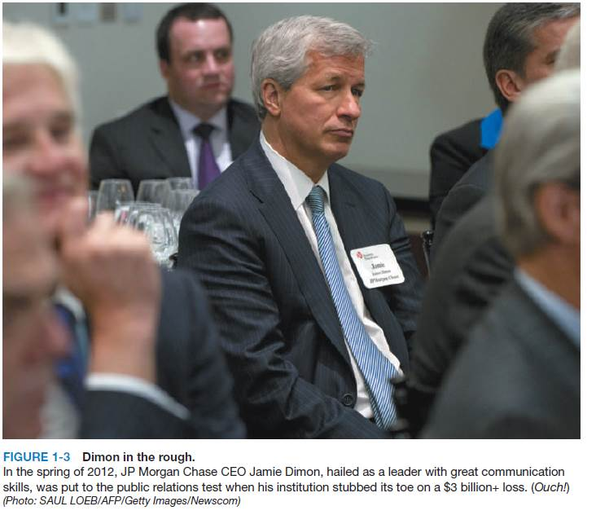
Public Relations as Public Interpreter
Learn about what public really thinks
Let management know
Examples:
  GM’s Corvair, Ralph Nader
  Mobil Oil in the 1970’s
  Hurricane Katrina
  Economic crisis from financial companies

Slide 14
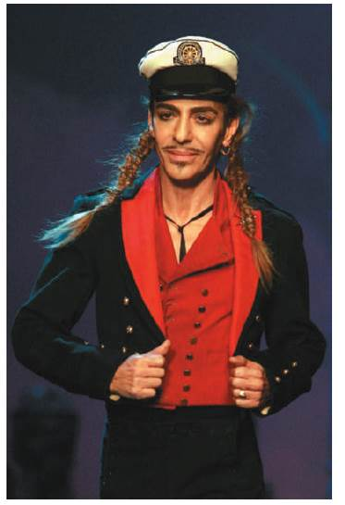
PR Ethics Mini-Case: Firing the Nazi in the House of Dior
John Galliano asked to leave Dior after anti-Semitic remarks hurt firm credibility (Page 10)
What other options did Dior have beyond firing Galliano?
Do you agree with the categorical decision made by the House of Dior?
Figure 1-4 (Photo: MAYA VIDON/EPA/Newscom)

Slide 15
Can you think of a recent case in which an organization was not correctly interpreting public views?
What were the consequences?
Now it’s your turn……

Slide 16
Learning Objective 2
To explore the various publics of public relations, as well as the field’s most prominent functions.

Slide 17
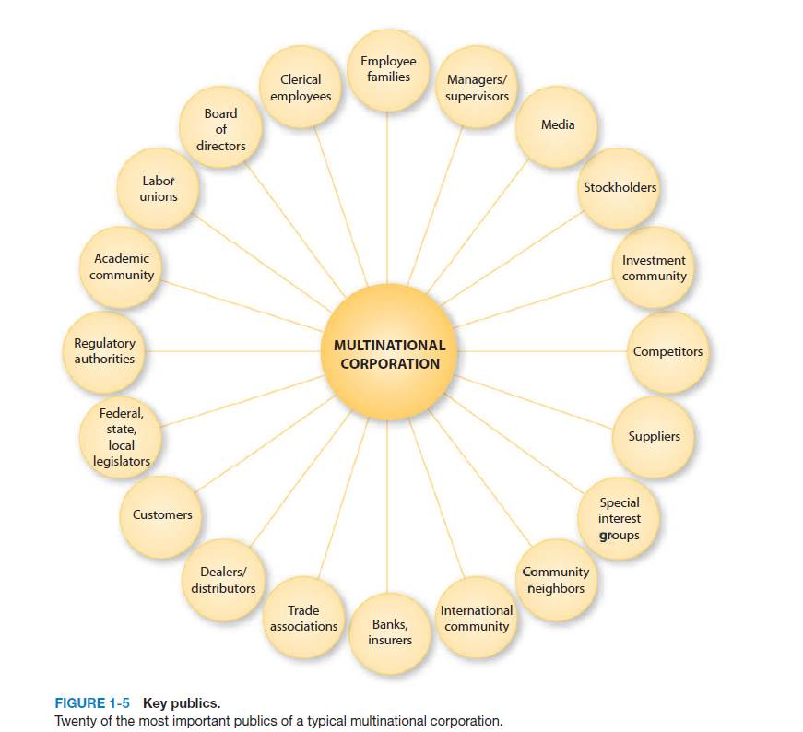
The Publics of Public Relations
Public relations should be publics relations
Internal and external
Primary, secondary and marginal
Traditional and future
Proponents, opponents and uncommitted

Slide 18
The Functions of Public Relations
Writing
Media relations
Social media interface
Planning
Counseling
Researching
Publicity
Marketing communications
Community relations
Consumer relations
Employee relations
Government affairs
Investor relations
Special publics relations
Public affairs and issues
Crisis communications

Slide 19
Learning Objective 2
Discussion Question
If you were the public relations director of the local United Way, whom would you consider your most important “publics” to be?

Slide 20
Learning Objective 3
To underscore the ethical nature of the field and to reject the notion that public relations practitioners are employed in the practice of “spin.”

Slide 21
The Sin of Spin
Spin ≠ Public Relations
Mild: Interpret issue to sway public opinion (e.g. positive slant on negative story)
Virulent: Confusing, distorting, or obfuscating the issue or Lying
Antithetical to proper practice of Public Relations
Public relations cardinal rule: Never, ever lie.

Slide 22
Learning Objective 3
Discussion Question
How do professional public relations people regard the aspect of “spin” as part of what they do?

Slide 23
Learning Objective 4
To examine the requisites - both technical and attitudinal - that constitute an effective public relations professional.

Slide 24
Seven Areas → Successful PR Career
Diversity of experience
Performance
Communications skills
Relationship building
Proactivity and passion
Teamliness
Intangibles, such as personality, likeability, and chemistry

Slide 25
Desired Technical Skills
Knowledge of the field.
Communications knowledge.
Technological knowledge.
Current events knowledge.
Business knowledge.
Management knowledge.

Slide 26
Desired Attitudinal Requisites
Pro communications.
Advocacy.
Counseling orientation.
Ethics.
Willingness to take risks.
Positive outlook.

Slide 27
Learning Objective 4
Discussion Question
What are the technical and attitudinal requisites most important for public relations success?

Slide 28
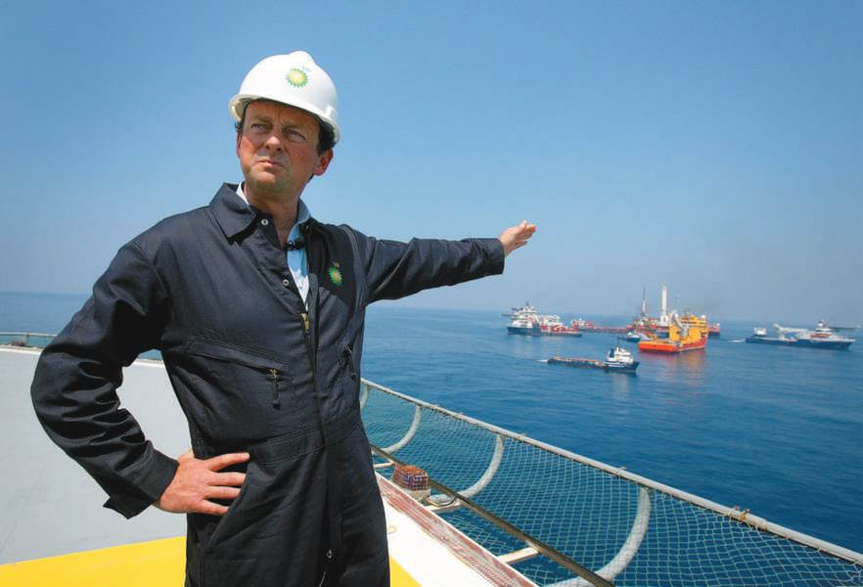
Case Study: BP’s Loose Lips Sink Credibility Ship
Page 18
How would you assess BP’s response to the Gulf of Mexico oil spill?
How could BP have prevented the damage done by its CEO spokesperson?
Had you been advising Hayward, what would you have suggested he say in response to the questions he was asked?
Figure 1-6 (Photo: Newscom)

Slide 29
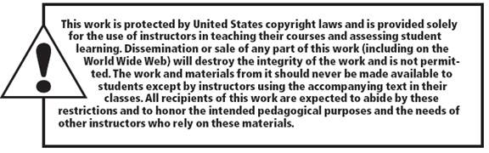
All rights reserved. No part of this publication may be reproduced, stored in a retrieval system, or transmitted, in any form or by any means, electronic, mechanical, photocopying, recording, or otherwise, without the prior written permission of the publisher. Printed in the United States of America.
Copyright ©2014 by Pearson Education, Inc. All rights reserved.

