Slide 1
Part III: The Publics
Chapter 10: Social Media
Copyright ©2014 by Pearson Education, Inc. All rights reserved.

Slide 2
Learning Objectives
To discuss the phenomenon of social media and its lasting impact on the practice of public relations.
To explore the general parameters of public relations and the Internet.
To discuss the four primary social media vehicles of Facebook, Twitter, LinkedIn, and YouTube and how public relations professionals use them.
To examine the pros and cons of dealing with bloggers and the new journalists who populate the Internet.
Copyright ©2014 by Pearson Education, Inc. All rights reserved.

Slide 3

Opening Example: Daniel Tosh’s Rape Joke
Daniel Tosh became a sensation because of the Internet
Tosh directed a “gang rape joke” at an L. A. audience member who left
Joke and exit were tweeted, blogged about, retweeted and reblogged
Tosh gave weak apology
Figure 10-1 (Photo: MZ1 WENN Photos/Newscom)
Copyright ©2014 by Pearson Education, Inc. All rights reserved.

Slide 4
Learning Objective 1
To discuss the phenomenon of social media and its lasting impact on the practice of public relations.
Copyright ©2014 by Pearson Education, Inc. All rights reserved.

Slide 5
Social Media Dominance
White House Director of New Media in 2009
News is tweeted first
Facebook’s $104 billion value
Opportunities and pitfalls
Immediate and pervasive
Has not replaced human relationships
Copyright ©2014 by Pearson Education, Inc. All rights reserved.

Slide 6
Brief History of the Internet
ARPANET during Cold War (1969)
World Wide Web in1989
Worldwide users in 2012 = 2.27 billion
Africa rose from 34 million in 2007 to 140 million in 2012
Asia rose from 418 million in 2007 to over 1 billion in 2012
Europe rose from 322 million in 2007 to 501 million in 2012
The Middle East rose from 20 million to 77 million
North America rose from 233 million to 273 million
Latin America rose from 100 million to 236 million
Oceania rose from 19 million to 24 million
Digital divide between haves and have-nots was closing
Some early ventures failed; others are thriving
Copyright ©2014 by Pearson Education, Inc. All rights reserved.

Slide 7
Learning Objective 1 Discussion Question
What is the status of the Internet and World Wide Web in public relations today?
Copyright ©2014 by Pearson Education, Inc. All rights reserved.

Slide 8
Learning Objective 2
To explore the general parameters of public relations and the Internet.
Copyright ©2014 by Pearson Education, Inc. All rights reserved.

Slide 9
Public Relations and the Internet
Public relations department have interactive specialists
Journalists embraced the Internet as primary source for research and reporting
Personal contact with a journalist via a relationship is still the best way to get your message heard
Practitioner Internet usage growth predicted due to
Demand for being education vs. sold
Quest for conversation
Need for real-time performance
Need for customization
Familiarity with Internet and its use are requisites for practice
Copyright ©2014 by Pearson Education, Inc. All rights reserved.

Slide 10
Websites
“First face” of organization to public
Serve multiple functions (e.g. find information, conduct business)
Permit organization to speak in its own voice
Make websites as navigable as possible
Have a clearly identifiable “Media” icon and organized subsections
Copyright ©2014 by Pearson Education, Inc. All rights reserved.

Slide 11
Developing a Winning Website Answer Strategic Questions
What is your goal?
What content will we include?
How often will we edit?
How will we enhance design?
How interactive will it be?
How will we track use?
Who will be responsible?
Search Engine Optimization
Copyright ©2014 by Pearson Education, Inc. All rights reserved.

Slide 12
Email
90% of adult Internet users surveyed regularly use email
Teens prefer text messaging, instant messaging, and social network site messaging
Pervasive internal communications vehicle
Face-to-face best; email viable alternative
Email newsletters replaced print newsletters
More immediate and interactive than print
Allow for feedback
Internal or external use
One page, relevant information, link content, disseminate regularly
Copyright ©2014 by Pearson Education, Inc. All rights reserved.

Slide 13
Instant Messaging (IM) and Texting
IM is closely relate to conversation
Texting is sending 160 characters or fewer messages from cell phones using Short Message Service (SMS)
Person-to-person messaging most common
Copyright ©2014 by Pearson Education, Inc. All rights reserved.

Slide 14
Blogs and CEO Blogs
Bloggers recognized as bona fide news source
Embraced by professional communicators, print and broadcast media; encourage dialogue
Corporate blogs are 8% of the blogosphere
People turn to blogs for information
Blogs gain respect through “sneezers” – early adopters in a social group
Some blogs are required reading for journalists
CEO blogs have gotten mixed reviews
CEO blogs should not read like warmed-over press releases
Copyright ©2014 by Pearson Education, Inc. All rights reserved.

Slide 15
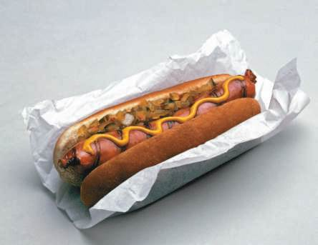
PR Ethics Mini-Case: Blogger Backlash Crushes ConAgra Conclave
Page 209
Had you been Ketchum, what would you have advised client ConAgra relative to its idea?
How would you have structured the invitation to bloggers?
Figure 10-5 (Photo: Dan Barba Stock Connection USA/Newscom)
Copyright ©2014 by Pearson Education, Inc. All rights reserved.

Slide 16
Learning Objective 2 Discussion Question
How has email changed the way people and organizations communicate?
Copyright ©2014 by Pearson Education, Inc. All rights reserved.

Slide 17
Learning Objective 3
To discuss the four primary social media vehicles of Facebook, Twitter, LinkedIn, and YouTube and how public relations professionals use them.
Copyright ©2014 by Pearson Education, Inc. All rights reserved.

Slide 18
Social Networks
Social networks attract a variety of age groups and interests
Expanding opportunities for public relations practice
Public relations professionals must be conversant and proficient in using Facebook, Twitter, LinkedIn, and YouTube
Copyright ©2014 by Pearson Education, Inc. All rights reserved.

Slide 19
Facebook
Biggest social networking service, one billion members
Ideal for sharing news, photos, videos, playing games, supporting causes and connecting with people with common interests
Facebook serves community-building purposes for public relations:
Attract attention
Two-way communication
Conversation monitor
Interactive activities
Internal communication
Halo effect
Network with media
Crisis management
Link to other materials
Copyright ©2014 by Pearson Education, Inc. All rights reserved.

Slide 20
Twitter
Micro-blogging – tweet < 140 characters to alert friends and followers
Multi-person text message service
Tool for public relations:
Finding your “Tweeple” – and what they think are important
Finding the “Tweetfluentials” who might be influential in speaking about brand
As a news sources – used to break news or pitch stories
Providing valuable content – tips and insights
Building a community – tweet daily to engage followers
Crisis management – issue statements and post updates

Slide 21
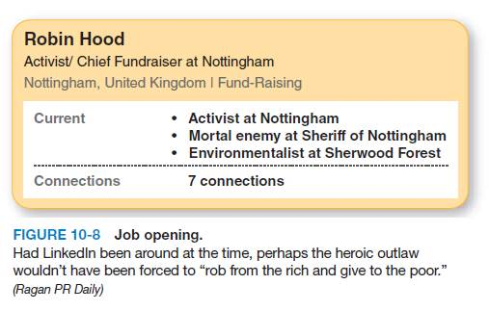
LinkedIn
Facebook for the professional set
Connect with like-minded professionals
Discover business or employment opportunities
Develop network of contacts
Public relations functions:
Notes – notify others of events, job openings, recommendations
Groups – forums, alumni groups, conferences
Answer Forum – advice from professionals
Polls and Card Munch
Job Openings
Copyright ©2014 by Pearson Education, Inc. All rights reserved.

Slide 22
YouTube
15 minutes of fame
Organizations use for marketing purposes
Target specific user groups
Messages must be short and simple
Some organizations have gotten into trouble because of YouTube posts
Copyright ©2014 by Pearson Education, Inc. All rights reserved.

Slide 23
Contenders: Pinterest and others
Pin pictures on a virtual bulletin board
Use site as canvas to create “ideal self”
Public relations uses:
Visual stories
Industry stories
Videos
Employee participation
Sharing
Instagram photo sharing bolsters brands
Foursquare check-ins – businesses can offer products and incentives
Yelp – customer reviews
Copyright ©2014 by Pearson Education, Inc. All rights reserved.

Slide 24
Social Media Analytics
Content sourcing and methods – standardize evaluations
Reach and impressions more difficult to come by in social media
Engagement – business outcomes like sales; other outcomes like blog posts, video comments, retweets
Influence and relevance – subjective human research
Opinion and advocacy – qualitative measure
Impact and value – financial results and reputation impact
Copyright ©2014 by Pearson Education, Inc. All rights reserved.

Slide 25
Learning Objective 3 Discussion Questions
What is the significance of Facebook relative to public relations practice?
What is the significance of Twitter relative to public relations practice?
Copyright ©2014 by Pearson Education, Inc. All rights reserved.

Slide 26
Learning Objective 4
To examine the pros and cons of dealing with bloggers and the new journalists who populate the Internet.
Copyright ©2014 by Pearson Education, Inc. All rights reserved.

Slide 27
Web-Based Communication Vehicles
Intranets
Extranets
Wikis
Podcasting
RSS
QR Codes and LBS
Copyright ©2014 by Pearson Education, Inc. All rights reserved.

Slide 28
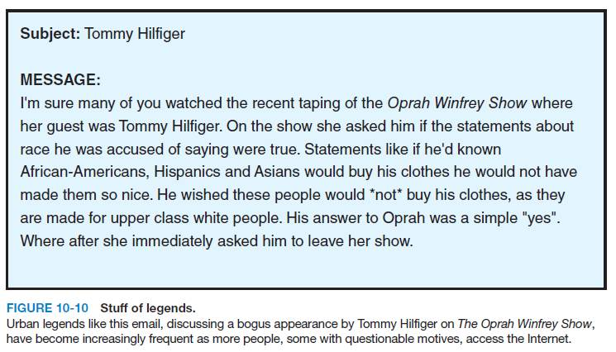
Dark Side of Online Communications
Internet sabotage: no organization is immune
Monitoring the Internet is important
Easy for customers to complain on blogs, start rogue websites, spread urban legends
Public relations professionals adopt “inoculation strategies”
Clear communications channels
Relay concerns privately before frustrations mount
Monitor and beware of the web
Copyright ©2014 by Pearson Education, Inc. All rights reserved.

Slide 29
Learning Objective 4 Discussion Question
How should organizations protect themselves from online attack?
Copyright ©2014 by Pearson Education, Inc. All rights reserved.

Slide 30
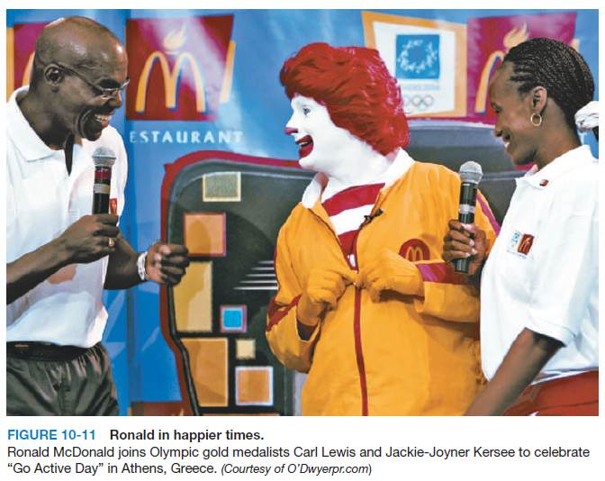
Case Study: Ronald McDonald’s Brush with Antisocial Media
Page 222
What do you think of McDonald’s social media strategy in general?
How would you characterize McDonald’s handling of the racist tweet?
What would you have done differently relative to the #McDStories controversy?
Copyright ©2014 by Pearson Education, Inc. All rights reserved.

Slide 31

All rights reserved. No part of this publication may be reproduced, stored in a retrieval system, or transmitted, in any form or by any means, electronic, mechanical, photocopying, recording, or otherwise, without the prior written permission of the publisher. Printed in the United States of America.
Copyright © 2014 Pearson Education, Inc. All rights reserved.
Copyright ©2014 by Pearson Education, Inc. All rights reserved.

