Slide 1
Part III: The Publics
Chapter 11: Employee Relations
Copyright ©2014 by Pearson Education, Inc. All rights reserved.

Slide 2
Learning Objectives
To discuss an often-overlooked but core critical constituency for organizational management, the internal public.
To explore the philosophy of dealing with employees in an era of layoffs and meager job growth.
To discuss the various tactics—print, online, and broadcast—of communicating with the internal public.
To examine the ways that social media have complicated and made more challenging the function of communicating with employees.
Copyright ©2014 by Pearson Education, Inc. All rights reserved.

Slide 3
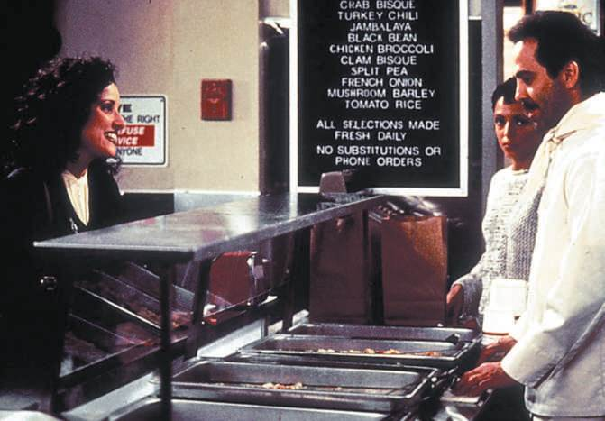
Opening Example: Beckerman Email
NJ PR Firm received irate email from CEO about milk
Future abuse of milk privilege (not refilling the milk) would lead to termination
Figure 11-1 (Photo: Zuma/Newscom)
Copyright ©2014 by Pearson Education, Inc. All rights reserved.

Slide 4
Learning Objective 1
To discuss an often-overlooked but core critical constituency for organizational management, the internal public.
Copyright ©2014 by Pearson Education, Inc. All rights reserved.

Slide 5
Worker – Boss Relationships Strained
Layoffs across sectors
Only one in five workers give “full discretionary effort on the job”
Highly engaged employees help the bottom line
Firms with highly engaged employees – shareholder returns 19% higher than average
Firms with low engagement levels – shareholder returns 44% lower than average
Copyright ©2014 by Pearson Education, Inc. All rights reserved.

Slide 6
Management Questions – lift employee morale, commitment and engagement
Is your leadership rolling out a new strategy or initiative that will require more engagement than ever from your employees?
Do you need to activate or reengage your employees as advocates or ambassadors?
How well is the urgency for change understood and acted on within your organization?
Should leadership communication be a critical component of delivering on your company’s strategy or organizational performance goals?
Copyright ©2014 by Pearson Education, Inc. All rights reserved.

Slide 7
Management Questions – lift employee morale, commitment and engagement (cont’d.)
Are you searching for novel ways to renew or reinvent the employee experience? Are leaders looking for better ways of engaging their teams?
Does your employee engagement research provide sufficient insights for leaders to build trust, cultivate two-way dialogue, and engage employees on critical priorities?
Do your current drivers of employee engagement support the business you need to become?
If employee engagement remains at its current level or decreases within your company, is there a downside risk?
Copyright ©2014 by Pearson Education, Inc. All rights reserved.

Slide 8
Lessons from Google
Free food is important – so is candor
Management communications with employees must be candid, clear and credible
Copyright ©2014 by Pearson Education, Inc. All rights reserved.

Slide 9
Critical Internal Communications
Employee relations matters
60% of corporate CEOs reported spending more time communicating with employees
Employee loyalty is low – no such thing as “lifetime employment”
Gulf in pay between senior officers and common workers
Globalization means it is important to communicate benefits and opportunities to enhance support and loyalty among worldwide staffs
Companies that communicate effectively with workers financially outperform those that don’t
Copyright ©2014 by Pearson Education, Inc. All rights reserved.

Slide 10
Learning Objective 1 Discussion Question
What societal factors have caused internal communications to become more important today than in the past?
Copyright ©2014 by Pearson Education, Inc. All rights reserved.

Slide 11
Learning Objective 2
To explore the philosophy of dealing with employees in an era of layoffs and meager job growth.
Copyright ©2014 by Pearson Education, Inc. All rights reserved.

Slide 12
Dealing with the Employee Public
Numerous subgroups:
Senior managers
First-line supervisors
Staff and line employees
Union laborers
Per diem employees
Contract workers
Each group has different interests and concerns
Smart organizations differentiate messages and communications for each segment
Copyright ©2014 by Pearson Education, Inc. All rights reserved.

Slide 13
How do you convey knowledge to staff?
Younger, increasingly female, more diverse, ambitious, career oriented, less complacent, less loyal
Questions to ask
Is management able to communicate effectively with employees?
Is communication trusted, and does it relay appropriate information to employees?
Has management communicated its commitment to its employees and to fostering a rewarding work environment?
Biggest problem often employees do not know where they stand in the eyes of management
Copyright ©2014 by Pearson Education, Inc. All rights reserved.

Slide 14

100 Best Companies to Work For in America Six Criteria
Willingness to express dissent
Visibility and proximity of upper management
Priority of internal to external communication
Attention to clarity
Friendly tone
Sense of humor
Figure 11-2 (Courtesy of the Bohle Company)
Copyright ©2014 by Pearson Education, Inc. All rights reserved.

Slide 15
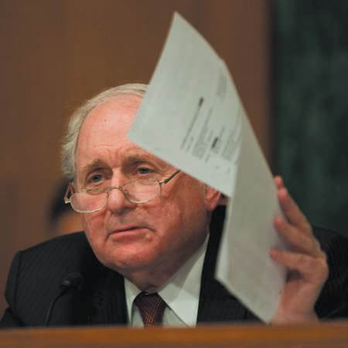
PR Ethics Mini-Case: I Hate You, I’m Leaving, Where’s My Check?
Page 233
How would you characterize the ethics of Smith’s decision to go public with his gripes as a Goldman employee?
What do you think of the company’s response to the controversy?
What advice would you give Goldman Sachs in its future public relations dealings?
Figure 11-3 (Photo: Zuma/Newscom)
Copyright ©2014 by Pearson Education, Inc. All rights reserved.

Slide 16
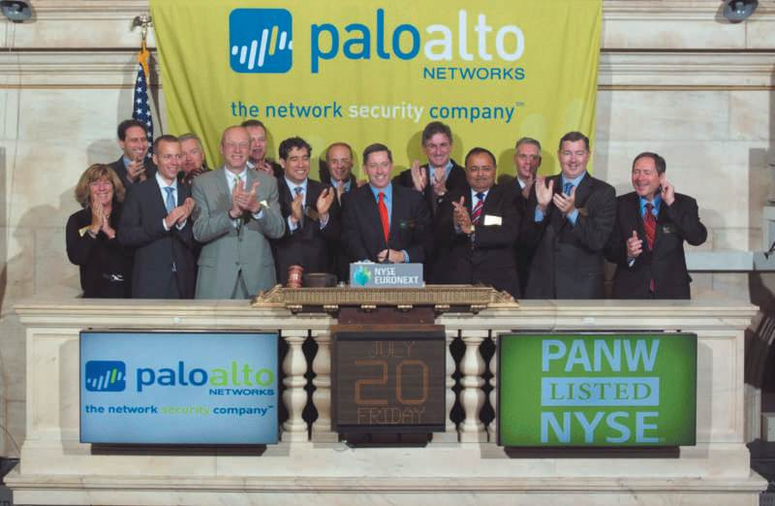
Credibility: The Key
Employees want facts; not wishful thinking
Trust in organizations would increase if management
Communicated earlier and more frequently
Demonstrated trust in employees by sharing bad news as well as good
Involved employees in the process by asking for their ideas and opinions
Well-informed employees = organization’s best goodwill ambassadors
Figure 11-4 (Courtesy NYSE Euronext)
Copyright ©2014 by Pearson Education, Inc. All rights reserved.

Slide 17
S-H-O-C the Troops Communications must be…
Strategic
Where is this organization going?
What is my role in helping us get there?
Honest
Management trust may be low
Can’t build credibility by sugarcoating
Open
Feedback
Two-way communications
Solicit, listen to, act one employee views
Action is key
Consistent
Regular, on-time, predictable communication program
Steadiness is key
Copyright ©2014 by Pearson Education, Inc. All rights reserved.

Slide 18
Learning Objective 2 Discussion Question
Summarize the keys to dealing with employees in today’s business environment.
Copyright ©2014 by Pearson Education, Inc. All rights reserved.

Slide 19
Learning Objective 3
To discuss the various tactics—print, online, and broadcast—of communicating with the internal public.
Copyright ©2014 by Pearson Education, Inc. All rights reserved.

Slide 20
Employee Communication Tactics
Internal Communications Audits
In-depth interviews with management and communicators – what management wants from communications team; what communicators think management wants
How do internal communications support the mission of the organization?
Do internal communications have management’s support?
Do internal communications justify the expense?
How responsive to employee needs and concerns are internal communications?
Online communications
Blogs
Podcasts
Wikis
Copyright ©2014 by Pearson Education, Inc. All rights reserved.

Slide 21
Employee Communication: Tactics
Intranet guidelines
Consider the culture
Set clear objectives and let it evolve
Treat it as a journalistic enterprise
Market, market, market
Link to outside lives
Senior management must commit
Print publications
Newsletters
Integrate with online publications
Bulletin boards
Suggestion Boxes and Town Hall Meetings
Internal Video
Copyright ©2014 by Pearson Education, Inc. All rights reserved.

Slide 22
Face-to-Face Communications
Best communications vehicle is face-to-face
Supervisors are the preferred source for most employees
Why?
Formalized meetings may mix management and staff in a variety of formats
Value of meetings lies in substance, regularity, and candor from managers
Copyright ©2014 by Pearson Education, Inc. All rights reserved.

Slide 23
Learning Objective 3 Discussion Question
What are some important employee communications tactics? How should each be used?
Copyright ©2014 by Pearson Education, Inc. All rights reserved.

Slide 24
Learning Objective 4
To examine the ways that social media have complicated and made more challenging the function of communicating with employees.
Copyright ©2014 by Pearson Education, Inc. All rights reserved.

Slide 25
Internal Social Media
Social media policies should be based on common sense
Moderating and identification
Social media effectiveness depends on
It must have a business purpose
It must be entertaining as well as informative
It must be composed of riveting content
Copyright ©2014 by Pearson Education, Inc. All rights reserved.

Slide 26
The Grapevine
Rumor mill can be treacherous
Identifying source of rumor difficult and not work the time
Do not overlook the value of explaining how you reached a decision
Grapevine may be valuable because it is believed
Copyright ©2014 by Pearson Education, Inc. All rights reserved.

Slide 27
Learning Objective 4 Discussion Question
What are the primary considerations in adopting internal social media?
Copyright ©2014 by Pearson Education, Inc. All rights reserved.

Slide 28
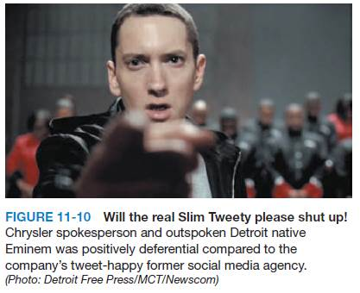
Case Study: Consultant Drops F-Bomb, Chrysler Drops Consultant
Page 246
How do you feel Chrysler handled the tweet controversy?
What new internal client rules would you enforce were you the CEO of NMS?
Should social media report to marketing or public relations? Why?
What are the larger lessons here for any public relations professional?
Copyright ©2014 by Pearson Education, Inc. All rights reserved.

Slide 29
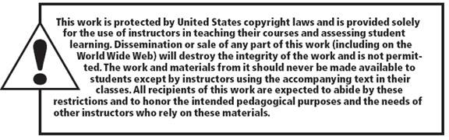
All rights reserved. No part of this publication may be reproduced, stored in a retrieval system, or transmitted, in any form or by any means, electronic, mechanical, photocopying, recording, or otherwise, without the prior written permission of the publisher. Printed in the United States of America.
Copyright © 2014 Pearson Education, Inc. All rights reserved.
Copyright ©2014 by Pearson Education, Inc. All rights reserved.

