Slide 1
Part III: The Publics
Chapter 12: Government Relations
Copyright ©2014 by Pearson Education, Inc. All rights reserved.

Slide 2
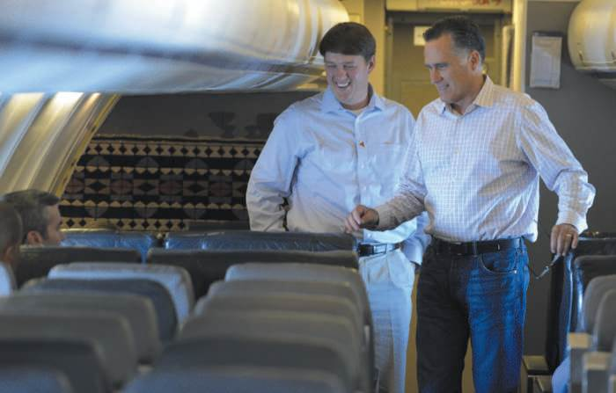
Opening Example: Mitt Romney’s Overseas Tour
Mitt Romney made gaffes overseas
Press secretary Rick Gorka reacted to media impulsively – then resigned
Video
Figure 12-1 (Photo: ERIK S. LESSER/EPA/Newscom)
Copyright ©2014 by Pearson Education, Inc. All rights reserved.

Slide 3
Politics and Social Media
Video
2008 presidential campaign – Barack Obama used social media as communication focal point
  Reach younger voters
  Announced vice presidential pick by text messaging supporters
98% of Congress uses at least one social media platform
72% use big three: Twitter, YouTube, and Facebook
Both 2012 presidential candidates had digital media directors
Copyright ©2014 by Pearson Education, Inc. All rights reserved.

Slide 4
Don’t Call It “Public Relations”
In 1913, the practice of “public relations” was barred from federal government
Politicians jockey for media attention and crave publicity
Obama’s communication prowess
Video
Public relations broadly represented throughout government
Copyright ©2014 by Pearson Education, Inc. All rights reserved.

Slide 5
Government Practitioners
1986 audit of public relations indicated
  $337 million on public affairs in 1985
  5,600 full-time employees assigned to public affairs duties
  $100 million for congressional affairs activities, 2,000 full-time employees assigned
2005 GAO Report
  Bush administration paid $1.6 billion on advertising and public relations contracts in 2.5 years
  DOD spent $1.1 billion on recruitment campaigns and public relations efforts
  54 public relations firms were contracted
Copyright ©2014 by Pearson Education, Inc. All rights reserved.

Slide 6
Two Prominent Departments:
The Defense Department
Department of Defense (DOD) communications intensified in wartime
American Forces Information Service (AFIS) promotes cooperation among branches
  Armed Forces Radio and Television Service
  Stars and Stripes newspaper
Newsreels: Video
Copyright ©2014 by Pearson Education, Inc. All rights reserved.

Slide 7
Other Government Agencies
Department of Health and Human Services – 700 public affairs professionals
Agriculture, State and Treasury departments – communications staffs > 400 people, budgets $20 million+
U.S. Department of Homeland Security and the CIA
Copyright ©2014 by Pearson Education, Inc. All rights reserved.

Slide 8
The President
President Reagan’s “Great Communicator” principles
  Plan ahead
  Stay on the offensive
  Control the flow of information
  Limit reporters’ access to the president
  Talk about the issues you want to talk about
  Speak in one voice
  Repeat the same message many times
  Video
Copyright ©2014 by Pearson Education, Inc. All rights reserved.

Slide 9
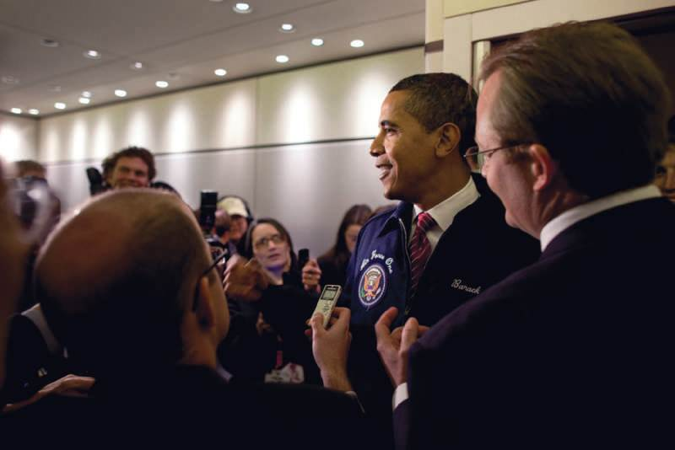
The President’s Press Secretary
Chief public relations spokesperson for administration
Communicate policies and practices of the president to the public
Figure 12-6 (White House Photo by Pete Souza)
Copyright ©2014 by Pearson Education, Inc. All rights reserved.

Slide 10
Lobbying the Government
Registered lobbyists total 11,268 responsible for spending $3 billion per year to influence legislators and legislation
State and local government lobbying is also active
Lobbying Act of 1946 – reporting requirements
1995 – Lobbying Disclosure Act
Well-informed in field; furnish Congress with facts and information to make intelligent decisions
Copyright ©2014 by Pearson Education, Inc. All rights reserved.

Slide 11
What Do Lobbyists Do?
Inform and persuade
  Fact-finding
  Interpretation of government actions
  Interpretation of company actions
  Advocacy of a position
  Publicity springboard
  Support of company sales
Emergence of E-Lobbying
  Grassroots lobbying
  Social media initiatives
  MoveOn.org
Copyright ©2014 by Pearson Education, Inc. All rights reserved.

Slide 12
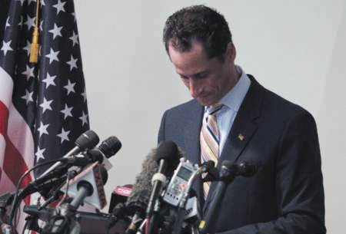
Case Study: Anthony Weiner Texts His “Anthony”
Page 269
Had you been Anthony Weiner’s public relations advisor, what would you have counseled him prior to going public about the tweets?
What general advice relative to social media communicating would you offer anyone in the public eye?
Do you think Anthony Weiner can make a political comeback? If he came to you with that question, what would you advise him?
Figure 12-8 (Photo: John Angelillo/UPI/Newscom)
Copyright ©2014 by Pearson Education, Inc. All rights reserved.

Slide 13
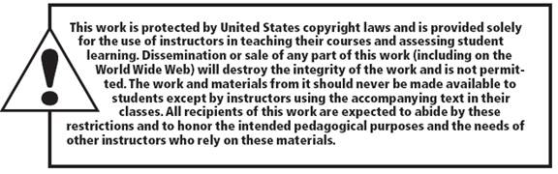
All rights reserved. No part of this publication may be reproduced, stored in a retrieval system, or transmitted, in any form or by any means, electronic, mechanical, photocopying, recording, or otherwise, without the prior written permission of the publisher. Printed in the United States of America.
Copyright © 2014 Pearson Education, Inc. All rights reserved.
Copyright ©2014 by Pearson Education, Inc. All rights reserved.

