Slide 1
Part III: The Publics
Chapter 13: Community Relations
Copyright ©2014 by Pearson Education, Inc. All rights reserved.

Slide 2
Learning Objectives
To discuss the importance of dealing with “communities,” both geographic and ethnic.
To review the tradition of corporate social responsibility that has uniquely characterized U.S. institutions.
To discuss the multicultural publics that populate society, including Hispanics, African Americans, Asians, and groups beyond nationalities, such as seniors and the LGBT community.
To examine the role of public relations in orchestrating the activities of nonprofit organizations.
Copyright ©2014 by Pearson Education, Inc. All rights reserved.

Slide 3

Opening Example: Susan G. Komen for the Cure and Planned Parenthood
Susan G. Komen for the Cure was a beloved and successful charity
Cut funding to Planned Parenthood’s breast screening due to legal investigation
Support plummeted, the decision was reversed, executives departed
Figure 13-1 (Photo: Jeff Malet Photography/Newscom)
Copyright ©2014 by Pearson Education, Inc. All rights reserved.

Slide 4
Learning Objective 1
To discuss the importance of dealing with “communities,” both geographic and ethnic.
Copyright ©2014 by Pearson Education, Inc. All rights reserved.

Slide 5
Multicultural Diversity
In 2012, more than half the children born in the U.S. were minorities
In 2010, Hispanics represented 16% of the U.S. Population and Asians represented almost 5% of the population – both growing at 3% per year
Multiracial Americans = fastest growing U.S. demographic
Minorities are getting younger while whites are getting older
Copyright ©2014 by Pearson Education, Inc. All rights reserved.

Slide 6
Multicultural Diversity
Immigrants gravitate to six U.S. states: California, New York, Texas, Florida, Illinois, and New Jersey
Hispanic buying power in the top 20 U.S. markets is $850 billion
High income Asian population fastest-growing racial/ethnic group in the U.S.
Copyright ©2014 by Pearson Education, Inc. All rights reserved.

Slide 7
Learning Objective 1
How important is it for an organization to focus on dealing with minorities?
Copyright ©2014 by Pearson Education, Inc. All rights reserved.

Slide 8
Learning Objective 2
To review the tradition of corporate social responsibility that has uniquely characterized U.S. institutions.
Copyright ©2014 by Pearson Education, Inc. All rights reserved.

Slide 9
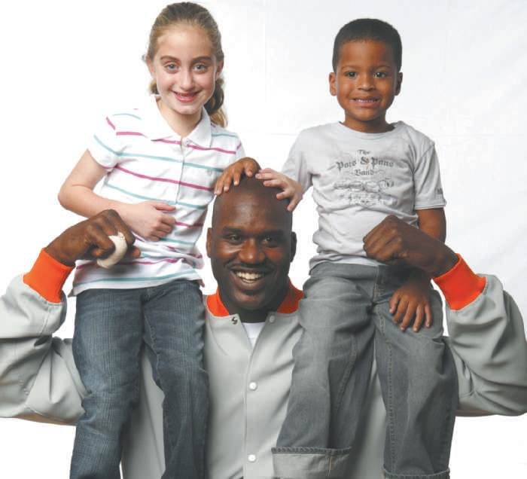
CSR – Corporate Social Responsibility
Social responsibility source of pride in the 1980s
Give back to society through participation in (voluntarism) and contributions to (financial support) not-for-profit organizations
Financial support was cut with the recession
Organizations are becoming more diverse
Figure 13-2 (Courtesy of O’Dwyer Company)
Copyright ©2014 by Pearson Education, Inc. All rights reserved.

Slide 10
Trends in Corporate Giving
Corporate giving is becoming more focused
Matching gifts are a high priority
International giving is on the rise
Corporate leaders taking active stance in confronting societal challenges
Corporate contributions depend on profits
Gen X is aware of and concerned about contributions to society (the firm’s and their own)
Copyright ©2014 by Pearson Education, Inc. All rights reserved.

Slide 11
Community Relations Expectations
Determine what the community knows and thinks about the organization
Inform the community of the organization’s point of view
Negotiate or mediate between the organization and the community and its constituents if there is a discrepancy
Community relations are critical
Copyright ©2014 by Pearson Education, Inc. All rights reserved.

Slide 12
What the Community Expects
Positive contributions to the community’s Appearance
Participation in civic functions, activities, and education
Stability so the company can help grown with the area
Pride that they are residents
Copyright ©2014 by Pearson Education, Inc. All rights reserved.

Slide 13
What the Organization Expects
Municipal services
Fair taxation
Good living conditions for employees
Good labor supply
Reasonable degree of support for the business and its products
Copyright ©2014 by Pearson Education, Inc. All rights reserved.

Slide 14
Community Relations Objectives
Tell the community about the operations of the firm
Correct misunderstandings, reply to criticism, remove disaffection that may exist among community neighbors
Gain favorable opinion of the community, especially when there is labor unrest
Inform employees and their families about company activities and developments
Copyright ©2014 by Pearson Education, Inc. All rights reserved.

Slide 15
Community Relations Objectives
Inform people in local government about firm’s contributions to community welfare & to obtain support for legislation
Find out what residents think about the organization
Establish a personal relationship between management and community leaders
Operate a profitable business – provide jobs and pay
Cooperate with other local businesses to advance economic and social welfare
Copyright ©2014 by Pearson Education, Inc. All rights reserved.

Slide 16
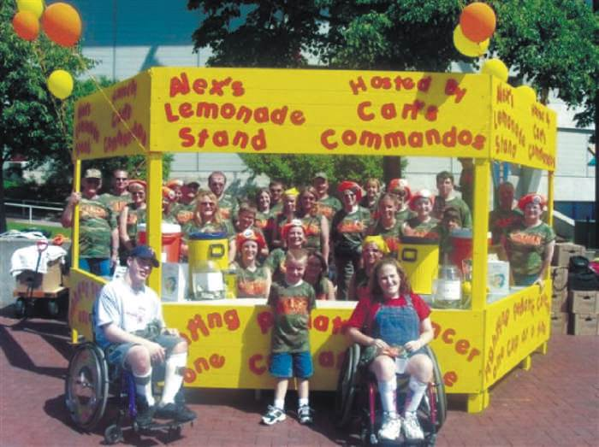
Community Relations on the Web
Expanded educational and commercial opportunities for minority communities and philanthropic organizations
Internet has potential to further human relations and progress
Figure 13-4 (Courtesy of Alex’s Lemonade Stand Foundation)
Copyright ©2014 by Pearson Education, Inc. All rights reserved.

Slide 17
Learning Objective 2 Discussion Question
What are typical community relations objectives for an organization?
Copyright ©2014 by Pearson Education, Inc. All rights reserved.

Slide 18
Learning Objective 3
To discuss the multicultural publics that populate society, including Hispanics, African Americans, Asians, and groups beyond nationalities, such as seniors and the LGBT community.
Copyright ©2014 by Pearson Education, Inc. All rights reserved.

Slide 19
Serving Diverse Communities
40 million Americans are foreign born
2/3 of current U.S. and future population growth in and will be due to immigration
Hispanics reached 50.5 million in 2010
Women, African Americans, Hispanics, Asians, LGBT people, seniors, persons with disabilities, etc. important members of labor force and sources of discretionary income
Equal pay, promotional opportunities, equal rights, etc.
Copyright ©2014 by Pearson Education, Inc. All rights reserved.

Slide 20
Women
51% of U.S. professional workers
51% of managerial and professional jobs
Mommy tracks, mommy wars, glass ceilings, pink-collar ghettos less prevalent
Women climbing to middle- and upper-management positions in PR, but make less money in those positions than men
Copyright ©2014 by Pearson Education, Inc. All rights reserved.

Slide 21
Hispanics
By 2050, they will comprise 1/3 of the population
77% of Hispanics reside in California, Texas, Florida, Arizona, New Jersey, and Illinois
Potent political and economic force
Voracious media consumers; TV and radio
Hispanic buying power is $1 trillion and will group 50% in the next five years
Copyright ©2014 by Pearson Education, Inc. All rights reserved.

Slide 22
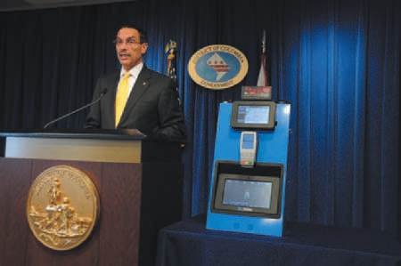
African Americans
Growth stabilized at 39 million
New York has the largest black population, followed by Florida, Texas, Georgia and California
56% of blacks live in the south (as of 2010)
Socioeconomic status improvement due to large increases in women’s incomes
Disposable income nearly $1 billion per year
Buying power projected to reach $1.307 billion in 2017
Figure 13-5 (Photo: Lateef Mangum, Audiovisual Producer/Photographer, Executive Office of the Mayor)

Slide 23
Asians/Muslims
Asian population fastest growing between 2000 and 2010
Emphasize traditional family mores
Greater importance on career and material success
Most put-upon public post 9/11 is Muslims
2.6 million Muslims in the U.S.
Bridges TV - “build bridges of understanding between American Muslims and mainstream America”
Copyright ©2014 by Pearson Education, Inc. All rights reserved.

Slide 24
LGBT Community, Seniors, and Others
LGBTmarket
15 million Americans
$690 billion spending power
Attitudes toward LGBT community and same-sex marriage changing
Senior citizens
Over-50 crowd controls more than 50% of America’s discretionary income
35 million members of AARP; half still work
Copyright ©2014 by Pearson Education, Inc. All rights reserved.

Slide 25
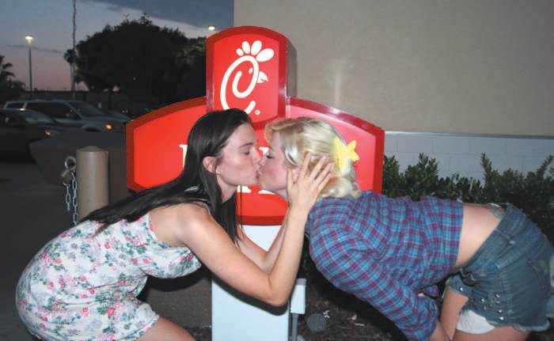
PR Ethics Mini-Case: Playing “Chicken” with Same-Sex Marriage
Page 285
Was the CEO wise in making his anti-gay marriage views known, exposing his company to such controversy?
Had you been advising Mr. Cathy, what would you have counseled him?
Figure 13-6 (Photo: GSA/ZOJ WENN Photos/Newscom)
Copyright ©2014 by Pearson Education, Inc. All rights reserved.

Slide 26
Learning Objective Three Discussion Question
Why do companies need to reach the Hispanic community?
Copyright ©2014 by Pearson Education, Inc. All rights reserved.

Slide 27
Learning Objective 4
To examine the role of public relations in orchestrating the activities of nonprofit organizations.
Copyright ©2014 by Pearson Education, Inc. All rights reserved.

Slide 28
Nonprofit Public Relations
Nonprofits serve social, educational, religious, and cultural needs of community around them
Primary source of employment for public relations graduates
Media advocacy = public relations without resources
Protests
Marches
Demonstrations
Media photo opportunities
Stealth Internet campaigns
Copyright ©2014 by Pearson Education, Inc. All rights reserved.

Slide 29
Master of All Trades
Positioning the Organization – “break a few eggs” to achieve a clear and differentiable identity
Developing a Marketing/Promotional Plan – raise non-profit’s profile, respect and levels of support
Media Relations – “free” media is critical; media advocates champion mission and cause
Support Fundraising – depend on donors for support
Identify campaign plans and objectives – set financial goal
Organize fact-finding
Recruit leaders
Plan and implement strong communications activities
Periodically review and evaluate
Copyright ©2014 by Pearson Education, Inc. All rights reserved.

Slide 30
Learning Objective 4 Discussion Question
What are the primary responsibilities of a non-profit public relations professional?
Copyright ©2014 by Pearson Education, Inc. All rights reserved.

Slide 31
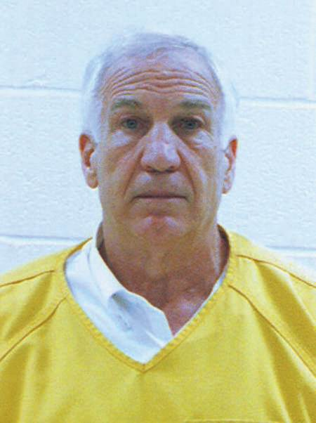
Case Study: The Silence of the Lions
Page 290
What would you have advised Second Mile to do when apprised of the charges against its founder?
What would you have counseled President Spanier to do when apprised of the charges against Sandusky?
What would you have counseled Coach Paterno to do when apprised of charges against his assistant?
Do you agree with Penn State’s decisions after the grand jury revelations?
Was the school fair in its treatment of Joe Paterno?
Figure 13-9 (Photo: Zuma/Newscom)
Copyright ©2014 by Pearson Education, Inc. All rights reserved.

Slide 32
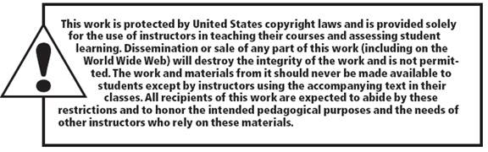
All rights reserved. No part of this publication may be reproduced, stored in a retrieval system, or transmitted, in any form or by any means, electronic, mechanical, photocopying, recording, or otherwise, without the prior written permission of the publisher. Printed in the United States of America.
Copyright © 2014 Pearson Education, Inc. All rights reserved.
Copyright ©2014 by Pearson Education, Inc. All rights reserved.

