Slide 1
Part III: The Publics
Chapter 14: International Consumer Relations
Copyright ©2014 by Pearson Education, Inc. All rights reserved.

Slide 2
Learning Objectives
To examine the important public of “consumers,” both in the United States and around the world.
To explain the nuances of consumer relations; dealing persuasively with customers and prospects to build an agreeable consumer experience.
To discuss the growth of the “consumer movement” in America and around the world.
To explore the building of worldwide brands through positive public relations activities, conducted on a consistent basis throughout geographic markets.
Copyright ©2014 by Pearson Education, Inc. All rights reserved.

Slide 3

Opening Example: Fiber One Brownies
General Mills, $12 billions, family-friendly Midwestern company bonded with famous potheads, Cheech and Chong
Magic Brownie Adventure on YouTube
Magic ingredient = fiber
Viral sensation
Figure 14-1 (Photo: FRED PROUSER/REUTERS/Newscom)
Copyright ©2014 by Pearson Education, Inc. All rights reserved.

Slide 4
Learning Objective 1
To examine the important public of “consumers,” both in the United States and around the world.
Copyright ©2014 by Pearson Education, Inc. All rights reserved.

Slide 5
Worldwide Consumer Class
Two billion people worldwide belong to “consumer class”
Highly processed foods
Desire bigger houses and more and bigger cars
Higher levels of debt
Lifestyles devoted to accumulation of nonessential goods
Half of global consumers reside in developing countries
240 million in China
120 million in India
Globalization and social media increase pressures on multinational companies
Differentiate product from the rest
Public relations techniques and social sensitivities help
Copyright ©2014 by Pearson Education, Inc. All rights reserved.

Slide 6
Learning Objective 1 Discussion Question
What are the implications of a worldwide consumer class for public relations professionals?
Copyright ©2014 by Pearson Education, Inc. All rights reserved.

Slide 7
Learning Objective 2
To explain the nuances of consumer relations; dealing persuasively with customers and prospects to build an agreeable consumer experience.
Copyright ©2014 by Pearson Education, Inc. All rights reserved.

Slide 8
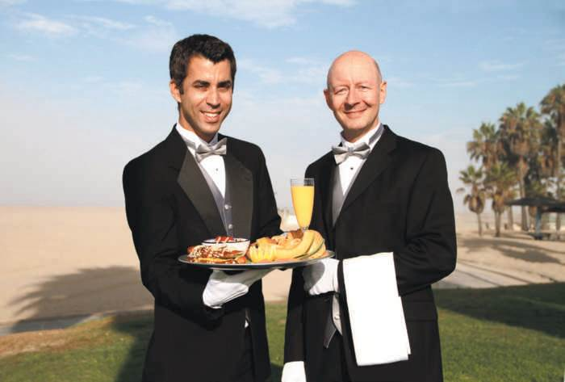
Consumer Relations Objectives
Keeping old customers
Attracting new customers
Marketing new items or services
Expediting complaint handling
Reducing costs
Figure 14-3 (Courtesy BlazePR)
Copyright ©2014 by Pearson Education, Inc. All rights reserved.

Slide 9
Consumer-Generated Media
New lead voice in town is social media
Gives consumers a voice
Gives consumers a publishing platform
Gives consumers a forum where their collective voices on products and services can be heard, shared and researched
Online consumer word-of-mouth originates from
Blogs
Message boards and forums
Public discussions
Discussions and forums on large email portals
Online opinion/review sites and services
Online feedback/complaint sites
Consumers trust fellow consumers
Copyright ©2014 by Pearson Education, Inc. All rights reserved.

Slide 10
Handling Consumer Complaints
Only 4% of dissatisfied customers complain
Bedbug letter – prewritten, generic response not desirable
Risk of consumer complaints going viral always present
Ombudsman
Originally responded to complaints about abuses by public officials
Now outsourced location customers call to seek redress for grievances
Companies that express understanding and courtesy will keep customers
Copyright ©2014 by Pearson Education, Inc. All rights reserved.

Slide 11
PR Ethics Mini-Case: Kenneth Cole’s Egyptian “Twagedy”
Page 299
What would you have advised that Kenneth Cole tweet about the Arab Spring?
In light of this contretemps, what policy would you recommend Mr. Cole follow in future tweets?
Copyright ©2014 by Pearson Education, Inc. All rights reserved.

Slide 12
Learning Objective 2 Discussion Question
Why is consumer-generated marketing relevant to public relations and consumer relations professionals?
Copyright ©2014 by Pearson Education, Inc. All rights reserved.

Slide 13
Learning Objective 3
To discuss the growth of the “consumer movement” in America and around the world.
Copyright ©2014 by Pearson Education, Inc. All rights reserved.

Slide 14
The Consumer Movement
Legislation to protect U.S. consumers emerged in 1872 – Criminal Fraud Statute
1887 – Interstate Commerce Commission
Upton Sinclair’s novel The Jungle – Food and Drug Act and Trade Commission Act
1927 – 1938: Consumers safeguarded from abuses of stakeholders in well-known brands of commercial products – Food, Drug and Cosmetic Act
1965: Ralph Nader’s Unsafe at Any Speed
1960s: President John F. Kennedy proposed bill of rights: rights to safety, to be informed, to choose and to be heard
Copyright ©2014 by Pearson Education, Inc. All rights reserved.

Slide 15
Consumerism Today
Government overseers of consumer interests
Labels, packaging, product safety
Consumer Financial Protection Bureau
Copyright ©2014 by Pearson Education, Inc. All rights reserved.

Slide 16
Learning Objective 3 Discussion Question
What is a consumer bill of rights? How should it be communicated to consumers?
Copyright ©2014 by Pearson Education, Inc. All rights reserved.

Slide 17
Learning Objective 4
To explore the building of worldwide brands through positive public relations activities, conducted on a consistent basis throughout geographic markets.
Copyright ©2014 by Pearson Education, Inc. All rights reserved.

Slide 18
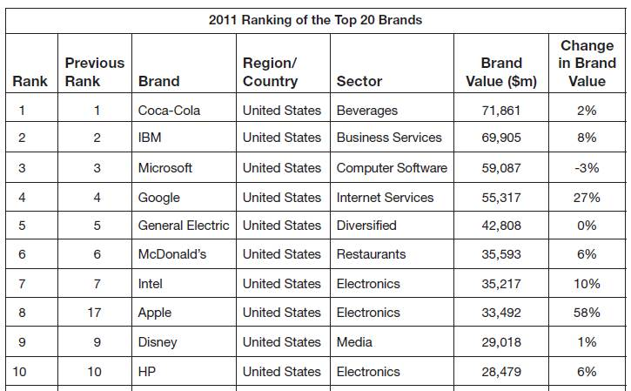
Operating Around the Globe
Multinational corporations must be sensitive to how their actions affect people of different cultures/geographies
10 most powerful brands in the world are based in the U.S.
Multinational companies face challenges from local communities and organizations
“Think global, act local” to win support
Figure 14-5 (Courtesy of Interbrand)
Copyright ©2014 by Pearson Education, Inc. All rights reserved.

Slide 19
Consumer Internet Activists
Organic consumer movements have been stimulated by the Internet
2011 Occupy Wall Street rallied troops with social media
Consumers use Internet to keep companies honest
Consumers Union – Consumer Reports
Consumer Federation of America
Internet activism uses Internet to
Enable faster communications
Coordinate citizen movements
Example: Arab Spring
Copyright ©2014 by Pearson Education, Inc. All rights reserved.

Slide 20
Think Multilingual and Straighten out Your English
It is important for companies to know how their brand names translate into other languages
Burrada = giant burrito; colloquial meaning = “big mistake”
Country Mist makeup = country manure in Germany
Colgate Cue toothpaste; Cue = porno magazine in France
In the same way, it is important for foreign lands to correctly translate messages into English
Copenhagen “We take your bags and send them in all directions”
Italy “Specialist in women and other diseases”
Acapulco “The manager has personally passed all the water served here”
Copyright ©2014 by Pearson Education, Inc. All rights reserved.

Slide 21
Business Gets the Message
Consumer relations started as a way to handle complaints/unanswerable queries
Companies broadened consumer relations function to encompass activities like
Developing guidelines to evaluate services and products for management
Developing consumer programs that meet consumer needs and increase sales
Developing field-training programs
Evaluating service approaches
Evaluating company effectiveness in demonstrating consumer for customers
Investment in consumer service pays off
Bad service can lead to negative word-of-mouth
Copyright ©2014 by Pearson Education, Inc. All rights reserved.

Slide 22
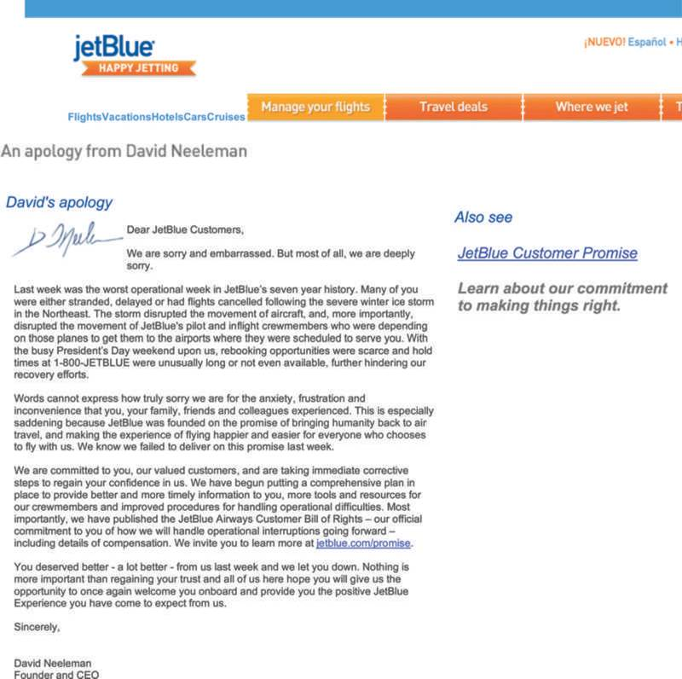
Consumer Philosophy at Jet Blue Airways
Valentine’s Day ice storm stranded thousands of customers and hurt reputation
“Wakeup call for Jet Blue”
New customer “Bill of Rights”
Figure 14-7 (Courtesy of JetBlue)
Copyright ©2014 by Pearson Education, Inc. All rights reserved.

Slide 23
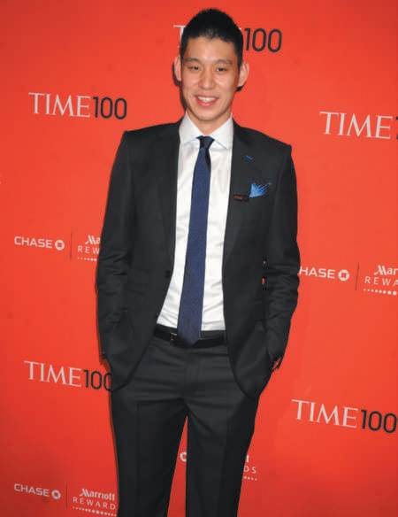
Case Study: Linsanity
Page 307
Was Jeremy Lin smart to take advantage of marketing/public relations deals and trademark immediately after his breakout month with the Knicks?
How would you market Lin in Houston?
What public relations contingency plans would you make for Jeremy Lin, were you the Houston Rockets?
Figure 14-8 (Photo: Newscom)
Copyright ©2014 by Pearson Education, Inc. All rights reserved.

Slide 24
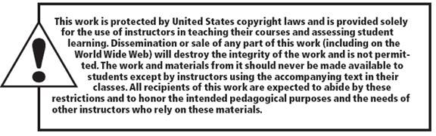
All rights reserved. No part of this publication may be reproduced, stored in a retrieval system, or transmitted, in any form or by any means, electronic, mechanical, photocopying, recording, or otherwise, without the prior written permission of the publisher. Printed in the United States of America.
Copyright © 2014 Pearson Education, Inc. All rights reserved.
Copyright ©2014 by Pearson Education, Inc. All rights reserved.

