Slide 1
Part IV: Execution
Chapter 15: Public Relations Writing
Copyright ©2014 by Pearson Education, Inc. All rights reserved.

Slide 2
Learning Objectives
To discuss the reasons that the public relations professional must be the best writer in the organization.
To explore the fundamentals of writing, from drafting to style to ensuring worthwhile content.
To discuss, in detail, the rationale for and elements of the news release, the most practical and ubiquitous of public relations writing vehicles.
To examine the requisites of writing for the Internet and social media.
Copyright ©2014 by Pearson Education, Inc. All rights reserved.

Slide 3
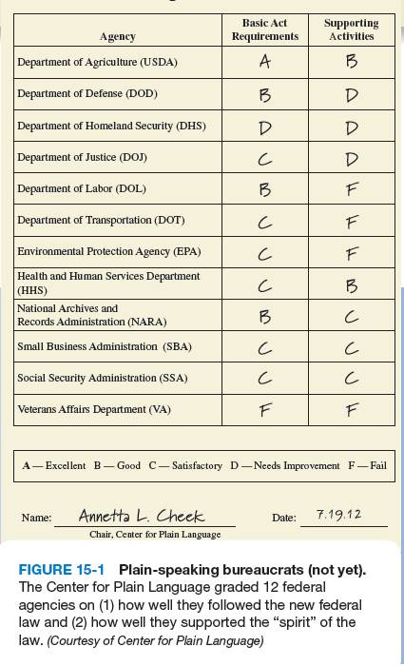
Opening Example:
Government Communications
2010 Plain Writing Act
  Official Website
Cut the “bureaucratese” in dealing with the public
  Avoid jargon and acronyms
Public relations practitioners are professional communicators
Communications means writing
Copyright ©2014 by Pearson Education, Inc. All rights reserved.

Slide 4
Learning Objective 1
To discuss the reasons that the public relations professional must be the best writer in the organization.
Copyright ©2014 by Pearson Education, Inc. All rights reserved.

Slide 5
Public Relations and Writing
Public relations professionals should write and speak better than their colleagues
No substitute for clear, precise, and succinct language in informing, motivating and persuading
Public relations professionals expected to have mastery over the written word
Copyright ©2014 by Pearson Education, Inc. All rights reserved.

Slide 6
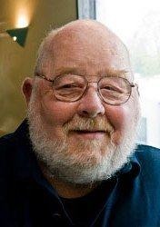
Public Relations and Writing
Public relations professionals should write and speak better than their colleagues
No substitute for clear, precise, and succinct language in informing, motivating and persuading
Public relations professionals expected to have mastery over the written word
Bradford O’Hearn
Approximately: Substitute “About”
In order to: Substitute “To”
Copyright ©2014 by Pearson Education, Inc. All rights reserved.

Slide 7
Writing for the Eye and the Ear
Writing for a Reader
Writing for a Listener
Reader has luxuries a listener does not have
  Scan material
  Study printed words
  Dart ahead
  Review passages for better understanding
  Reader can check facts
Online readers are fickle and impatient – copy must corral them
Listener gets only one opportunity to hear and comprehend a message – no second chance
Grab listener quickly – tune out difficult to draw back into listening fold
Know how to write a speech
Copyright ©2014 by Pearson Education, Inc. All rights reserved.

Slide 8
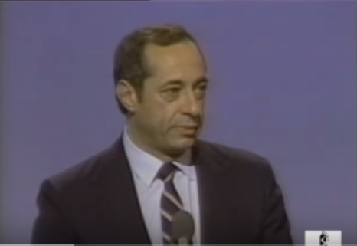
1984 Democratic National Convention Speech by NY Gov. Mario M. Cuomo

Slide 9
Learning Objective 1
Discussion Question
Why is writing the foremost technical skill of public relations professionals?
Copyright ©2014 by Pearson Education, Inc. All rights reserved.

Slide 10
Fundamentals of Writing
Idea must precede the expression
Don’t be afraid of the draft
No need to write linearly (start at the end!)
Simplify, clarify
Writing must be aimed at a particular audience
Copyright ©2014 by Pearson Education, Inc. All rights reserved.

Slide 11
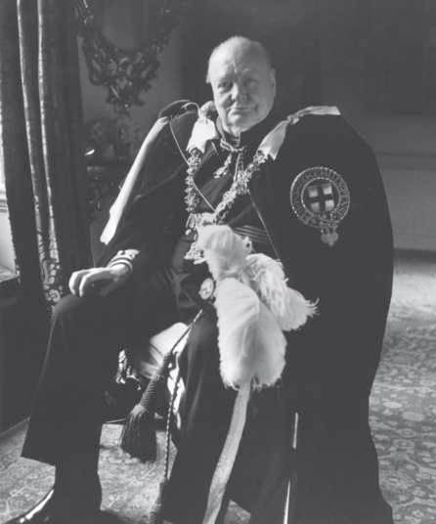
The Greatest Public Relations Writer of All Time: Sir Winston Churchill
He got straight to the point
He wrote the truth
He painted pictures
He used simple words
We worked his verbs (stressed words of action)
Figure 15-2 (Photo: akg-images/Newscom)
Copyright ©2014 by Pearson Education, Inc. All rights reserved.

Slide 12
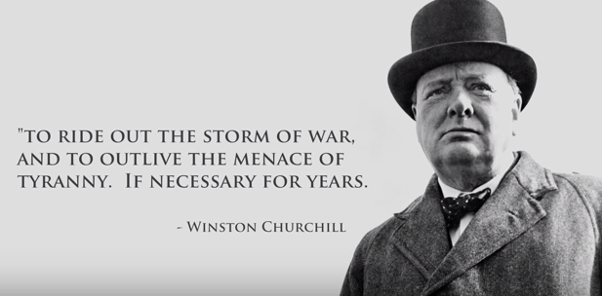

Slide 13
Flesch Readability Formula
Avoid pomposity¹ and murkiness²
Substitute simple words for “25-cent words”
Use contractions such as it’s and doesn’t
Leave out the word that whenever possible
Use pronouns such as I, we, they and you
Refer back to a noun with a repeat of the noun or a pronoun; don’t create eloquent substitutions
Cover one item/idea per paragraph
Use language the reader understands
      Pretension or arrogance
      Lack of clarity
Copyright ©2014 by Pearson Education, Inc. All rights reserved.

Slide 14
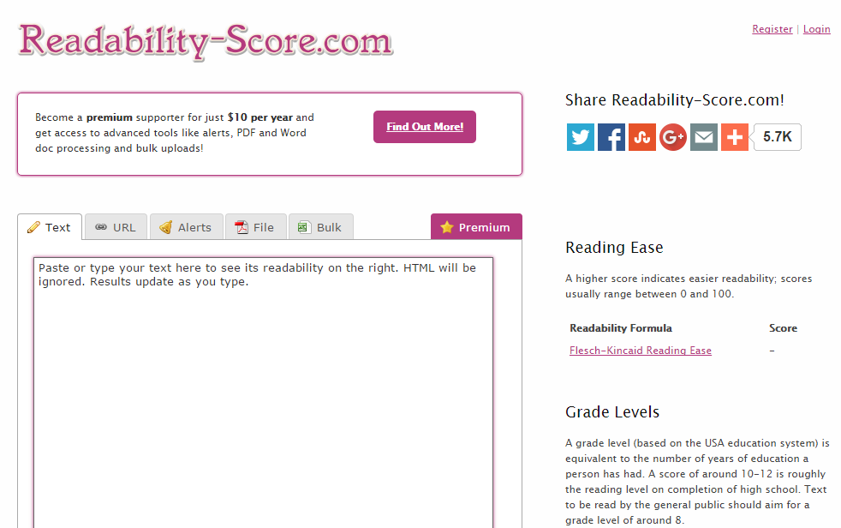
https://readability-score.com/
I endeavor to assist you in this initiative.
I want to help you with this project.

Slide 15

The Beauty of the Inverted Pyramid
Climax of news story comes at the beginning
Lead, first 1-2 paragraphs of a story, includes the most important facts
Paragraphs are written in descending order of importance; less important facts presented as the article continues
Lead answers who, what, why, when, where and occasionally how
Copyright ©2014 by Pearson Education, Inc. All rights reserved.

Slide 16


Slide 17
Learning Objective 3
To discuss, in detail, the rationale for and elements of the news release, the most practical and ubiquitous of public relations writing vehicles.
Copyright ©2014 by Pearson Education, Inc. All rights reserved.

Slide 18
The News Release
First news release – Ivy Lee, 1906 explanation from Pennsylvania Railroad about crash that killed 50 people published verbatim in The New York Times
End of news releases predicted to be nigh, but it’s not
Document of record to state organization’s official position
Influence publication to write favorably about material discussed
Some news releases are used verbatim
Copyright ©2014 by Pearson Education, Inc. All rights reserved.

Slide 19
Five Newsworthy Topics for News Releases
Impact – major announcement that affects organization, community, society
Oddity – unusual occurrence, milestone
Conflict – significant dispute or controversy
Known principal – the greater the title of person making announcement, the greater the chance it will be used
Proximity – how localized the release is or how timely it is, relative to the news of the day
Human interest stories, which touch on an emotional personal experience, are regularly considered newsworthy
Copyright ©2014 by Pearson Education, Inc. All rights reserved.

Slide 20

News 12 Long Island - July 3, 2015
Veterans with PTSD Ask for Fireworks Courtesy

Slide 21
News Release News Value
Think like a news reporter
Write like a news reporter
Copyright ©2014 by Pearson Education, Inc. All rights reserved.

Slide 22
News Release News Value
Have a well-defined reason for sending the release
Focus on one central subject in each release
Make certain the subject is newsworthy in the context of the organization, industry and community
Include facts about the product, service or issue being discussed
Provide the facts “factually” with no puff, no bluff, no hyperbole
Rid the release of unnecessary jargon
Include appropriate quotes from principals (without inflated superlatives)
Include product specifications and other pertinent information
Include a brief description of the company/boilerplate
Write clearly, concisely, forcefully
Copyright ©2014 by Pearson Education, Inc. All rights reserved.

Slide 23
News Release Content
Proper newspaper style
Clear and concise
Who?
What?
Where?
When?
Why?
And sometimes How?
Gist of story must be communicated in the lead
News release should be objective; fair and accurate
Copyright ©2014 by Pearson Education, Inc. All rights reserved.

Slide 24
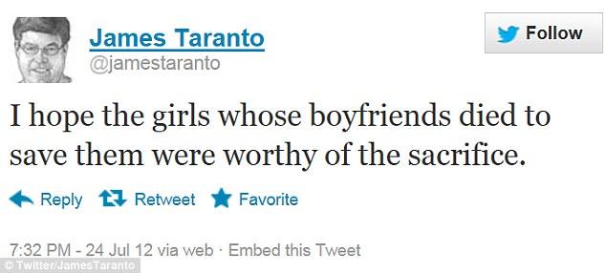
PR Ethics Mini-Case: Bad Taste Tweet Release
Page 321
How would you have advised James Taranto to word his tweet about the Colorado massacre?
Copyright ©2014 by Pearson Education, Inc. All rights reserved.

Slide 25
News Release Essentials
Rationale
Focus
No puffery
Nourishing quotes
Company description
Spelling, Grammar, Punctuation
Clarity, Conciseness, Commitment
Copyright ©2014 by Pearson Education, Inc. All rights reserved.

Slide 26
News Release Style
Sloppy style can ruin chance for publication
News release style is subjective and ever changing
Capitalization – use capital letters sparingly
Abbreviations
  Months should be abbreviated when date used, but not when without date.
  Days of week never abbreviated
  First mention of organizations and agencies should be spelled out – acronyms or abbreviation ok to use afterward.
Numbers – spell out zero through nine and use figures for 10 and up (with some exceptions)
Spelling – check it in the dictionary; use first/preferred
Copyright ©2014 by Pearson Education, Inc. All rights reserved.

Slide 27
Social Media Releases (SMRs)
Designed to reach non-traditional journalists (bloggers and podcasters)
A release only needs a photo to qualify for an SMR but may link to audio, video, links, etc.
Include contact information, boilerplate, and quotes
Embed head shots and logos; include video, audio and photos; link to additional material that might be relevant
Include tags to social bookmarking services
Copyright ©2014 by Pearson Education, Inc. All rights reserved.

Slide 28
Writing Releases for the Internet
Brevity and succinctness are paramount
One reporter per “To” line
  Never put all names in the “To” field
Limit subject line headers – four to six provocative words
Hammer home the headline
Limit length
Observe 5W format (Who, What, When, Why, Where and How)
No attachments: link to hosted document/image
Remember readability
Copyright ©2014 by Pearson Education, Inc. All rights reserved.

Slide 29
Importance of Editing
Important to edit work
Verbs are important; use active and get rid of passive verbs
Each word, phrase, sentence, paragraph should be weighed carefully
Editor should be gutsy and use bold strokes
Concentrate on organizing copy so it flows
Copyright ©2014 by Pearson Education, Inc. All rights reserved.

Slide 30
Case Study: The Raina, Inc. News Release
Page 326
If you were assigned to draft a news release to accompany Sludge to the Blackrock City Council meeting on April 11, which items would you use in your lead (i.e., who, what, why, where, when, how)?
Which items would you avoid using in the news release?
If a reporter from the Blackrock Bugle called and wanted to know what happened to former Blackrock manager Fowler Aire, what would you tell the reporter?
How could Raina use the Internet to research public opinion of the pollution problem? How could the company use the Internet to communicate its position in advance of the Blackrock City Council meeting?
Copyright ©2014 by Pearson Education, Inc. All rights reserved.

Slide 31


Slide 32

All rights reserved. No part of this publication may be reproduced, stored in a retrieval system, or transmitted, in any form or by any means, electronic, mechanical, photocopying, recording, or otherwise, without the prior written permission of the publisher. Printed in the United States of America.
Copyright © 2014 Pearson Education, Inc. All rights reserved.
Copyright ©2014 by Pearson Education, Inc. All rights reserved.

