Slide 1
Part IV: Execution
Chapter 16: Integrated Marketing Communications
Copyright ©2014 by Pearson Education, Inc. All rights reserved.

Slide 2
Learning Objectives
To discuss the synthesis of advertising, marketing, and public relations to yield an integrated marketing approach in promoting products, services, and brands.
To explore the distinctions among advertising, marketing, and public relations.
To discuss, in detail, the two marketing differentiators of public relations—publicity and third-party endorsement.
To examine the various tactics and techniques that distinguish integrated marketing, from the traditional— public relations advertising, trade shows, cause-related marketing, etc.—to the 21st-century innovations—social media marketing, brand integration, buzz marketing, etc.
Copyright ©2014 by Pearson Education, Inc. All rights reserved.

Slide 3

Opening Example: It Ain’t “Your Mother’s Marketing” Environment
Pizza Hut advertised in space
Weldon’s Bulgari product placement in novel
Cisco in CSI:NY
Everything is up for sale
Disciplines that add up to “marketing” are more integrated than before
Figure 16-1 (Photo: Dennis Van Tine/ABACAUSA.COM/Newscom)
Copyright ©2014 by Pearson Education, Inc. All rights reserved.

Slide 4
Learning Objective 1
To discuss the synthesis of advertising, marketing, and public relations to yield an integrated marketing approach in promoting products, services, and brands.
Copyright ©2014 by Pearson Education, Inc. All rights reserved.

Slide 5
Integrated Marketing
Intersection of public relations and publicity, advertising, sales promotion and marketing to promote organizations, products, and services
Marketing-oriented tweets and Facebook messages, YouTube videos, Internet publicity, using celebrities as spokespersons, inserting product placements in movies, sponsoring concerns, creating street theater, other publicity seeking techniques
All sell products and ideas
Public relations establishes credibility and tells brand story more comprehensively than advertising
Copyright ©2014 by Pearson Education, Inc. All rights reserved.

Slide 6
Learning Objective 1 Discussion Question
Describe the different roles each of the following might play in an integrated marketing communications strategy:
Advertising
Public relations
Database marketing
Sales promotions
Copyright ©2014 by Pearson Education, Inc. All rights reserved.

Slide 7
Learning Objective 2
To explore the distinctions among advertising, marketing, and public relations.
Copyright ©2014 by Pearson Education, Inc. All rights reserved.

Slide 8
Public Relations vs. Marketing vs. Advertising
Marketing – selling a service or product through pricing, distribution and promotion
Advertising – subset of marketing; pay to place message in media formats
Public relations – marketing of an organization via unbiased, objective third-party endorsement
Clutter increased importance of public relations
Copyright ©2014 by Pearson Education, Inc. All rights reserved.

Slide 9
Learning Objective 2 Discussion Question
How is public relations different from marketing and advertising?
Copyright ©2014 by Pearson Education, Inc. All rights reserved.

Slide 10
Learning Objective 3
To discuss, in detail, the two marketing differentiators of public relations—publicity and third-party endorsement.
Copyright ©2014 by Pearson Education, Inc. All rights reserved.

Slide 11
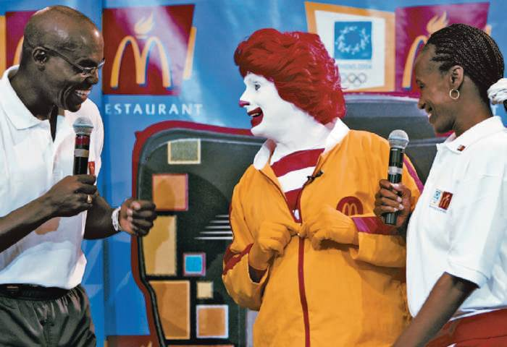
Product Publicity
Essence of value of integrating public relations and marketing – break through clutter with public relations
Can be effective when
Introducing a revolutionary new product
Eliminating distribution problems with retail outlets
Small budgets and strong competition
Explaining a complicated product
Tying the product to a unique representative
Figure 16-2 (Courtesy of O’Dwyerpr.com)
Copyright ©2014 by Pearson Education, Inc. All rights reserved.

Slide 12
Third-Party Endorsement
Tacit support of objective third-party observer
Advertising perceived as self-serving
Publicity carries no stigma; editors are considered objective, impartial, indifferent and neutral
News is more trustworthy than advertising from a nonobjective sponsor
Bloggers may be sponsored; print editors sensitive to product placements
Copyright ©2014 by Pearson Education, Inc. All rights reserved.

Slide 13
Learning Objective 3 Discussion Questions
What is meant by third-party endorsement?
In what situations is product publicity most effective?
Copyright ©2014 by Pearson Education, Inc. All rights reserved.

Slide 14
Learning Objective 4
To examine the various tactics and techniques that distinguish integrated marketing, from the traditional— public relations advertising, trade shows, cause-related marketing, etc.—to the 21st-century innovations—social media marketing, brand integration, buzz marketing, etc.
Copyright ©2014 by Pearson Education, Inc. All rights reserved.

Slide 15
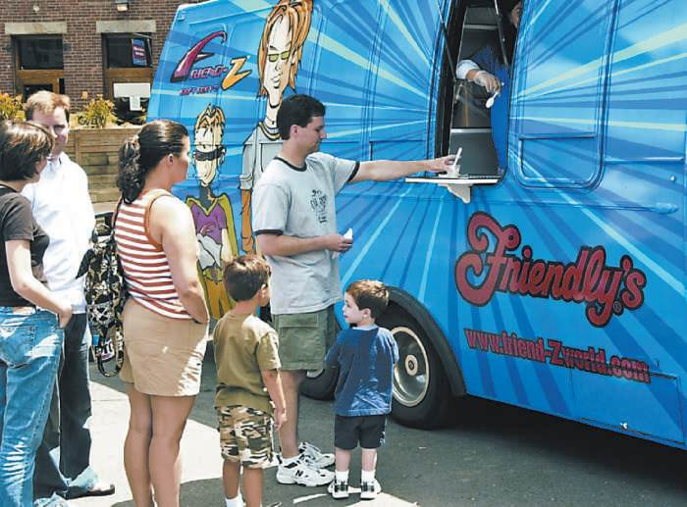
Building a Brand
Be early – law of primacy
Be memorable – be bold and unique
Be aggressive – get the name out and keep it there
Use heritage – nostalgia
Create a personality
Figure 16-4 (Courtesy of O’Dwyerpr.com)
Copyright ©2014 by Pearson Education, Inc. All rights reserved.

Slide 16

Public Relations Advertising
Marketing of an image vs. a product
Image advertising, issues advertising, public relations
Mergers and diversifications
Personnel changes
Organizational resources
Manufacturing and service capabilities
Growth history
Financial strength and stability
Figure 16-6 (Courtesy of PETA)
Copyright ©2014 by Pearson Education, Inc. All rights reserved.

Slide 17
Traditional Integrated Marketing
Article Reprints – use for maximum sales punch
Trade show participation
Analyze the show carefully
Select a common theme
Emphasize what’s new
Consider local promotional efforts
Evaluate the worth
Spokespersons – articulate, fast on feet, knowledgeable
Cause-related marketing
In-kind promotions
Copyright ©2014 by Pearson Education, Inc. All rights reserved.

Slide 18
21st-Century Integrated Marketing
Online/Social Media Marketing – create buzz
Television brand integration – product placements integrated into plot lines
Product placements – novels, TV programs, movies, video games, cartoons
Ad creep is growing
Infomercials – program-length commercials work
Buzz marketing – target influencers or trend setters
Others
Song placements
Sports teams
Online game shows
Copyright ©2014 by Pearson Education, Inc. All rights reserved.

Slide 19
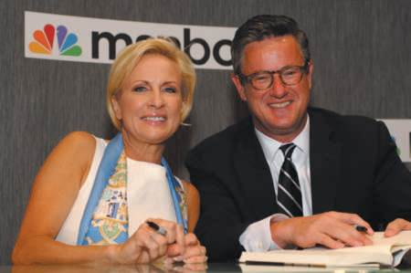
PR Ethics Mini-Case: Shilling the Morning Joe
Page 341
Do you agree with MSNBC’s decision not to mention the Starbuck’s sponsorship in its segment with Howard Schultz?
Were you public relations advisor to MSNBC, what would you have counseled the network to do with respect to the Schultz interview?
Were you a Starbuck’s advisor, what would you have counseled CEO Schultz to do during the interview?
Figure 16-8 (Photo: Cindy Barrymore/ABACAUSA.COM/Newscom)
Copyright ©2014 by Pearson Education, Inc. All rights reserved.

Slide 20
Learning Objective 4 Discussion Question
What are several 21st-century techniques of integrated marketing communications?
Copyright ©2014 by Pearson Education, Inc. All rights reserved.

Slide 21
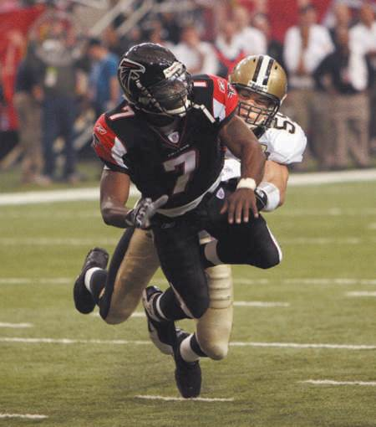
Case Study: Resurrecting Brand Vick
Page 344
What do you think of Michael Vick’s decision to accept jail time and hold a press conference?
If you were advising Vick, how would you suggest he comport himself now that he is back in the NFL? What should he do, in a public relations sense, when he is freed?
If you were advising the National Football League, how would you suggest it handle Vick’s reinstatement?
If you were advising corporate sponsors, what would you suggest they do relative to Michael Vick, now that he is back in the NFL?
What do you think of Nike’s decision to reinstate him as an endorser?
Figure 16-9 (Photo: Johnny Crawford/AJC/Newscom)
Copyright ©2014 by Pearson Education, Inc. All rights reserved.

Slide 22
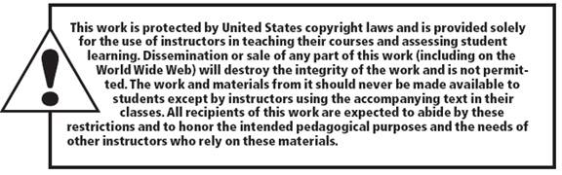
All rights reserved. No part of this publication may be reproduced, stored in a retrieval system, or transmitted, in any form or by any means, electronic, mechanical, photocopying, recording, or otherwise, without the prior written permission of the publisher. Printed in the United States of America.
Copyright © 2014 Pearson Education, Inc. All rights reserved.
Copyright ©2014 by Pearson Education, Inc. All rights reserved.

