Slide 1
Part IV: Execution
Chapter 17: Crisis Management
Copyright ©2014 by Pearson Education, Inc. All rights reserved.

Slide 2
Learning Objectives
To discuss the importance in counseling on the actions and managing the communication of an organization in crisis.
To explore the role of public relations in managing issues and risks and communicating in a crisis.
To discuss, in detail, the aspects of crisis planning, message mapping, and implementing crisis communication.
To examine how media relations differs in time of crisis than in normal everyday operations.
Copyright ©2014 by Pearson Education, Inc. All rights reserved.

Slide 3

Opening Example: The Dark Knight Rises Murders
The Dark Knight Rises – crisis arose when gunman killed 12 and wounded 58 others at Aurora premier
Warner Brothers had to reevaluate marketing and public relations plan
Stars flew to Colorado
Trailers for Gangster Squad, which showed four men shooting up a movie theater, were suspended
Figure17-1 (Photo: RICHARD B. LEVINE/Photoshot/Newscom)
Copyright ©2014 by Pearson Education, Inc. All rights reserved.

Slide 4
Learning Objective 1
To discuss the importance in counseling on the actions and managing the communication of an organization in crisis.
Copyright ©2014 by Pearson Education, Inc. All rights reserved.

Slide 5

Lance Armstrong
Seven-time winner of Tour de France dropped defense against anti-doping charges
Stripped of titles
Admitted to Oprah Winfrey that his life was a lie – doped throughout cycling career
Organizations and individuals are always one step away from a crisis
Figure 17-2 (Photo: OLIVIER HOSLET/EPA/Newscom)
Copyright ©2014 by Pearson Education, Inc. All rights reserved.

Slide 6
Crisis Pervades Society
Crisis = “unplanned visibility”
Most well-regarded and highest-paid professionals in public relations manage crises
Instant Internet communications, round-the-clock social media, cable news commentary, talk radio, tabloid news journalism → increased number and depth of crises
In government
In business
In education
In religion
In charitable institutions
In journalism
In public relations
Copyright ©2014 by Pearson Education, Inc. All rights reserved.

Slide 7
Learning Objective 1 Discussion Question
How have changes in communications media affected the need for crisis management?
Copyright ©2014 by Pearson Education, Inc. All rights reserved.

Slide 8
Learning Objective 2
To explore the role of public relations in managing issues and risks and communicating in a crisis.
Copyright ©2014 by Pearson Education, Inc. All rights reserved.

Slide 9
Issue Management
“Issues management is the capacity to understand, mobilize, coordinate, and direct all strategic and policy planning functions, and all public affairs/public relations skills, toward achievement of one objective: meaningful participation in creation of public policy that affects personal and institutional destiny” – W. Howard Chase (1976)
Copyright ©2014 by Pearson Education, Inc. All rights reserved.

Slide 10
Issues Management
Anticipate emerging issues
Identify issues selectively
Deal with opportunities and vulnerabilities
Plan from the outside in
Bottom-line orientation
Copyright ©2014 by Pearson Education, Inc. All rights reserved.

Slide 11
Risk Communication and Message Mapping
Risk communication = outgrowth of issues management
Take scientific data related to health and environmental hazards and present them to lay audience in understandable, meaningful way
Position: perception is reality
When stressed, ability to hear, understand and remember diminishes
In times of high stress, people can miss up to 80% of message content
Of the 20% they hear, most messages are negative
Copyright ©2014 by Pearson Education, Inc. All rights reserved.

Slide 12
Message-Mapping Steps
Identify stakeholder
Determine specific concerns for each stakeholder group
Analyze specific concerns to fit underlying general concerns
Conduct structured brainstorming with input from message-mapping teams
Assemble supporting facts and proof for each key message
Ask outside experts to systematically test messages
Plan delivery of resulting messages and supporting materials
Copyright ©2014 by Pearson Education, Inc. All rights reserved.

Slide 13
Message Map Requirements
Three key messages
Seven to 12 words per message
Three supporting facts for each key message
Deeds, not words, are what count in communicating risk
Copyright ©2014 by Pearson Education, Inc. All rights reserved.

Slide 14
Learning Objective 2 Discussion Question
What is meant by “message mapping”?
Copyright ©2014 by Pearson Education, Inc. All rights reserved.

Slide 15
Learning Objective 3
To discuss, in detail, the aspects of crisis planning, message mapping, and implementing crisis communication.
Copyright ©2014 by Pearson Education, Inc. All rights reserved.

Slide 16
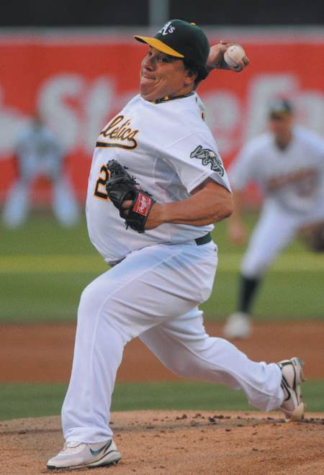
Signs of a Crisis
Definitions
“A crisis is a situation that has reached a critical phase for which dramatic and extraordinary intervention is necessary to avoid or repair major damage.” – Harvard Business Review
“Anything the CEO says it is!”
Short-term issue that affects one element or department can be limited
Crisis is longer-term and impacts the entire organization, affects many parts of the organization, and runs the risk of damaging the organization’s reputation
Positive crisis response can establish goodwill and cement positive reputation
Figure 17-3( Photo: JOSE CARLOS FAJARDO/MCT/Newscom)
Copyright ©2014 by Pearson Education, Inc. All rights reserved.

Slide 17
Seven Instant Warning Signs of Crisis
Surprise – unexpected
Insufficient information – hard to understand everything
Escalating events – crisis expands
Loss of control – too many things happening
Increased outside scrutiny – responses desired
Siege mentality – organization feels surrounded
Panic
Copyright ©2014 by Pearson Education, Inc. All rights reserved.

Slide 18
Planning in a Crisis
Define the risk for each potentially impacted audience
Describe the actions that might mitigate each risk defined
Identify the cause of each risk
Demonstrate responsible management action
Create a consistent message
Copyright ©2014 by Pearson Education, Inc. All rights reserved.

Slide 19
PR Ethics Mini-Case: Kobe’s Nimble Public Relations Once Again Saves the Day
How do you think Kobe Bryant handled the gay slur controversy?
Were you a Bryant sponsor, would you take action against him?
Were you a Bryant advisor, how would you have counseled him to handle the NBA fine?
Copyright ©2014 by Pearson Education, Inc. All rights reserved.

Slide 20
Learning Objective 3 Discussion Question
What are the principles in planning for crisis?
Copyright ©2014 by Pearson Education, Inc. All rights reserved.

Slide 21
Learning Objective 4
To examine how media relations differs in time of crisis than in normal everyday operations.
Copyright ©2014 by Pearson Education, Inc. All rights reserved.

Slide 22
Communicating in a Crisis
Every crisis is different – no answer to solve every crisis
Manage court of public opinion
No comment often perceived as guilty
Silence triggers anger from media and compounds problem
Cardinal rule for communications during a crisis: Tell it all and tell it fast!
Goals
Terminate the crisis quickly
Limit the damage
Restore credibility
Copyright ©2014 by Pearson Education, Inc. All rights reserved.

Slide 23
Engaging the Media: Battlefield Rules
Set up media headquarters
Establish media rules
Media live for the “box score”
Don’t speculate
Feed the beast
Speed triumphs
Copyright ©2014 by Pearson Education, Inc. All rights reserved.

Slide 24
10 General Principles for What is Said to the Media
Speak first and often
Don’t speculate
Go off the record at your own peril
Stay with the facts
Be open and concerned, not defensive
Make your point and repeat it
Don’t wage war with the media; you will lose
Establish yourself as the most authoritative source
Stay calm and be truthful and cooperative
Never lie
Copyright ©2014 by Pearson Education, Inc. All rights reserved.

Slide 25
Social Media Crisis Management
Social media does not set the tone for most crises; traditional media do
Communicate well with mainstream media
Monitor social media 24/7
Dark website – bring live for information about crisis
Copyright ©2014 by Pearson Education, Inc. All rights reserved.

Slide 26
Learning Objective 4 Discussion Questions
What is the cardinal rule for communicating in a crisis?
What are the keys to successful crisis communication?
Copyright ©2014 by Pearson Education, Inc. All rights reserved.

Slide 27
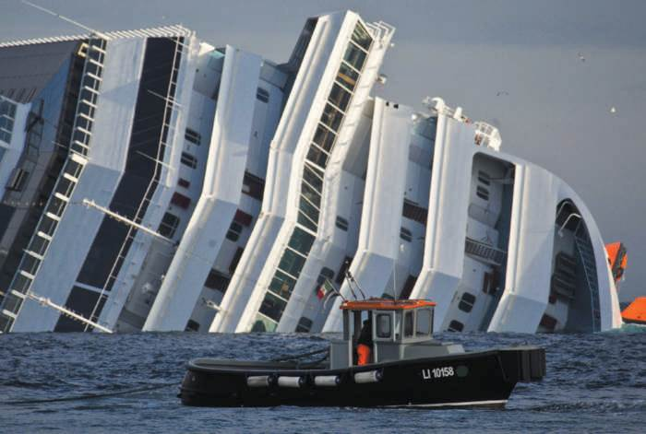
Case Study: Carnival’s Crisis Cruise
Page 360
What do you think of Carnival Cruise Line’s response to its crisis?
What role would you have advised of Carnival’s CEO?
How do you feel about the “settlement” offer and the discount that Costa Concordia offered?
In retrospect, what public relations changes, if any, would you advise Carnival in the event of a similar tragedy in the future (such as the one that hit it in the winter of 2013)?
Figure 17-7 (Photo: MASSIMO PERCOSSI/EPA/ Newscom)
Copyright ©2014 by Pearson Education, Inc. All rights reserved.

Slide 28
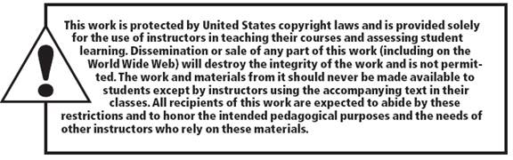
All rights reserved. No part of this publication may be reproduced, stored in a retrieval system, or transmitted, in any form or by any means, electronic, mechanical, photocopying, recording, or otherwise, without the prior written permission of the publisher. Printed in the United States of America.
Copyright © 2014 Pearson Education, Inc. All rights reserved.
Copyright ©2014 by Pearson Education, Inc. All rights reserved.

