Slide 1
Part IV: Execution
Chapter 18: Launching a Career
Copyright ©2014 by Pearson Education, Inc. All rights reserved.

Slide 2
Learning Objectives
To discuss how a public relations student or novice finds a position in the practice of public relations.
To explore the role of public relations in time of economic uncertainty, charting how the field has improved its position even in times of stress.
To discuss, in detail, the aspects of organizing the search, job letters, résumés, interviewing, and follow-up.
To examine how an individual can map his or her course for long-term public relations success.
Copyright ©2014 by Pearson Education, Inc. All rights reserved.

Slide 3

Opening Example: David Murray and Steve Jobs
David Murray found communications work in 2009 by
  Reaching out to followers on Twitter
  Twitter Search keywords
  RSS feeds of keyword conversation
  Followed up on promising leads – introduced himself via Twitter
Corporate bigwigs not always helpful. Example: Steve Jobs
Figure 18-1 (Photo: EMMANUEL DUNAND/AFP/Getty Images/Newscom)
Copyright ©2014 by Pearson Education, Inc. All rights reserved.

Slide 4
Learning Objective 2
To explore the role of public relations in time of economic uncertainty, charting how the field has improved its position even in times of stress.
Copyright ©2014 by Pearson Education, Inc. All rights reserved.

Slide 5
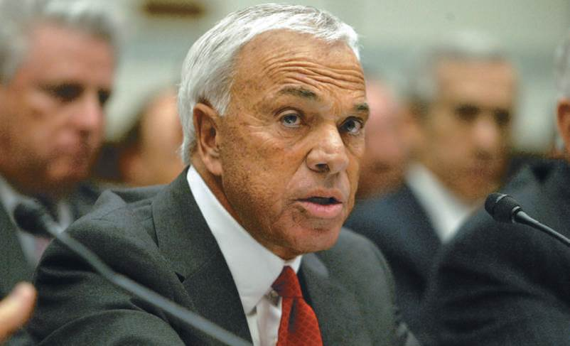
Public Relations in Economic Downturn
Public relations jobs no longer first to fall when economic times are tough
USC study of 200 organizations – public relations only moderately decreased
  Staffs not cut
  Salaries frozen or compensation reduced
Public relations understand changing dynamics of marketplace
Figure 18-2 (Photo: CD1 WENN Photos/Newscom)
Copyright ©2014 by Pearson Education, Inc. All rights reserved.

Slide 6
Learning Objective 2
How is the practice of public relations doing in the midst of economic downturn?
Copyright ©2014 by Pearson Education, Inc. All rights reserved.

Slide 7
Learning Objective 1
To discuss how a public relations student or novice finds a position in the practice of public relations.
Copyright ©2014 by Pearson Education, Inc. All rights reserved.

Slide 8
Getting a Jump
Standards for public relations jobs are raised, competition is fierce, labor market contracted
Start search in school
Show you can add value and adapt
Improve communication skills
Start networking
Focus on what you do best and like best
Look at companies you like
Get internships
Copyright ©2014 by Pearson Education, Inc. All rights reserved.

Slide 9
Learning Objective 1
Discussion Question
What steps can a college student take to get a jump on public relations employment?
Copyright ©2014 by Pearson Education, Inc. All rights reserved.

Slide 10
Learning Objective 3
To discuss, in detail, the aspects of organizing the search, job letters, résumés, interviewing, and follow-up.
Copyright ©2014 by Pearson Education, Inc. All rights reserved.

Slide 11
Organizing the Job Search
Consider what interests you and start early
Get a name – avoid “dead letter response”
Dispatch a personal letter
Call
Prepare an elevator speech
Copyright ©2014 by Pearson Education, Inc. All rights reserved.

Slide 12
Organizing the Résumé
What’s your intro?
What three impressions do you want to create?
What can you say about achievements that will make someone want to know more?
Cover time sequence without gaps
Add value in each slot – show problem-solving and leadership
Have an anecdote about each post
List professional awards, educational achievements, community service
2 pages, no less than 12 pt. type
Copyright ©2014 by Pearson Education, Inc. All rights reserved.

Slide 13
Résumé DON’TS
Don’t use a goofy or inappropriate email address
Don’t include an objective statement – it’s about what you can do for the employer
Don’t forget skill sets – important for keywords
Don’t place awards and top achievements at the end of the document
Don’t lump multiple jobs at one employer into one position
Don’t stretch your employment dates
Don’t upgrade your job title
Don’t fail to keep it up to date
Copyright ©2014 by Pearson Education, Inc. All rights reserved.

Slide 14
Organizing the Job Interview
Take charge of the interview
Lead with knowledge and strength
Beware the “gotcha” questions
  Do you have any questions?
  What is your biggest weakness?
  Tell me about yourself?
  What do you know about our company?
Indicate what you’ll add to the mix
Get more names
Follow up
Copyright ©2014 by Pearson Education, Inc. All rights reserved.

Slide 15
Learning Objective 3
Discussion Questions
What are the principles in creating an effective resume?
How can an applicant “control the agenda of a job interview?
Copyright ©2014 by Pearson Education, Inc. All rights reserved.

Slide 16
Learning Objective 4
To examine how an individual can map his or her course for long-term public relations success.
Copyright ©2014 by Pearson Education, Inc. All rights reserved.

Slide 17
Ensuring Public Relations Success
Seven Keys to a Successful PR Career
Diversity of experience
Performance - results
Communication skills
Relationship building
Proactivity and passion
Teamliness
Intangibles
Most significant limitation on public relations practice and influence was “inaccurate or incomplete perceptions of the function’s role and value”
Copyright ©2014 by Pearson Education, Inc. All rights reserved.

Slide 18
Learning Objective 4
Discussion Question
What additional steps should an up-and-coming professional follow to ensure success?
Copyright ©2014 by Pearson Education, Inc. All rights reserved.

Slide 19
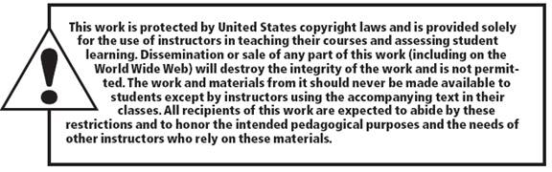
All rights reserved. No part of this publication may be reproduced, stored in a retrieval system, or transmitted, in any form or by any means, electronic, mechanical, photocopying, recording, or otherwise, without the prior written permission of the publisher. Printed in the United States of America.
Copyright © 2014 Pearson Education, Inc. All rights reserved.
Copyright ©2014 by Pearson Education, Inc. All rights reserved.

