Slide 1
Part I: Evolution
Chapter 2: The History and Growth of Public Relations

Slide 2
Evolution of Public Relations
Modern public relations 100 years old
John D. Rockefeller Jr. – 1914 Ludlow massacre
Evolution influenced by
Growth of big institutions
Heightened public awareness and media sophistication
Increasing incidence of societal change, conflict and confrontation
Globalization and the growing power of global media, public opinion and democratic capitalism
Dominance of the Internet and growth of social media

Slide 3

Ivy Lee, the Rockefellers and the Ludlow Massacres of 1914

Slide 4
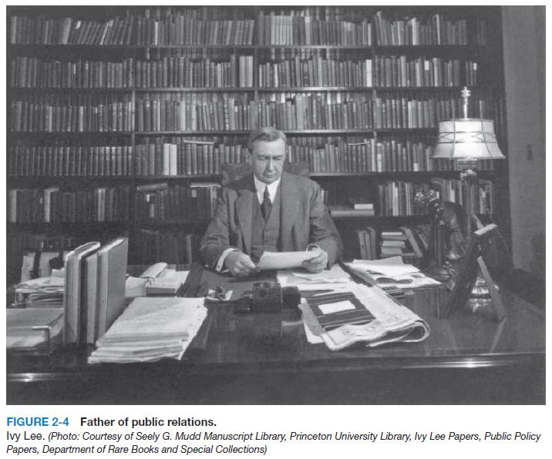
Ivy Lee: The Real Father of Modern Public Relations
Public should be informed
Critics should be answered honestly
Company should strive for public confidence and goodwill
Humanize clients
Distinguished publicity and press agentry from public relations

Slide 5
Early American Experience
American Revolution
Committees of Correspondence
Events (e.g. Boston Tea Party)
Thomas Paine’s Crisis papers
“Taxation without representation is tyranny”
Contemporary political battle cries
The Buck Stops Here: Pres. Harry Truman
Think Globally, Act Locally: Environmental Groups
We are the 99%: Occupy Wall Street

Slide 6
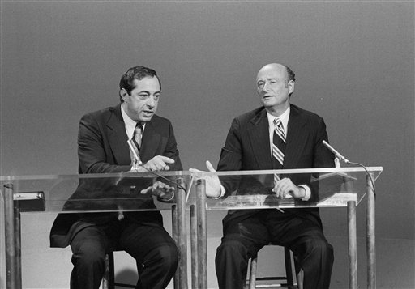

Slide 7
VOTE FOR CUOMO
NOT THE HOMO

Slide 8
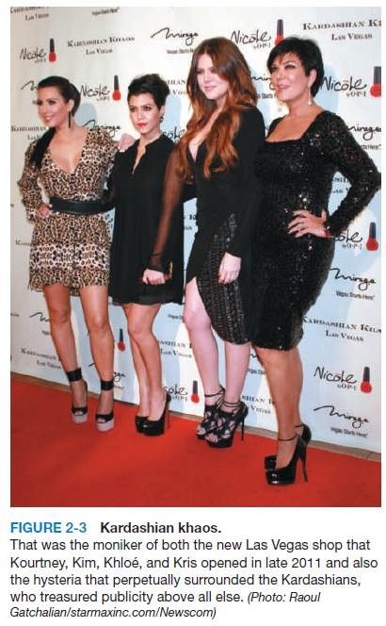
Discussion Question
Compare the Kardashian’s to P.T. Barnum’s legacy.
How does their ability to get publicity relate to the idea that public relations communication should always reflect performance and truth?

Slide 9
The Growth of Modern Public Relations
Government
Office of War Information
World War II public relations officers
President Harry Truman
President Richard Nixon
“Great Communicator” Ronald Reagan
President Bill Clinton
President Barack Obama
Counseling

Slide 10
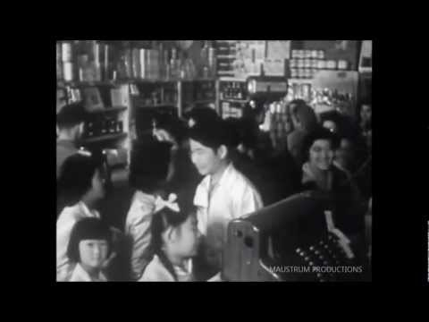
World War II U.S. Government Newsreel

Slide 11
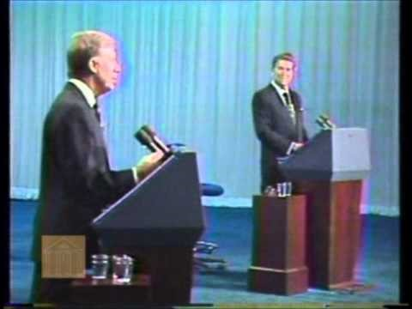
“There you go again”

Slide 12
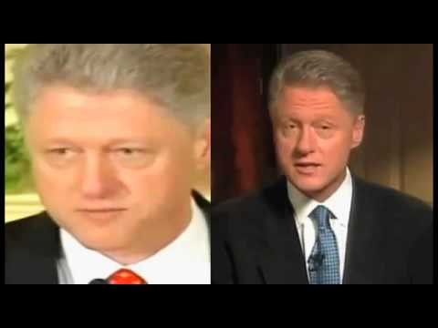
“I did not have sexual relations with that woman…Miss Lewinsky.”

Slide 13
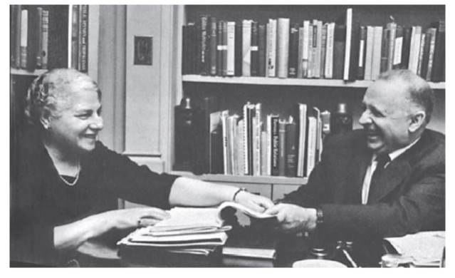
The Growth of Modern Public Relations
Edward L. Bernays
Crystallizing Public Opinion
Taught first public relations course in 1923
Recruited Doris E. Fleischman (mother of public relations)
“Publicity direction”
Gave field underpinnings in psychology, sociology, and social psychology
Hill & Knowlton
Burson-Marsteller
Figure 2-5 (Photo: Courtesy of the Museum of Public Relations,
www.prmuseum.com)

Slide 14
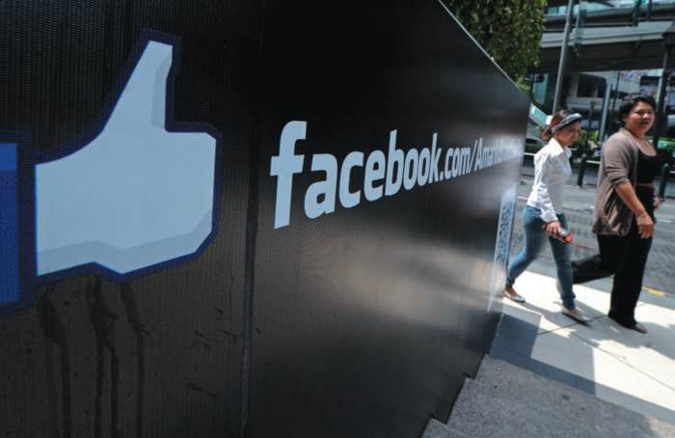
PR Ethics Mini-Case: Burson Fumbles Facebook Flap
Facebook planted stories about Google (Page 36)
How should Burson have handled its Facebook assignment?
Should a public relations client always be notified?
Figure 2-6 (Photo: PORNCHAI KITTIWONGSAKUL/AFP/ Getty Images/Newscom)

Slide 15
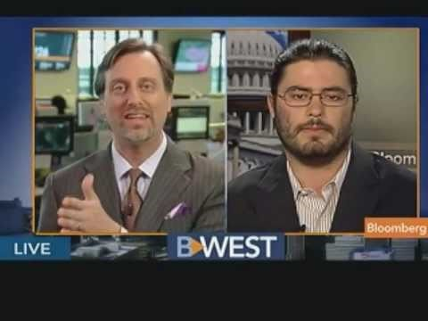
Facebook Goes on an Aggressive PR Offsensive vs. Google

Slide 16
The Growth of Modern Public Relations
Five principles for successful corporate public relations
Make sure management thoughtfully analyzes relation to public
Create system to inform employees about firm policies and practices
Create system giving contact employees knowledge to be polite and reasonable to public
Create system drawing employee and public questions and criticism back through organization to management
Ensure frankness in telling the public about the company’s actions

Slide 17
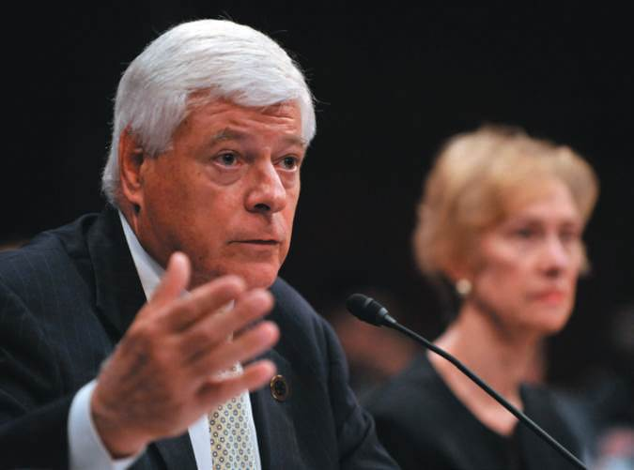
Opening Example: “The Tylenol Murders”
High integrity response to product sabotage; customer murders
2010 recall of products
Lost profits
Congressional inquiry
Executive departures
Figure 2-1 (Photo: ZUMA Press/ Newscom)

Slide 18
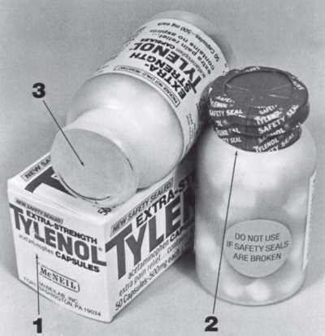
Case Study: The Tylenol Murders
Page 42
What might have been the consequences if Johnson & Johnson had decided to “tough out” the first reports of Tylenol-related deaths and not recall the product?
What other public relations options did Johnson & Johnson have in responding to the first round of Tylenol murders?
Figure 2-8 (Photo: Courtesy of Johnson & Johnson)

Slide 19
The Tylenol Murders

Slide 20
Public Relations Education
Over 200 programs offer concentrated study in public relations
Public relations should be incorporated into business schools
Journalists should also be educated about public relations

Slide 21
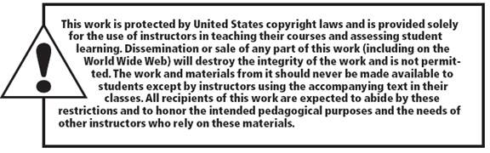
All rights reserved. No part of this publication may be reproduced, stored in a retrieval system, or transmitted, in any form or by any means, electronic, mechanical, photocopying, recording, or otherwise, without the prior written permission of the publisher. Printed in the United States of America.
Copyright ©2014 by Pearson Education, Inc. All rights reserved.

