Slide 1
Part II: Preparation/Process
Chapter 3: Communication

Slide 2
Learning Objectives
To discuss the goals and theories of modern communication as they relate to the practice of public relations.
To explore the importance and proper use of words and semantics to deliver ideas and persuade others toward one’s point of view.
To discuss the various elements that effect communication, including the media, the bias of receivers, and the individuals or entities delivering messages.
To examine the necessity of feedback in evaluating communication and formulating continued communication.

Slide 3
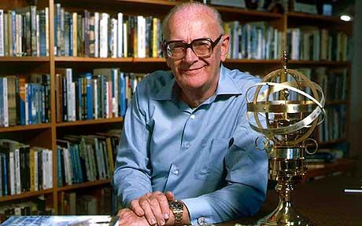
Public Relations Practitioner = Professional Communicator
The world has become a “global village”
Sir Arthur Clarke
Public relations practitioner = professional communicator
Exchange information
Impart ideas
Make oneself understood by others
Understand others in return

Slide 4
Goals of Communication
Communication goals
To inform
To persuade
To motivate
To build mutual understanding
Objective
Purpose

Slide 5
Traditional Theories of Communication
Two-step flow theory
Concentric-circle theory
Pat Jackson’s five-step process:
Build awareness
Develop latent readiness
Trigger event
Intermediate behavior
Behavioral change

Slide 6
Traditional Theories of Communication
S-E-M-D-R (Source, Encoding, Message, Decoding, Receiver)
Dissonance theory
Spiral of silence

Slide 7
Contemporary Theories of Communication
Constructivism
Coordinated management of meaning
Grunig-Hunt public relations models
Press agentry/publicity
Public information
Two-way asymmetric
Two-way symmetric

Slide 8
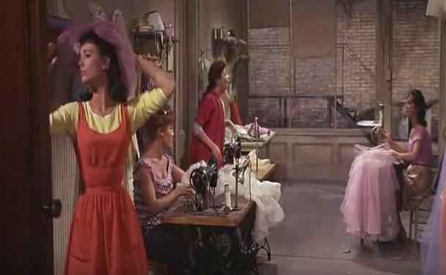
Words Matter

Slide 9
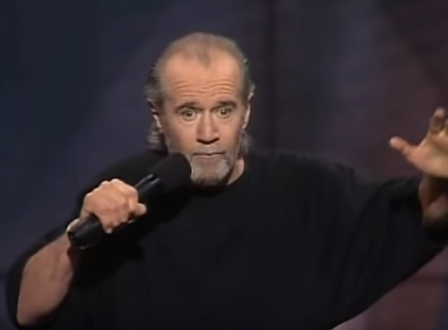
The Word
Words are perpetually changing
Denotative vs. Connotative
Gay/Gay/Gay
Understanding semantics
Words are personal and potent weapons (Examples??)
Encoding the client’s message – public relations “interpreter”
Jargon
Complexity
New concepts

Slide 10
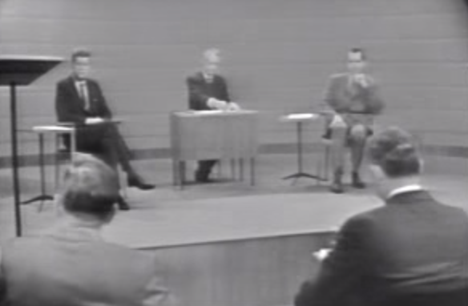
The Message
Content vs. Medium vs. Message Kennedy-Nixon TV Debate - 1960

Slide 11
The Message
The content is the message
Meaning of the article or intent of the speech most important
Medium and communicator less important than the content
The medium is the message
Content less important than the medium in which message is carried
The person is the message
The speaker can persuade, regardless of the message or medium
Charisma may play a part in persuasion
Speaker’s words, body, eyes, attitude, timing, wit, presence form a composite that influences the listener

Slide 12
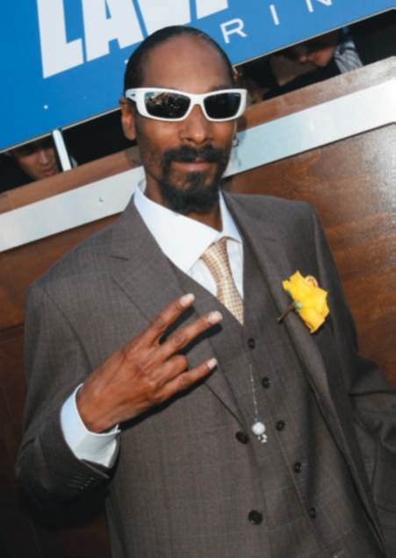
Profizzle of Lexicizzle
Rapper Snoop Dogg created a lexicon of izzle speak
Page 55
How does the changing meaning of words affect a public relations professional’s ability to interpret messages to key publics?
Figure 3-3 (Photo: Snapper Media/Splash News/Newscom)

Slide 13
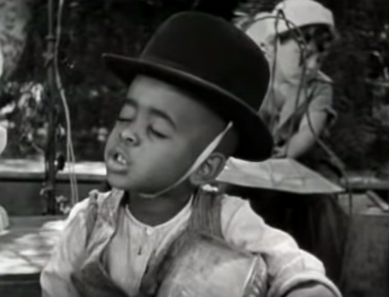
Receiver’s Bias
Message decoding depends on the person’s perception
Everyone is biased
Stereotypes
Symbols
Semantics
Peer group pressures
The media

Slide 14

Receiver’s Bias: Stereotypes and Symbols
Most people are victims of stereotypes
Stereotypes influence communication
Example: Person wearing glasses more believable
Symbols leave distinct impressions on most people
Symbols can persuade
Persuasion can be positive or negative
Figure 3-4 (Photo: Jim Sulley/newscast/Newscom)

Slide 15
Receiver’s Bias: Semantics
Use words to effectively communicate desired meanings
Same words hold contrasting meanings for different people
Language and the meaning of words change constantly
Consider consequences of words you plan to use before using them
Loaded Language
Emotional “noise”

Slide 16
Choose the correct word!
Thin, slim, lanky, skinny, gaunt, slender
Aggressive, assertive, domineering, dynamic, pushy, forceful
Shrewd, egghead, bright, clever, brilliant, cunning, smart, intelligent, brainy
Home, house, dwelling, residence

Slide 17
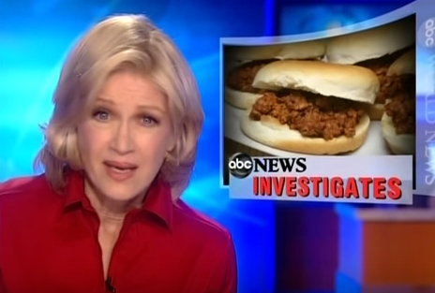
PR Ethics Mini-Case: The Name that Slimed an Industry

Slide 18
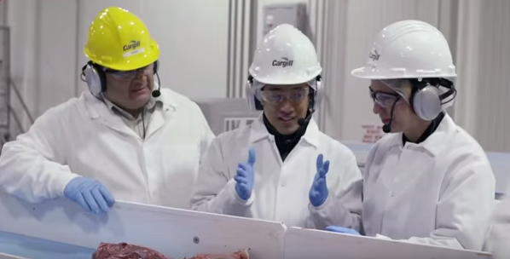
PR Ethics Mini-Case: The Name that Slimed an Industry

Slide 19
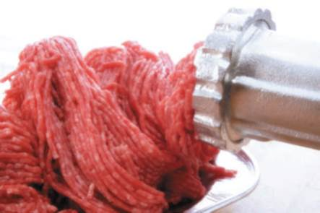
PR Ethics Mini-Case: The Name that Slimed an Industry
Page 58
How “fair” was the debate over “pink slim” and what does it say about the use of semantics in popular controversy?
If you were Beef Products, what public relations approach would you have adopted?
Figure 3-5 (Photo: Creativ Studio Heinemann/Westend61/Newscom)

Slide 20
Receiver’s Bias: Peer Groups and Media
Peer pressure influences the way messages are perceived
Peer groups influence attitudes and actions
Media is a powerful agenda setter – tells us what issues are important
“The press and the media do not reflect reality; they filter and shape it” This is what your text says. True?
Media concentration on a few issues and subjects leads the public to perceive those issues as more important than other issues
Traditional media (may have??) lost some clout due to social media, the Internet, cable news, and talk radio
The New York Times, The Washington Post and USA Today are still usually the most powerful for setting agendas

Slide 21
Feedback
Communicator must get feedback from receiver
Know what messages are or are not getting through
Know how to structure future communications
Effective communication doesn’t take place if
The message doesn’t reach the intended receivers
The message doesn’t exert the desired effect on the receivers
Effects of messages include
Attitude change
Attitude crystallization
Creation of a wedge of doubt
No effect

Slide 22
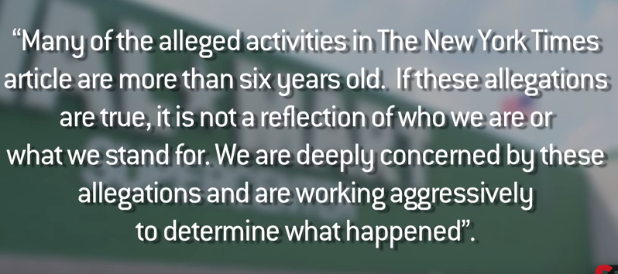
Walmart 2012 Bribery Scandal

Slide 23
Case Study: Walmart’s Bribery Shutdown
Page 61
Had you been public relations advisor to CEO Scott at the time of the bribery allegations, what would you have counseled him to do?
How would you characterize Walmart’s internal and external response to the bribery charges?
How significantly do you think the bribery allegations impacted the company’s reputation?
What should Walmart’s public relations posture be going forward, relative to the bribery charges?

Slide 24
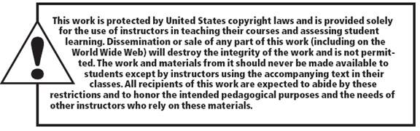
All rights reserved. No part of this publication may be reproduced, stored in a retrieval system, or transmitted, in any form or by any means, electronic, mechanical, photocopying, recording, or otherwise, without the prior written permission of the publisher. Printed in the United States of America.
Copyright © 2014 Pearson Education, Inc. All rights reserved.

