Slide 1
Part II: Preparation/Process
Chapter 4: Public Opinion
Copyright ©2014 by Pearson Education, Inc. All rights reserved.

Slide 2
Learning Objectives
To discuss the phenomenon of public opinion, contemporary examples of it, the areas that impact it, and how it is formed.
To explore the issue of attitudes, how they are influenced, motivated, and changed.
To discuss the area of persuasion, its various theories, and how individuals are persuaded.
To examine reputation, particularly corporate image, and how companies might enhance their reputation.
Copyright ©2014 by Pearson Education, Inc. All rights reserved.

Slide 3
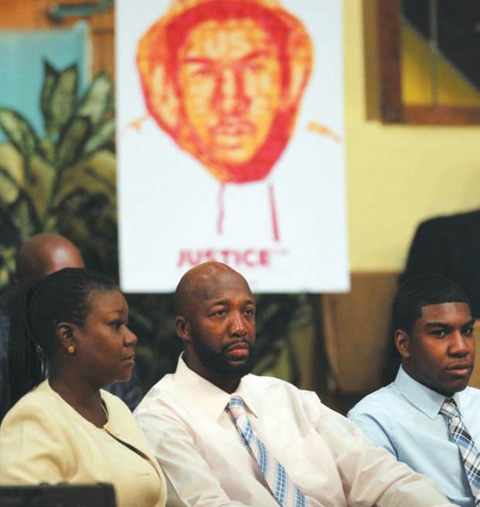
Opening Example: Trayvon Martin
Coca-Cola, Pepsi, Walmart and Johnson & Johnson supported ALEC
ALEC supported free-market solutions, voter ID AND “Stand Your Ground Laws”
Most big companies severed their memberships when civil rights activists went after them
Figure 4-1(Photo: Splash News/Newscom)
Copyright ©2014 by Pearson Education, Inc. All rights reserved.

Slide 4
You can’t pour perfume on a skunk
You cannot build trust if reality is destroying it
Public opinion is a combustible and changing commodity
It is hard to move people toward a strong opinion on anything
“You can’t put lipstick on a pig.”
Copyright ©2014 by Pearson Education, Inc. All rights reserved.

Slide 5
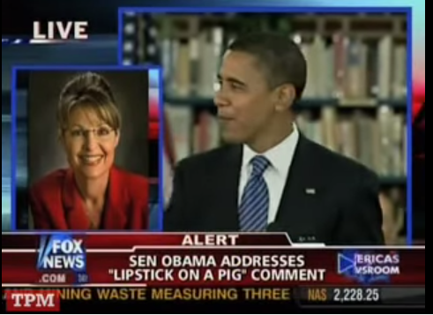
You can’t pour perfume on a skunk
…or … “You can’t put lipstick on a pig.”
Copyright ©2014 by Pearson Education, Inc. All rights reserved.

Slide 6
What is Public Opinion?
“unknown god to which moderns burn incense”
“an ill-defined, mercurial, and changeable group of individual judgments”
A group of people who share a common interest in a specific subject and their expressions of strong attitudes on a particular topic
Attitudes → Opinions → Actions
Public opinion is the aggregate of many individual opinions on a particular issue that affects a group of people
Consensus
Copyright ©2014 by Pearson Education, Inc. All rights reserved.

Slide 7
Learning Objective 1 Discussion Question
What is the relationship between public relations and public opinion?
Copyright ©2014 by Pearson Education, Inc. All rights reserved.

Slide 8
What Are Attitudes?
Evaluations people make about specific problems or issues
May differ from issue to issue
Characteristics
Personal
Cultural
Educational
Familial
Religious
Social Class
Race
Copyright ©2014 by Pearson Education, Inc. All rights reserved.

Slide 9
How Are Attitudes Influenced?
Attitudes are positive, negative or nonexistent
Person is for something, against it, or neutral
“The silent majority”
Theory of cognitive dissonance
Avoid dissonant/opposing information
Seek consonant/supportive information
Social judgment theory
Range of opinions anchored by a clear attitude
Work within latitude of acceptance to modify opinions
Copyright ©2014 by Pearson Education, Inc. All rights reserved.

Slide 10
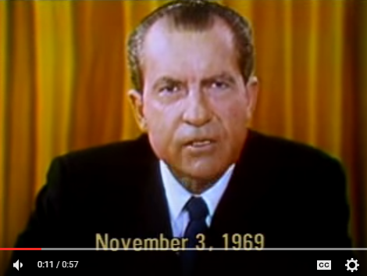

Slide 11

Motivating Attitude Change
Everyone is motivated by different needs and wants
Maslow’s Hierarchy of Needs
Physiological
Safety
Love
Esteem
Self-actualization
Elaboration Likelihood Model
Central route
Peripheral route
Copyright ©2014 by Pearson Education, Inc. All rights reserved.

Slide 12
Discussion Questions
What are attitudes, and on what characteristics are they based?
How are attitudes influenced? Provide an example that demonstrates the application of one of the theories we discussed?
Copyright ©2014 by Pearson Education, Inc. All rights reserved.

Slide 13
Power of Persuasion
Persuading is the goal of most public relations programs
Getting someone to do something through advice, reasoning or arm-twisting
Classic persuasion theory – people may be of two minds
Systematic mode (carefully considers argument)
Heuristic mode (skimming the surface)
People are persuaded by different things, so persuasion is more of an art than a science
Copyright ©2014 by Pearson Education, Inc. All rights reserved.

Slide 14
Kinds of Evidence that Persuade
Facts (empirical data)
Emotions (emotional appeals)
Personalizing (personal experience)
Appealing to “you” (appeal to audience)
Emotion may be difficult for some to grasp (e.g. business leaders)
Copyright ©2014 by Pearson Education, Inc. All rights reserved.

Slide 15
Influencing Public Opinion
Public relations program can crystallize attitudes, reinforce beliefs, change public opinion
Opinions to be changed or modified must be identified and understood
Target publics must be clear
Sharp focus on the “laws” that govern public opinion
Copyright ©2014 by Pearson Education, Inc. All rights reserved.

Slide 16
Laws of Public Opinion
Opinion is highly sensitive to important events
Opinions is generally determined more by events than by words – unless those words are themselves interpreted as an event
At critical times, people become more sensitive to the adequacy of their leadership
Confident – more responsibility to it
Lack confidence – less tolerant than usual
Copyright ©2014 by Pearson Education, Inc. All rights reserved.

Slide 17
Laws of Public Opinion
Once self-interest is involved, opinions are slow to change
People have more opinions and are able to form opinions more easily on goals than on methods to reach goals
People in democracies with educational opportunities/information access display hardheaded common sense
Copyright ©2014 by Pearson Education, Inc. All rights reserved.

Slide 18
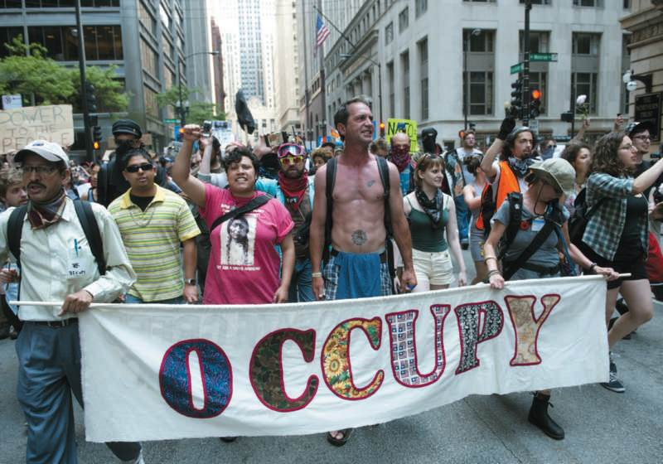
PR Ethics Mini-Case: Occupy: Si, Changing Public Opinion: Not Exactly
Page 73
How successful do you believe Occupy Wall Street was?
Had you been running the movement’s public relations initiative, how would you have improved its approach?
Figure 4-4 (Photo: SAUL LOEB/AFP/Getty Images/Newscom)
Copyright ©2014 by Pearson Education, Inc. All rights reserved.

Slide 19
Learning Objective 4
To examine reputation, particularly corporate image, and how companies might enhance their reputation.
Copyright ©2014 by Pearson Education, Inc. All rights reserved.

Slide 20
Polishing the Corporate Image
Organizations have little choice but to go public
Examples
ExxonMobile 2008 climate change
GM, Chrysler, Ford in 2009
Ponzi schemes in 2010 and 2011
JP Morgan Chase $2 billion trading loss in 2012
Credibility is fragile
Winning favorable public opinion is a necessity for long-term success
Copyright ©2014 by Pearson Education, Inc. All rights reserved.

Slide 21
Managing Reputation
Reputation is gained by what one does not by what one says
Reputation management is a buzzword
Relationship management aligns communications with an organization’s character and action
Creates recognition, credibility and trust among key constituents
Stays sensitive to its conduct in public with customers and in private with employees
Understands responsibilities to broader society and is empathetic to society’s needs
Value of reputation is indisputable
Copyright ©2014 by Pearson Education, Inc. All rights reserved.

Slide 22
Learning Objective 4 Discussion Questions
What are the elements involved in managing reputation?
In assessing the list of best and worst companies in terms of reputation, what specific characteristics influence these rankings?
Copyright ©2014 by Pearson Education, Inc. All rights reserved.

Slide 23
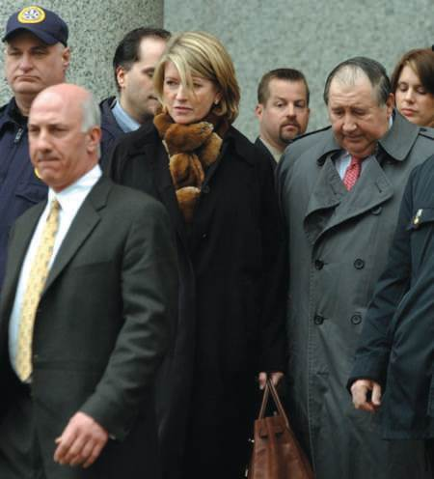
Case Study: The Rise and Fall and Rise of Queen Martha
Page 78
How would you characterize Martha Stewart’s initial public relations response to the charges against her?
What key public relations principle did Martha Stewart violate?
Had you been advising her, what public relations strategy and tactics would you have recommended? How “vocal” should she have been?
How important, from a public relations perspective, was her decision to go to jail early?
What public relations strategy should Stewart adopt now?
Should she acknowledge that she made mistakes?
Figure 4-6 (Photo: Justin LANE/EPA/Newscom)
Copyright ©2014 by Pearson Education, Inc. All rights reserved.

Slide 24
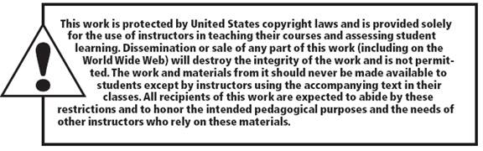
All rights reserved. No part of this publication may be reproduced, stored in a retrieval system, or transmitted, in any form or by any means, electronic, mechanical, photocopying, recording, or otherwise, without the prior written permission of the publisher. Printed in the United States of America.
Copyright © 2014 Pearson Education, Inc. All rights reserved.
Copyright ©2014 by Pearson Education, Inc. All rights reserved.

