Slide 1
Part II: Preparation/Process
Chapter 6: Ethics
Copyright ©2014 by Pearson Education, Inc. All rights reserved.

Slide 2
Learning Objectives
To discuss the one aspect that should differentiate public relations from the law and other business pursuits—ethics.
To explore ethics—or the lack thereof—in today’s business, government, media, and public relations cultures.
To discuss the concept of corporate social responsibility.
To underscore the bedrock importance of public relations professionals “doing the right thing.”
Copyright ©2014 by Pearson Education, Inc. All rights reserved.

Slide 3
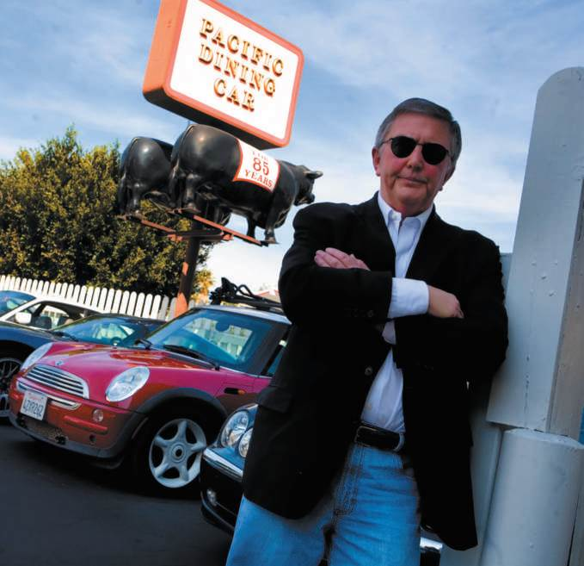
Opening Example: Former Fleishman-Hillard Head Douglas Dowie
Defrauded Los Angeles taxpayers by padding consulting bills
Overcharged city’s Department of Water and Power about $50K a month for three years
Dowie and two Fleishman-Hillard subordinates were fined and sent to prison
Figure 6-1 (Photo: ZUMA Press/Newscom)
Copyright ©2014 by Pearson Education, Inc. All rights reserved.

Slide 4
Learning Objective 1
To discuss the one aspect that should differentiate public relations from the law and other business pursuits—ethics.
Copyright ©2014 by Pearson Education, Inc. All rights reserved.

Slide 5
Public Relations Professionals Must Conduct Themselves Ethically
2010 FTC complaint against Reverb Communications
2011 Lanny Davis resigned as public relations representative for Ivory Coast leader Laurent Gbagbo
2012 Walmart fired Mercury Public Relations for ruse
Earn credibility by telling the truth and doing the right thing
Copyright ©2014 by Pearson Education, Inc. All rights reserved.

Slide 6
What are ethics?
Right vs. wrong
Religious beliefs
Law
Acceptable standards of behavior
Utilitarianism (greatest good for greatest number)
Deontology (do what is right though the world should perish)
Do the right thing
Cardinal rule of public relations: Never, ever lie
Copyright ©2014 by Pearson Education, Inc. All rights reserved.

Slide 7
Learning Objective 1
Discussion Question
How would you define ethics?
Copyright ©2014 by Pearson Education, Inc. All rights reserved.

Slide 8
Learning Objective 2
To explore ethics—or the lack thereof—in today’s business, government, media, and public relations cultures.
Copyright ©2014 by Pearson Education, Inc. All rights reserved.

Slide 9
Unethical Behavior
Government
  Carley Rangel
  Anthony Weiner
  Operation Fast and Furious
  Scott McClellan
Business
  Insider trading
  Bernie Madoff, Allen Stanford, Raj Rajaratnam, Rajat Gupta
Sports
  Steroids scandal (Mark McGwire, Roger Clemens, Sammy Sosa)
  Lance Armstrong
Education (Penn State)
Catholic Church
Copyright ©2014 by Pearson Education, Inc. All rights reserved.

Slide 10
PRSA Member Code of Ethics 2000
Advocacy
Honesty
Expertise
Independence
Loyalty
Fairness
Copyright ©2014 by Pearson Education, Inc. All rights reserved.

Slide 11
Do the Right Thing
Josephson Institute: ethics are “standards of conduct that indicate how one should behave based on moral duties and virtues”
  Right vs. wrong
  Fairness vs. unfairness
  Honesty vs. dishonesty
Ethics depend on culture, religion, education
Copyright ©2014 by Pearson Education, Inc. All rights reserved.

Slide 12
Perspectives on Ethics
Utilitarianism – “greater good”
Golden mean of moral virtue – between two extremes
Categorical imperative – act on maxim you will to become universal law
Principle of utility – greatest happiness for greatest number
Judeo-Christian ethic – love neighbor as thyself
Copyright ©2014 by Pearson Education, Inc. All rights reserved.

Slide 13
Applied Ethics
Professional ethics
Public relations people must always tell the truth
Honesty and fairness are at the heart of public relations
Are we doing the right thing?
Copyright ©2014 by Pearson Education, Inc. All rights reserved.

Slide 14
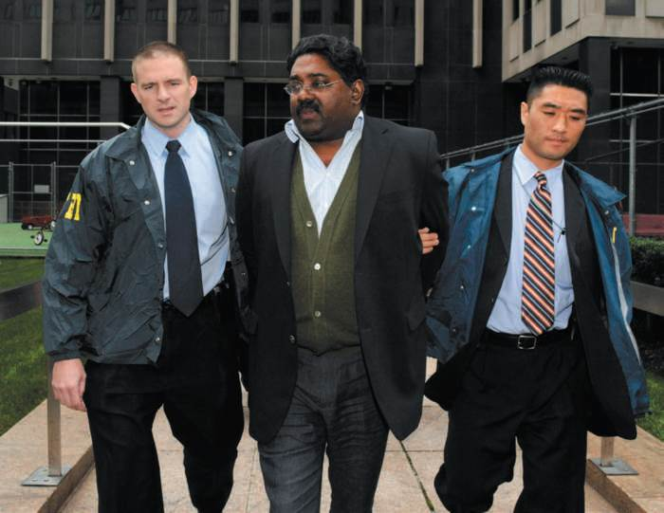
Ethics in Business
Why do people think business ethics is an oxymoron?
Investments in ethics and compliance programs
Corporate Codes of Conduct
  Increase public confidence
  Stem tide of regulation
  Improve internal operations
  Respond to transgressions
Figure 6-3 (Photo: BRENDAN MCDERMID/REUTERS/ Newscom)
Copyright ©2014 by Pearson Education, Inc. All rights reserved.

Slide 15
Learning Objective 2
Discussion Questions
How important is the ethical component of the practice of public relations?
Why have corporations adopted corporate codes of conduct?
Copyright ©2014 by Pearson Education, Inc. All rights reserved.

Slide 16
Learning Objective 3
To discuss the concept of corporate social responsibility.
Copyright ©2014 by Pearson Education, Inc. All rights reserved.

Slide 17
Corporate Social Responsibility
How companies manage business processes for a positive societal impact
Product lines
Marketing practices
Corporate philanthropy
Environmental activities
External relations
Employment diversity in retaining and promoting minorities and women
Employee safety and health
Copyright ©2014 by Pearson Education, Inc. All rights reserved.

Slide 18
Ethics in Government
24-hour cable news, 24/7 blogosphere increase scrutiny
Sleaze factor poisons politics
  Elliott Spitzer
  Mark Sanford
  Anthony Weiner
  Herman Cain
  John Edwards
Copyright ©2014 by Pearson Education, Inc. All rights reserved.

Slide 19
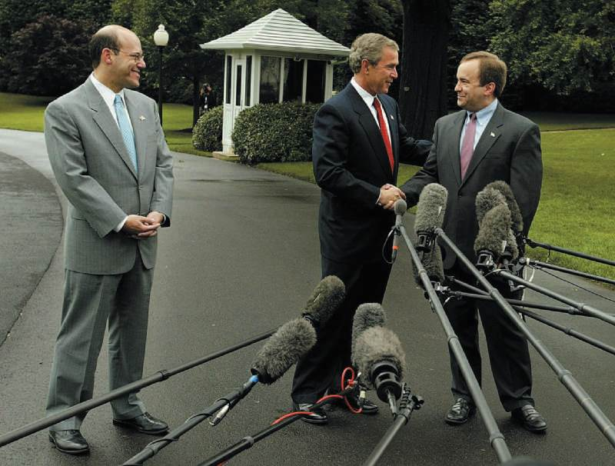
PR Ethics Mini-Case: The Sad Memoir of Scott McClellan
Page 115
How would you assess Scott McClellan’s ethical responsibility to be loyal to his boss versus his ethical responsibility to reveal what happened at the White House?
What are the public relations ethical considerations revealed by the McClellan case?
Figure 6-4 (Photo: Shawn Thew/EPA/Newscom)
Copyright ©2014 by Pearson Education, Inc. All rights reserved.

Slide 20
Ethics in Journalism
Respect dignity, privacy, rights and well-being of people when gathering and presenting news
Do not communicate unofficial charges affecting reputation or moral character without giving accused chance to reply
Guard against invading a person’s right to privacy
Do not pander to morbid curiosity about details of vice and crime
Judgments against ethical standards
  Plagiarism in The New York Times, Washington Post, Boston Globe
  Refusal to reveal sources/suppressing news
  Get stories at any cost/pay for stories
  Screamers
Copyright ©2014 by Pearson Education, Inc. All rights reserved.

Slide 21
Learning Objective 3
Discussion Question
What is corporate social responsibility?
Copyright ©2014 by Pearson Education, Inc. All rights reserved.

Slide 22
Learning Objective 4
To underscore the bedrock importance of public relations professionals “doing the right thing.”
Copyright ©2014 by Pearson Education, Inc. All rights reserved.

Slide 23
Ethics in Public Relations
Differentiates public relations from other professions
Relevant ethical theories
  Attorney/adversary model
    Lawyers and public relations are advocates in an adversarial climate
    Both assume counterbalancing messages will be provided by adversaries
  Two-way communication model
    Collaborate, work jointly with people, listen and give-and-take
    Balance role as advocate with one as social conscience
  Responsible advocacy model
    Professional responsibility: first loyalty to clients
    Responsibility to voice opinions of organizational stakeholders
Copyright ©2014 by Pearson Education, Inc. All rights reserved.

Slide 24
Six Core Values
Advocacy – act as responsible advocates; never reveal confidential or private client information
Honesty – don’t embellish or lie
Expertise – guide client decision-making
Independence – strike an independent tone
Loyalty – loyalties must remain constant
Fairness – treat even obnoxious reporters with fairness
Copyright ©2014 by Pearson Education, Inc. All rights reserved.

Slide 25
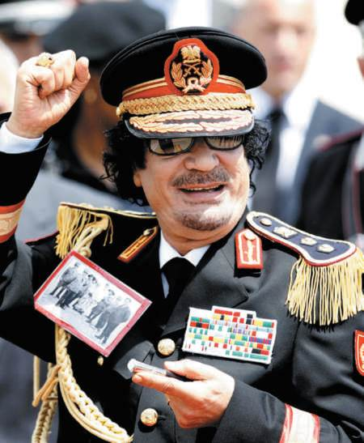
Defending a Dictator
Middle East dictators sought help from U.S. PR firms and scholars
Many accepted blood money and attempted to portray dictators in a positive light
What are the ethical implications associated with representing someone who does not “do the right thing?”
Figure 6-8 (Photo: Donatella Giagnori/ZUMA Press/Newscom)
Copyright ©2014 by Pearson Education, Inc. All rights reserved.

Slide 26
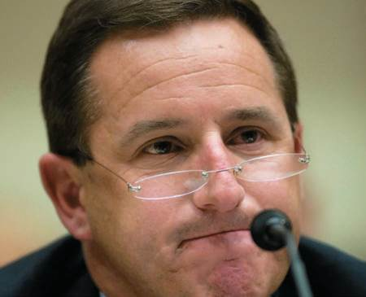
Case Study: Doing the Right Thing by Making a “Hurd” Decision
Page 122
What other options did Hewlett-Packard have in dealing with Mark Hurd?
Do you think the board did the right thing?
Had HP decided to slap its CEO on the wrists for his infraction, what might have been the outcome for the company?
Figure 6-9 (Photo: MANDEL NGAN/AFP/Getty Images/Newscom)
Copyright ©2014 by Pearson Education, Inc. All rights reserved.

Slide 27
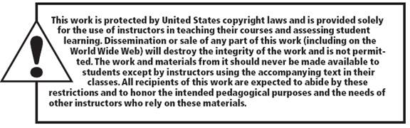
All rights reserved. No part of this publication may be reproduced, stored in a retrieval system, or transmitted, in any form or by any means, electronic, mechanical, photocopying, recording, or otherwise, without the prior written permission of the publisher. Printed in the United States of America.
Copyright © 2014 Pearson Education, Inc. All rights reserved.
Copyright ©2014 by Pearson Education, Inc. All rights reserved.

