Slide 1
Part II: Preparation/Process
Chapter 7: The Law
Copyright ©2014 by Pearson Education, Inc. All rights reserved.

Slide 2
Learning Objectives
To discuss the relationship between public relations professionals and lawyers and the importance to public relations practitioners of understanding the law.
To explore, in particular, the First Amendment, from which free speech emerges.
To discuss the various areas of the law relevant to public relations professionals, including defamation, disclosure, insider trading, copyright and Internet law.
To underscore the new importance in the 21st century of litigation public relations.
Copyright ©2014 by Pearson Education, Inc. All rights reserved.

Slide 3

Opening Example: Taco Bell
Lawsuit – taco mixture contained more fiber than meat
Taco Bell publicized lawsuit on Facebook and YouTube: “Thank You for Suing Us.”
Viral and public rebuttal squelched potential publicity about the negative lawsuit
Figure 7-1 (Photo: Tonya Wise/London Ent/Splash/Newscom)
Copyright ©2014 by Pearson Education, Inc. All rights reserved.

Slide 4
Learning Objective 1
To discuss the relationship between public relations professionals and lawyers and the importance to public relations practitioners of understanding the law.
Copyright ©2014 by Pearson Education, Inc. All rights reserved.

Slide 5
Difference in Legal vs. Public Relations Advice
Lawyers advise clients on what they must do, within legal requirements, to defend themselves in a court of law
Public relations advisors counsel clients on what the should do to defend themselves in the court of public opinion
Public relations and the law both begin with the First Amendment – freedom of speech
Copyright ©2014 by Pearson Education, Inc. All rights reserved.

Slide 6
Public Relations and the Law: An Uneasy Alliance
Public relations must understand legal implications
Firm’s legal position must be first consideration
Lawyer: “Say nothing, and say it slowly!”
Public Relations: Go public early
Copyright ©2014 by Pearson Education, Inc. All rights reserved.

Slide 7
Learning Objective 1: Discussion Question
What is the difference between a public relations professional’s responsibility and a lawyer’s responsibility?
Copyright ©2014 by Pearson Education, Inc. All rights reserved.

Slide 8
Learning Objective 2
To explore, in particular, the First Amendment, from which free speech emerges.
Copyright ©2014 by Pearson Education, Inc. All rights reserved.

Slide 9
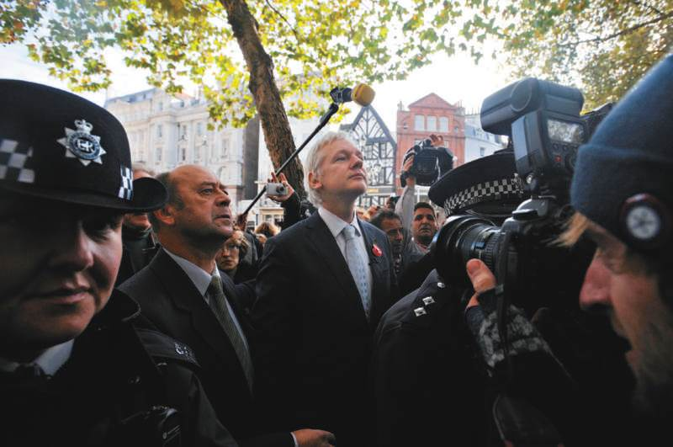
Public Relations and the First Amendment
First Amendment = cornerstone of free speech in our society
Interpreting the First Amendment is a challenge
Example: WikiLeaks
Defending First Amendment is frontline responsibility of public relations professionals
Figure 7-3 (Photo: FACUNDO ARRIZABALAGA/EPA/Newscom)
Copyright ©2014 by Pearson Education, Inc. All rights reserved.

Slide 10
Learning Objective 2: Discussion Question
What have been recent challenges to the First Amendment?
Copyright ©2014 by Pearson Education, Inc. All rights reserved.

Slide 11
Learning Objective 3
To discuss the various areas of the law relevant to public relations professionals, including defamation, disclosure, insider trading, copyright and Internet law.
Copyright ©2014 by Pearson Education, Inc. All rights reserved.

Slide 12
Public Relations and Defamation Law
Defamation is umbrella term used to describe libel (printed falsehood) and slander (oral falsehood)
Requirements for defamation:
Falsehood communicated through print, broadcast, or other electronic means
Subject of falsehood was identified or easily identifiable
Identified person suffered injury (monetary loss, reputation loss, mental suffering)
Privacy of ordinary citizen protected
More difficult if in limelight
Copyright ©2014 by Pearson Education, Inc. All rights reserved.

Slide 13
Public Figures and Defamation
Show media acted with actual malice
Statements published with the knowledge they were false
Reckless disregard for whether the statements were false
Proving actual malice is difficult
Definition of defamation becoming more complex and global with proliferation of blogs, tweets, Facebook posts, cable and radio talk shows
Copyright ©2014 by Pearson Education, Inc. All rights reserved.

Slide 14
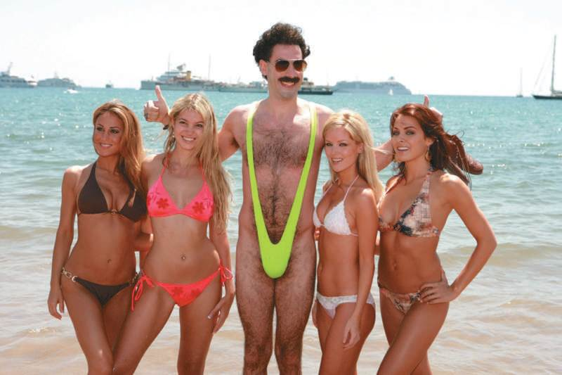
Defamation Cases and Implications
Celebrities frequently sue for defamation
Sacha Baron Cohen won defamation case: attempt at ironic commentary
Staples lost case where they circulated a truth but showed actual malice
Take care in written and verbal communications
Figure 7-4 (Photo: GOLD/MILLER PRODUCTIONS/Album/Newscom)
Copyright ©2014 by Pearson Education, Inc. All rights reserved.

Slide 15
Public Relations and Insider Trading
Public companies must deal frankly, comprehensively and immediately with material information
Material information might cause an investor to buy, hold, or sell a stock
All investors should have an opportunity to learn about material information as promptly as possible
Companies cannot disseminate false or misleading information to investors
Insiders cannot trade securities on the basis of material information that is not available to the public
Copyright ©2014 by Pearson Education, Inc. All rights reserved.

Slide 16
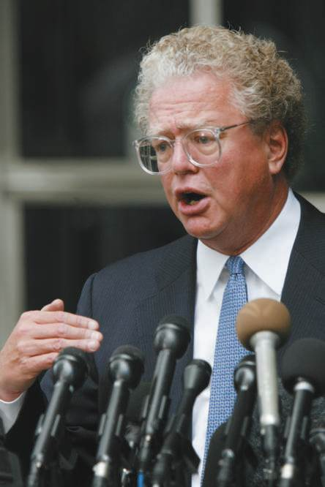
Criminal Attorneys - Literally
Page 133
Richard Scruggs – attempted bribery
Melvyn Weiss – using kickbacks in class actions
William Lerach – using kickbacks in class actions
Figure 7-5: (Photo: Steve Ueckert/Rapport Press/Newscom)
Copyright ©2014 by Pearson Education, Inc. All rights reserved.

Slide 17
Public Relations and Disclosure Law
Information that companies disseminate must be accurate
Disclose vs. withholding material information
SEC increased focus on private meetings between companies and analysts
Fair disclosure = companies are required to widely disseminate any material announcement
If information shared with analyst, company obligated to issue a news release within 24 hours
Sarbanes-Oxley – publicly traded companies increase financial disclosure and annual report on accounting practice effectiveness
Copyright ©2014 by Pearson Education, Inc. All rights reserved.

Slide 18
Public Relations and Ethics Law
Campaign finance reform
Proliferation of Super PACs
Copyright ©2014 by Pearson Education, Inc. All rights reserved.

Slide 19
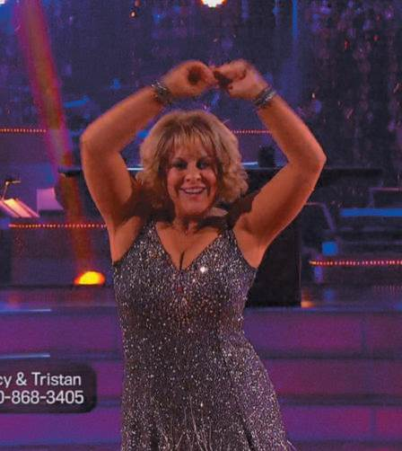
PR Ethics Mini-Case: Fall from Grace
Page 135
Have you any objection to Nancy Grace’s opinions in the ongoing legal cases cited here?
What were the public relations implications for Grace’s network, HLN, with respect to its outspoken lawyer?
Figure 7-6 (Photo: Steve Ueckert/Rapport Press/Newscom)
Copyright ©2014 by Pearson Education, Inc. All rights reserved.

Slide 20
Public Relations and Copyright Law
Original work of authorship has copyright protection when work is in “fixed” form
Fixed means the work is permanent enough to be perceived, reproduced, or otherwise communicated
Copyright owners have exclusive right to reproduce and authorize others to reproduce the work, prepare derivative works, and perform and/or display the work publicly
News reporting, teaching, scholarship, research use of copyrighted material is not infringement; fair use
Fair use depends on volume, future market, and heart
Copyright ©2014 by Pearson Education, Inc. All rights reserved.

Slide 21
Freelance Artist and Writers
Freelancers retain the right to copyright what they create
Public relations professionals must document the authorization to use freelance work
Copyright ©2014 by Pearson Education, Inc. All rights reserved.

Slide 22
Public Relations and Internet Law
Not all speech is created equal
Censorship – Communications Decency Act
Children’s Online Privacy Protection Act
Intellectual Property – Stop Online Piracy Act defeated
Music downloads
Video games
Software
Movies and books
Cybersquatting – shake down rightful registrant
E-Fraud and click fraud
Copyright ©2014 by Pearson Education, Inc. All rights reserved.

Slide 23
Social Media
Legal issues related to employee relations and social media
Illegal to fire an employee who criticizes his/her supervisor on his/her Facebook page?
Employers review Internet and social media policies to see if vulnerable to allegations of rights limitations
Copyright ©2014 by Pearson Education, Inc. All rights reserved.

Slide 24
Learning Objective 3 Discussion Questions
How can someone prove that he or she has been libeled or slandered?
What are some of the dominant issues in laws affecting the Internet?
Copyright ©2014 by Pearson Education, Inc. All rights reserved.

Slide 25
Learning Objective 4
To underscore the new importance in the 21st century of litigation public relations.
Copyright ©2014 by Pearson Education, Inc. All rights reserved.

Slide 26
Litigation Public Relations
Plaintiffs and defendants try to influence the verdict outside the courtroom
Litigation public relations is managing the media process during a legal dispute to affect the outcome or its impact on the client’s overall reputation
Affects Sixth Amendment guarantee of an impartial jury
Communication is central to modern litigation
Copyright ©2014 by Pearson Education, Inc. All rights reserved.

Slide 27

Litigation Visibility
Learn the process
Develop a message strategy
Settle fast
Anticipate high-profile variables
Keep the focus positive
Try settling again
Fight nicely
Figure 7-7 (Courtesy of Institute for Justice, photo by Don Wilson)
Copyright ©2014 by Pearson Education, Inc. All rights reserved.

Slide 28
Learning Objective 4 Discussion Question
Provide an example of a situation where lawyers used the guidelines associated with litigation visibility to affect the outcome of a case.
Copyright ©2014 by Pearson Education, Inc. All rights reserved.

Slide 29
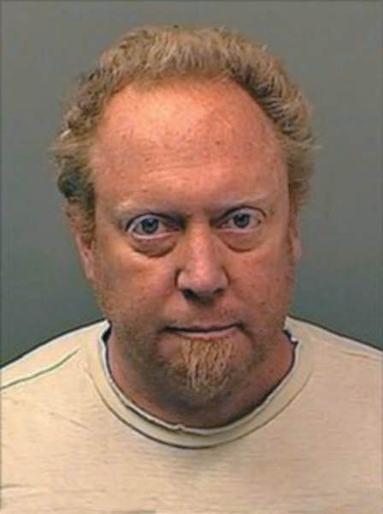
Case Study: Amazon Shuts Free Speech Door on Pedophile Book
Page 142
Do you agree with Amazon’s first or second decision?
Where should Amazon draw the line on distributing books that contain questionable content?
What do you think of Amazon’s public relations posture in this case?
Figure 7-8 (Photo: PacificCoastNews/Newscom)
Copyright ©2014 by Pearson Education, Inc. All rights reserved.

Slide 30
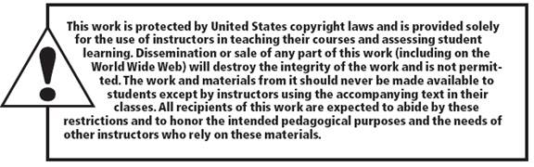
All rights reserved. No part of this publication may be reproduced, stored in a retrieval system, or transmitted, in any form or by any means, electronic, mechanical, photocopying, recording, or otherwise, without the prior written permission of the publisher. Printed in the United States of America.
Copyright © 2014 Pearson Education, Inc. All rights reserved.
Copyright ©2014 by Pearson Education, Inc. All rights reserved.

