Slide 1
Part II: Preparation/Process
Chapter 8: Research
Copyright ©2014 by Pearson Education, Inc. All rights reserved.

Slide 2
Learning Objectives
To discuss the importance of research as the essential first step in every public relations assignment.
To explore research principles, types, and methods.
To discuss the various research tools and evaluative techniques available to public relations professionals.
To underscore the importance of web monitoring and tools available for Internet research.
Copyright ©2014 by Pearson Education, Inc. All rights reserved.

Slide 3
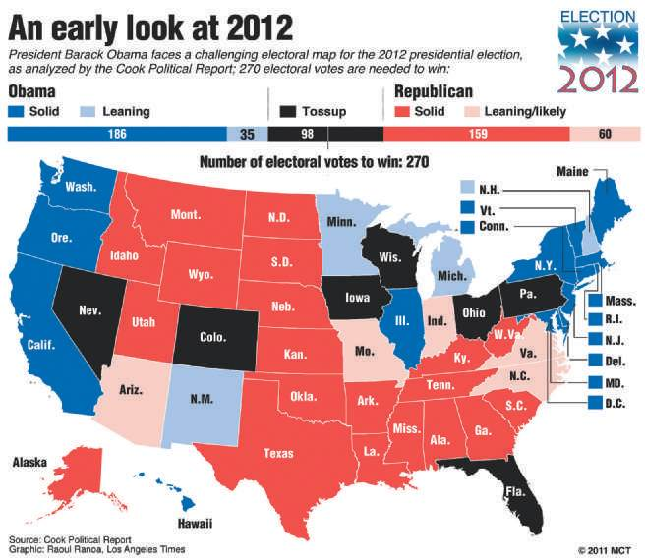
Opening Example: 2012 Presidential Election
Muddled middle dominated the election
Numbers may be correct but interpretation of numbers may not be
“Figures lie, and liars figure”
Figure 8-1 (Photo: Ranoa/MCT/Newscom)
Copyright ©2014 by Pearson Education, Inc. All rights reserved.

Slide 4
Learning Objective 1
To discuss the importance of research as the essential first step in every public relations assignment.
Copyright ©2014 by Pearson Education, Inc. All rights reserved.

Slide 5
Research as a Starting Point
Research is foundation for sensible programmatic initiative
Must be complemented by analysis and judgment
Managers want proof that advice is based on logic and clear thinking
Ground advice in hard data
Copyright ©2014 by Pearson Education, Inc. All rights reserved.

Slide 6
Essential First Step
Demonstrate efforts contribute to bottom line
Outputs – Did we get the coverage we wanted?
Outtakes – Did our target audience see and/or believe our messages?
Outcomes – Did audience behavior or relationships change, and did sales increase?
Public relations programs must help meet business objectives
Segment market targets
Analyze audience preferences and dislikes
Determine which messages might be most effective
Initial stage and final stage of campaign
Copyright ©2014 by Pearson Education, Inc. All rights reserved.

Slide 7
Learning Objective 1 Discussion Question
Why is research important in public relations work?
Copyright ©2014 by Pearson Education, Inc. All rights reserved.

Slide 8
Learning Objective 2
To explore research principles, types, and methods.
Copyright ©2014 by Pearson Education, Inc. All rights reserved.

Slide 9
What is Research?
Systematic collection and interpretation of information to increase understanding
Answer questions for accurate information about publics:
How can we identify and define our constituent groups?
How does this knowledge relate to the design of our messages?
How does it relate to the design of our programs?
How does it relate to the media we use to convey our messages?
How does it relate to the schedule we adopt in using our media?
How does it relate to the ultimate implementation tactics of our program?
Copyright ©2014 by Pearson Education, Inc. All rights reserved.

Slide 10
Principles of Public Relations Research
Establish clear program objectives and desired outcomes tied to business goals
Differentiate between measuring outputs and outcomes
Measure media content as first step
Understand that no one technique can evaluate effectiveness
Be wary of attempts to compare public relations effectiveness with advertising effectiveness
Most trustworthy measurement of public relations effectiveness stems from organization with clear key messages, target audiences and desired channels
Copyright ©2014 by Pearson Education, Inc. All rights reserved.

Slide 11

Figures and Faces - Lie
Each woman selected as “lovelier” 50% of the time
When one named Jennifer and the other Gertrude, Jennifer voted lovelier 80% of the time (regardless of which picture is assigned with the name)
Implication: People introduce their own biases
Figure 8-2 (Courtesy of Fraser P. Seitel)
Copyright ©2014 by Pearson Education, Inc. All rights reserved.

Slide 12
Types of Public Relations Research
Describe a process, situation, or phenomenon
Explain why something is happening, what its causes are, what effect it will have
Predict what will happen if we do/don’t take action
Applied research solves practical problems
Theoretical research aids understanding of a public relations process
Secondary research relies on existing material (e.g. books, articles, databases, etc.)
Copyright ©2014 by Pearson Education, Inc. All rights reserved.

Slide 13
Applied Research: Strategic or Evaluative
Strategic Research – used in program development to:
Determine program objectives
Develop message strategies,
Establish benchmarks
Evaluative Research – summative research
Conducted primarily to determine whether public relations program accomplished goals and objectives
Can also be used for monitoring
Copyright ©2014 by Pearson Education, Inc. All rights reserved.

Slide 14
Theoretical Research
More abstract and conceptual
Builds theories/frameworks for persuasion
High credibility sources important (trustworthy, experts, powerful)
Simple messages easier to understand, localize, make relevant
Persuasiveness increased when involvement is high
Copyright ©2014 by Pearson Education, Inc. All rights reserved.

Slide 15
Secondary Research
Cheap – based on someone else’s primary research
Desk research
Database monitoring
Use to launch research effort
Copyright ©2014 by Pearson Education, Inc. All rights reserved.

Slide 16
Methods of Public Relations Research
Surveys reveal attitudes and opinions
Communications audits reveal differences between real and perceived communications between management and target audiences
Unobtrusive measures like fact-finding, content analysis, readability studies allow study without intrusion
Copyright ©2014 by Pearson Education, Inc. All rights reserved.

Slide 17
Surveys
Most frequently used research method
Descriptive surveys offer snapshot of a current situation or condition
Explanatory surveys are concerned with cause and effect
Four elements
Sample – selected target group; representative of total public
Questionnaire
Interviews
Analysis
Copyright ©2014 by Pearson Education, Inc. All rights reserved.

Slide 18
Sample
Random Sample – Equality and Independence
Simple Random Sampling
Systematic Random Sampling
Stratified Random Sampling
Cluster Sampling
Nonrandom Sample
Convenience
Quota
Volunteer
Copyright ©2014 by Pearson Education, Inc. All rights reserved.

Slide 19
Questionnaire
Keep it short
Use structured (vs. open-ended) questions
Measure intensity of feelings
Don’t use fancy/unclear words
Don’t ask loaded or double-barreled questions
Pretest
Attach letter explaining importance
Hand-stamp envelopes when mailed
Follow up your first mailing
Send out more questionnaires than you think you need
Enclose a reward
Copyright ©2014 by Pearson Education, Inc. All rights reserved.

Slide 20
Interviews
Random people or Delphi panel
Focus Groups
Telephone Interviews
Email Interviews
Drop-Off Interviews
Intercept Interviews
Delphi Panels
Internet Interviews
Copyright ©2014 by Pearson Education, Inc. All rights reserved.

Slide 21
Results Analysis
Valid and Reliable results
Margin of error
Statistical significance
Copyright ©2014 by Pearson Education, Inc. All rights reserved.

Slide 22

PR Ethics Mini-Case: Sleep-Deprived Research
Page 159
Were you Sleepy’s, would you have distributed this research to the media?
Were you The New York Times, would you have run an article based on the research?
Figure 8-6 (Photo: J. KYLE KEENER KRT/Newscom)
Copyright ©2014 by Pearson Education, Inc. All rights reserved.

Slide 23
Learning Objective 3
To discuss the various research tools and evaluative techniques available to public relations professionals.
Copyright ©2014 by Pearson Education, Inc. All rights reserved.

Slide 24
Communications Audits
Help public relations professionals understand relationships between management actions and objectives and communications methods to promote those objectives
Analyze company’s standing with employees/community neighbors
Assess readership of annual reports and news releases
Examine organization’s performance as corporate citizen
Part of process of measurement and performance improvement
Copyright ©2014 by Pearson Education, Inc. All rights reserved.

Slide 25
Unobtrusive Methods
Fact-finding
Content analysis
Copy testing
Case study research
Copyright ©2014 by Pearson Education, Inc. All rights reserved.

Slide 26
Evaluation
Results analyzed for meaning and action
Measure results against established objectives
Accountability = taking responsibility for achieving the performance promised
Outcome evaluation measures
Target received messages
Target paid attention to messages
Target understood messages
Target retained messages
Target acted on messages
Copyright ©2014 by Pearson Education, Inc. All rights reserved.

Slide 27
Measuring Public Relations Outcomes
Awareness and Comprehension Measurement
Recall and Retention Measurement
Attitude and Preference Measurement
Behavior Measurements
Copyright ©2014 by Pearson Education, Inc. All rights reserved.

Slide 28
Learning Objective 3: Discussion Questions
What kinds of tools are used to measure public relations outcomes?
Why is evaluation important in public relations research?
Copyright ©2014 by Pearson Education, Inc. All rights reserved.

Slide 29
Learning Objective 4
To underscore the importance of Web monitoring and tools available for Internet research.
Copyright ©2014 by Pearson Education, Inc. All rights reserved.

Slide 30
Research and the Web
Web Analytics
Unique Visitors
Returning Visitors
Costs per click through
Total time spent on a site
Downloads
Costs per contact
Links from other sites
Google Page Rank
Content popularity
Sales
Search Engine Optimization
Hits, Eyeballs, and Google Analytics
Copyright ©2014 by Pearson Education, Inc. All rights reserved.

Slide 31
Web Research Considerations
Establish objectives
Determine criteria
Determine benchmarks
Select the right measurement tool
Compare results to objectives
Draw actionable conclusions
Copyright ©2014 by Pearson Education, Inc. All rights reserved.

Slide 32
Learning Objective 4: Discussion Question
What are the characteristics that can be measured in Web-based research?
Copyright ©2014 by Pearson Education, Inc. All rights reserved.

Slide 33
Case Study: Researching a Position for Alan Louis General
Page 164
What kind of communications program would you launch to accomplish Rapcorn’s objectives?
What would be the cornerstone—the theme—of your communications program?
What would be the specific elements of your program?
In launching the program, what specific steps would you follow— both inside and outside the hospital—to build support?
How could you use the Internet to conduct more research about area hospitals and residents’ perceptions of the care at these hospitals? How could you use the Internet to research the effectiveness of the communications program you implement?
Copyright ©2014 by Pearson Education, Inc. All rights reserved.

Slide 34
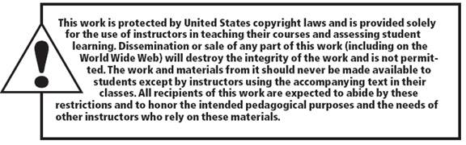
All rights reserved. No part of this publication may be reproduced, stored in a retrieval system, or transmitted, in any form or by any means, electronic, mechanical, photocopying, recording, or otherwise, without the prior written permission of the publisher. Printed in the United States of America.
Copyright © 2014 Pearson Education, Inc. All rights reserved.
Copyright ©2014 by Pearson Education, Inc. All rights reserved.

