Slide 1
Part III: The Publics
Chapter 9: Media
Copyright ©2014 by Pearson Education, Inc. All rights reserved.

Slide 2
Learning Objectives
To discuss the bedrock importance of media relations as the most fundamental skill in public relations work.
To explore media communication in all its forms—print, electronic, Internet.
To discuss the value of publicity as more powerful and credible than advertising.
To examine the proper way of dealing with journalists vis-à-vis organizational publicity.
Copyright ©2014 by Pearson Education, Inc. All rights reserved.

Slide 3
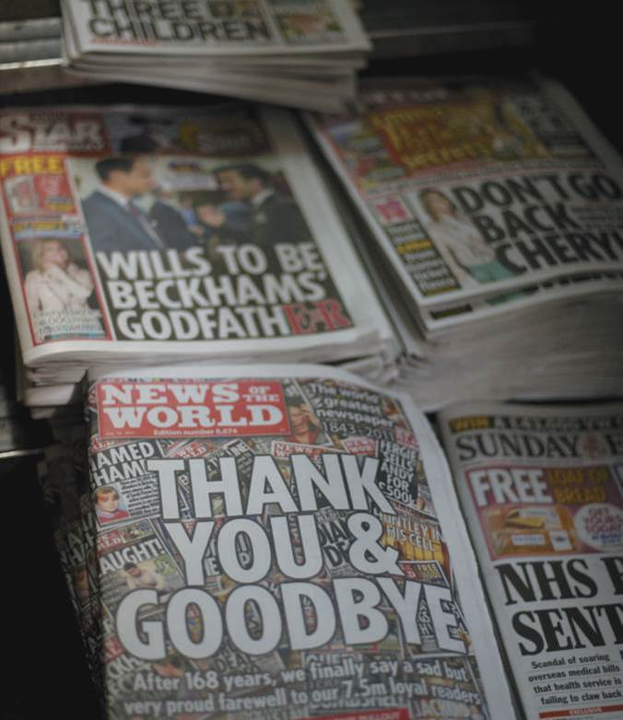
Opening Example: News of the World Hacking
Distrust of the media has reached record high
News of the World accused of hacking into telephones
News of the World shut down and its editor was arrested
Copyright ©2014 by Pearson Education, Inc. All rights reserved.

Slide 4
Learning Objective 1
To discuss the bedrock importance of media relations as the most fundamental skill in public relations work.
Copyright ©2014 by Pearson Education, Inc. All rights reserved.

Slide 5
News on the Internet
More pervasive, intrusive, accessible, and more likely to cause problems for public relations professionals
Examples
Microsoft’s email to Wired magazine reporter
Target’s response to “nontraditional media outlets” that do not reach their “core guest”
Redner Group’s threatening tweets to Wired.com
Fragmented, omnipresent (24/7), aggressive, opinionated, sharp-elbowed and less trained reporters
Copyright ©2014 by Pearson Education, Inc. All rights reserved.

Slide 6
Media Importance
Public relations must know how to deal with the press
Press plays “devil’s advocate” role
Most reporters have a liberal bias
Everyone is biased one way or another
Public relations professionals should base opinions on objective facts
Reporters may “break eggs” to ferret out the truth
70% accuracy considered “acceptable” on the Internet
Copyright ©2014 by Pearson Education, Inc. All rights reserved.

Slide 7
Objectivity in the Media
Securing positivity publicity through the media still at heart of public relations practice
Publicity is more credible than advertising
Reporters more competitive, more aggressive, and less objective
Objectivity = fairness with the intention of remaining neutral
Copyright ©2014 by Pearson Education, Inc. All rights reserved.

Slide 8
Objectivity in the Media
Total objectivity impossible; biases & preconceived notions exist
Reporters do not accept party line on faith
Reporters should not distort the official view once substantiated
Copyright ©2014 by Pearson Education, Inc. All rights reserved.

Slide 9
Public Relations and the Media: Friendly Adversaries
Reporters want to get the facts from all sides
Reporters want to be treated fairly and will reciprocate
The reporter wants the “story”
Organizations want things to be presented in the best light
Some executives consider journalists the enemy because they want to reveal bad news
Copyright ©2014 by Pearson Education, Inc. All rights reserved.

Slide 10
Learning Objective 1 Discussion Question
What is meant by the “devil’s advocate” role of the media?
Copyright ©2014 by Pearson Education, Inc. All rights reserved.

Slide 11
Learning Objective 2
To explore media communication in all its forms—print, electronic, Internet.
Copyright ©2014 by Pearson Education, Inc. All rights reserved.

Slide 12
Print: Hanging In
Newspapers closed or cut back during the recession
By summer 2012, print circulation was stabilizing and newspaper reading on the Internet was way up
Print still important among public relations professionals
Newspapers and magazines use news releases and other publicity vehicles more than network/cable TV (they wait for print coverage)
Online databases, blogs, and other Web-based media use releases targeted at print
Number of newspapers and subscribers declined, but newspapers still set news agenda for the nation
Copyright ©2014 by Pearson Education, Inc. All rights reserved.

Slide 13
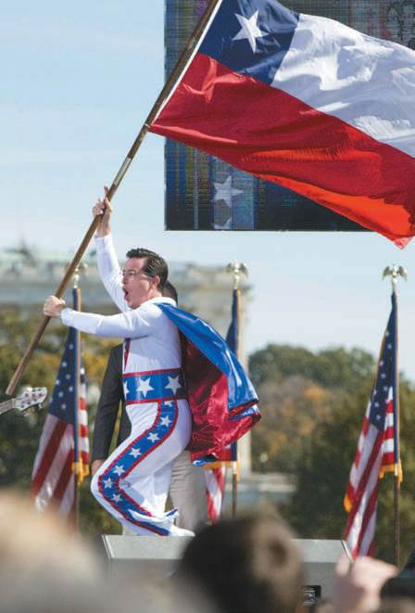
Electronic Media: Cable Ups and Downs
Cable has dramatic impact on news consumption habits
24/7 cable news and biased channels created difficulty discerning true “news”
Specialized cable networks and “fake news” popularity
Talk radio as a political and social force
30 minutes of news fills one half of one page in a newspaper
Figure 9-3 (Photo: TRIPPLAAR KRISTOFFER SIPA/Newscom)
Copyright ©2014 by Pearson Education, Inc. All rights reserved.

Slide 14
The Internet Factor
New age of reporting: immediate and freewheeling
Twitter and Facebook broadcast news from 2010 Arab Spring
Internet hurt journalistic standards and increases rumors
Newspaper websites have grown in popularity and online staffs continue to expand
“New-age news sources”
Blogs – 181 million and counting
Public relations professionals must foster close relationships with those who present the news
Copyright ©2014 by Pearson Education, Inc. All rights reserved.

Slide 15
Dealing with the Media
A reporter is a reporter
You are the organization
There is no standard-issue reporter
Treat journalists professionally
Don’t sweat the skepticism
Don’t try to “buy” a journalist
Become a trusted source
Talk when not “selling”
Don’t expect “news” agreement
Don’t have an attitude
Never lie
Read the paper
Copyright ©2014 by Pearson Education, Inc. All rights reserved.

Slide 16
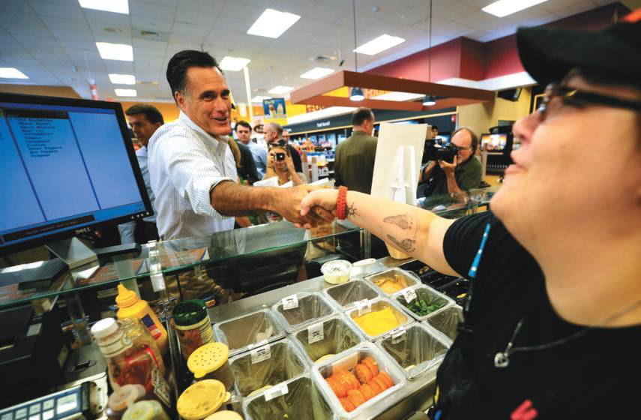
PR Ethics Mini-Case: MSNBC Cries “Wawa” with Made-Up Romney Gaffe
Page 181
How would you assess MSNBC’s handling of the Romney Wawa moment?
How would you have handled the incident were you Andrea Mitchell?
Figure 9-5 (Photo: EMMANUEL DUNAND/AFP/Getty Images/Newscom)
Copyright ©2014 by Pearson Education, Inc. All rights reserved.

Slide 17
Learning Objective 3
To discuss the value of publicity as more powerful and credible than advertising.
Copyright ©2014 by Pearson Education, Inc. All rights reserved.

Slide 18
Attracting Publicity
Publicity is more powerful than advertising
Publicity gained by dealing directly with media
Differences between publicity and advertising
Advertising costs money while publicity costs time and effort (roughly 10% of equivalent advertising expenditures)
Advertising guarantees content, size, location, reach and frequency while publicity does not
Publicity appears as news so it carries a third-party endorsement while advertising viewed as sponsoring the organization’s self-serving view
Copyright ©2014 by Pearson Education, Inc. All rights reserved.

Slide 19
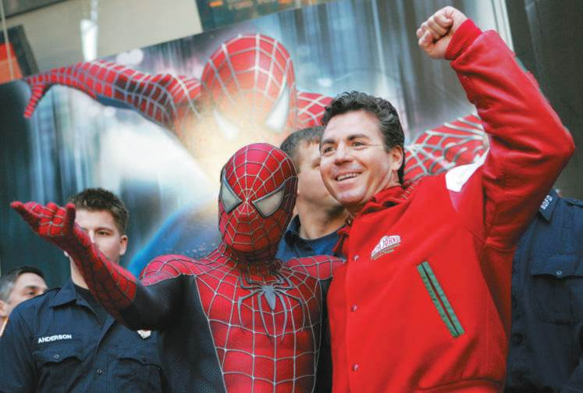
Value of Publicity
Announcing a new product or service
Reenergizing an old product
Explaining a complicated product
Little or no budget
Enhancing the organization’s reputation
Crisis response
Figure 9-7 (Courtesy of Odwyerpr.com)
Copyright ©2014 by Pearson Education, Inc. All rights reserved.

Slide 20
Pitching Publicity
Be time sensitive
Write first, then call
Direct release to specific person or editor
Determine how the reporter wants to be contacted
Don’t badger
Use exclusives but be careful
Do your own calling
Don’t send clips of other stories about your client
Develop a relationship
Never lie
Copyright ©2014 by Pearson Education, Inc. All rights reserved.

Slide 21
Online Publicity
Online publicity still a relationship business
Journalists moving toward social media
Paid wires guarantee use of material
Paid wires reach newsrooms and have enhanced web use options
Staging online events can draw reporters and publics
Bar for web events has been raised
Copyright ©2014 by Pearson Education, Inc. All rights reserved.

Slide 22
Learning Objective 3 Discussion Questions
What is the difference between advertising and publicity?
What is the value of publicity?
Copyright ©2014 by Pearson Education, Inc. All rights reserved.

Slide 23
Learning Objective 4
To examine the proper way of dealing with journalists vis-à-vis organizational publicity.
Copyright ©2014 by Pearson Education, Inc. All rights reserved.

Slide 24
Handling Media Interviews
Coordinate interviews for organization’s executives with media
Executives are generally unfamiliar and uncomfortable in interview situations
Reporters may ask impertinent questions
Executives not used to being put on the spot
First question: What purpose will this serve the organization?
Copyright ©2014 by Pearson Education, Inc. All rights reserved.

Slide 25
Media Interview Dos and Don’ts
Prepare – know interviewer’s point of view, interests, questions
Know your lines
Relax
Speak in personal terms
Welcome the naïve question
Answer questions briefly and directly
Don’t bluff
State facts and back up generalities
There is no such thing as “off the record”
Don’t say “No comment.”
Tell the truth
Copyright ©2014 by Pearson Education, Inc. All rights reserved.

Slide 26
Learning Objective 4 Discussion Question
What’s the most important thing to remember in any interview?
Copyright ©2014 by Pearson Education, Inc. All rights reserved.

Slide 27
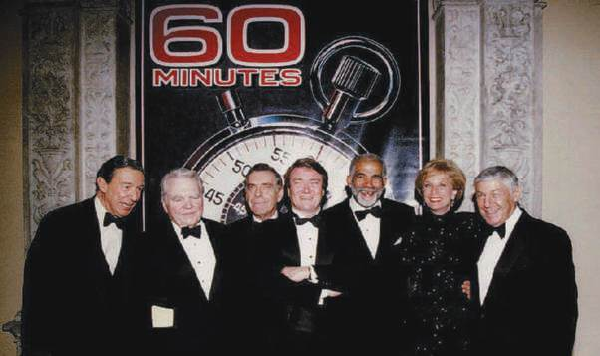
Case Study: They’re Heeere
Page 195
Would you let 60 Minutes in?
Would you let them film the press conference?
Would you let them film the cocktail party?
Would you let them film a separate interview with the president?
Would you change the format of the party?
How does the American Bankers Association (ABA) deal with the media today? Visit its online press room (www.aba.com/press+room/default.html).
What resources can members of the press access on this site? How does ABA make it easy for reporters to make contact?
Figure 9-10 (Photo: BOB STRONG/AFP/Getty Images/Newscom)
Copyright ©2014 by Pearson Education, Inc. All rights reserved.

Slide 28
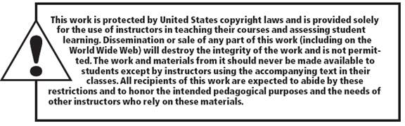
All rights reserved. No part of this publication may be reproduced, stored in a retrieval system, or transmitted, in any form or by any means, electronic, mechanical, photocopying, recording, or otherwise, without the prior written permission of the publisher. Printed in the United States of America.
Copyright © 2014 Pearson Education, Inc. All rights reserved.
Copyright ©2014 by Pearson Education, Inc. All rights reserved.

