Slide 1
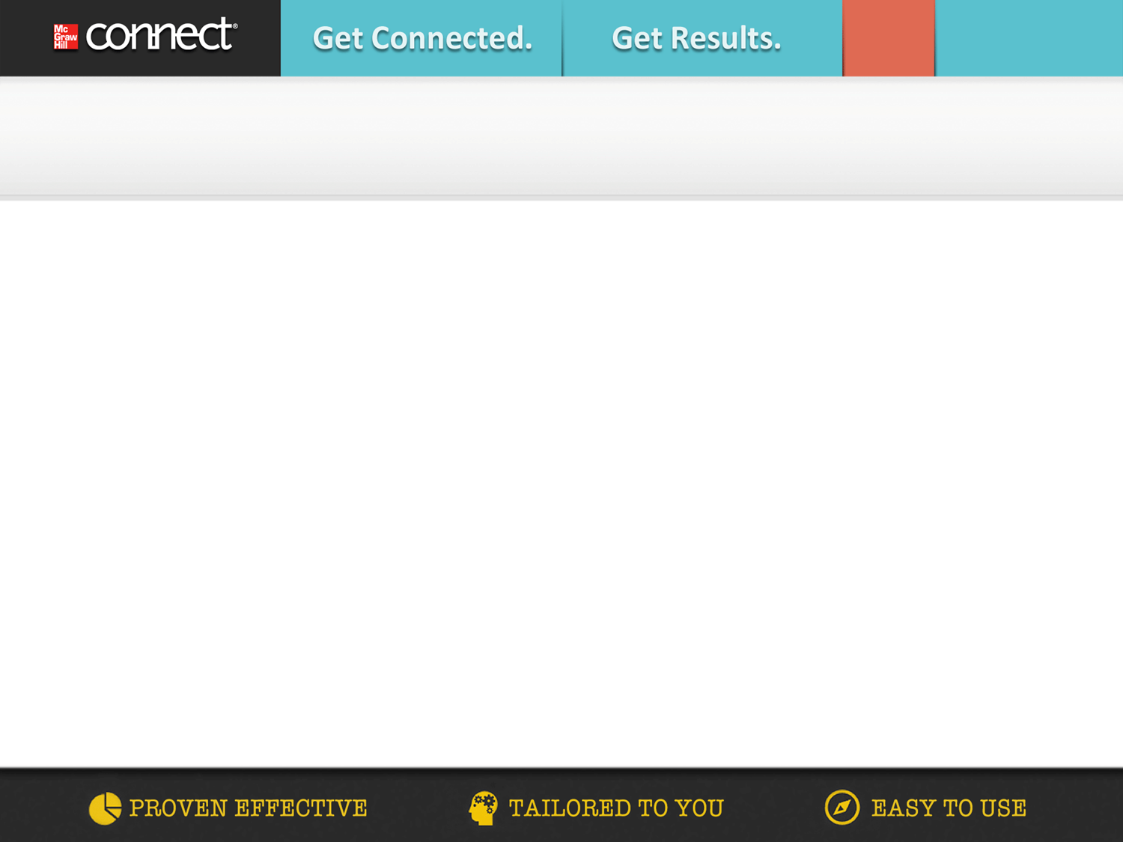


Get Started in 4 Easy Steps!
Go to http://connect.mheducation.com/class/grossman-com105-fall2014
and click the “Register Now” button.
Enter your email address
Enter your access code, or select “Buy Online,” or you can “Start courtesy access” if you don’t have an access code.
Complete the registration form and click “Submit”

Slide 2
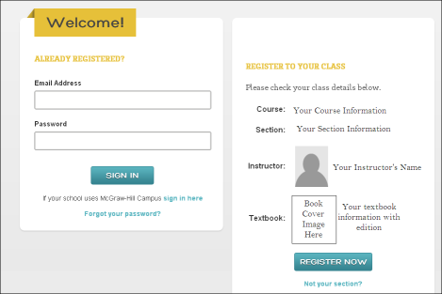
Get Started in 4 Easy Steps!
Go http://connect.mheducation.com/class/grossman-com105-fall2014
and click the “Register Now” button

Slide 3
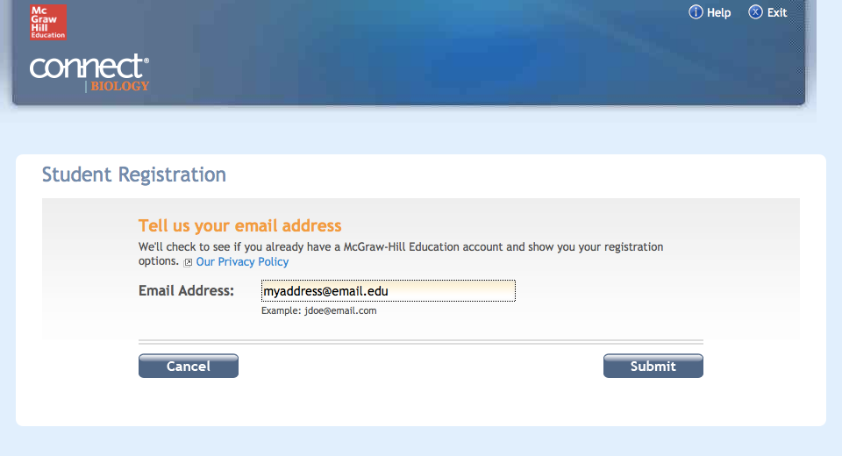
Get Started in 4 Easy Steps!
2. Enter your email address

Slide 4
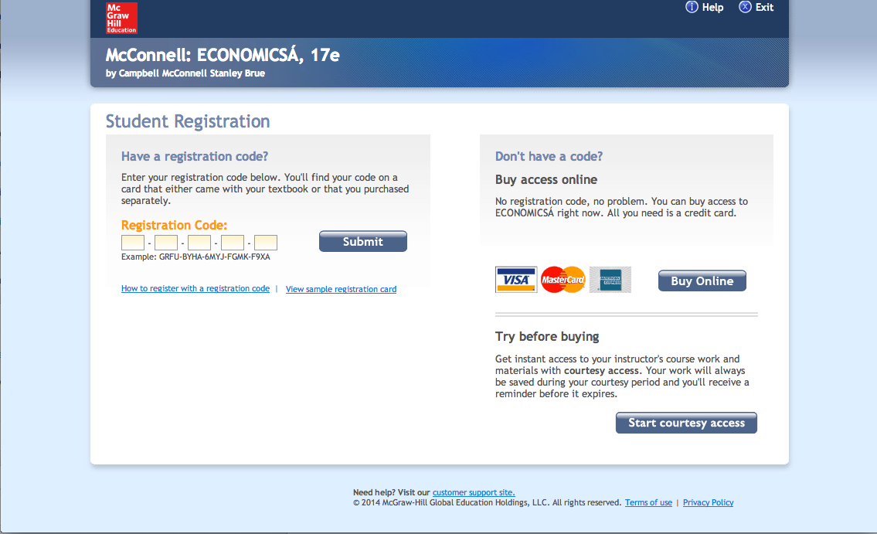
Get Started in 4 Easy Steps!
Enter your access code, or select “Buy Online,” or you can
“Start courtesy access” if you don’t have an access code.

Slide 5
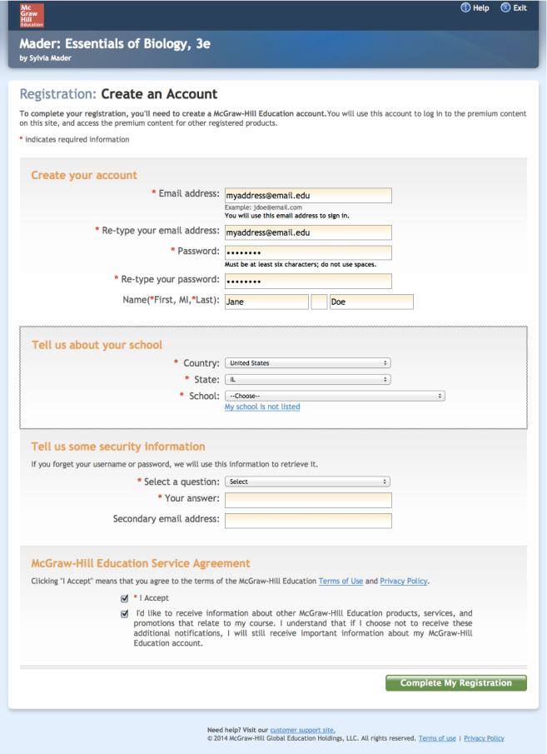
Get Started in 4 Easy Steps!
4. Complete the registration form and click “Submit”

