Slide 1
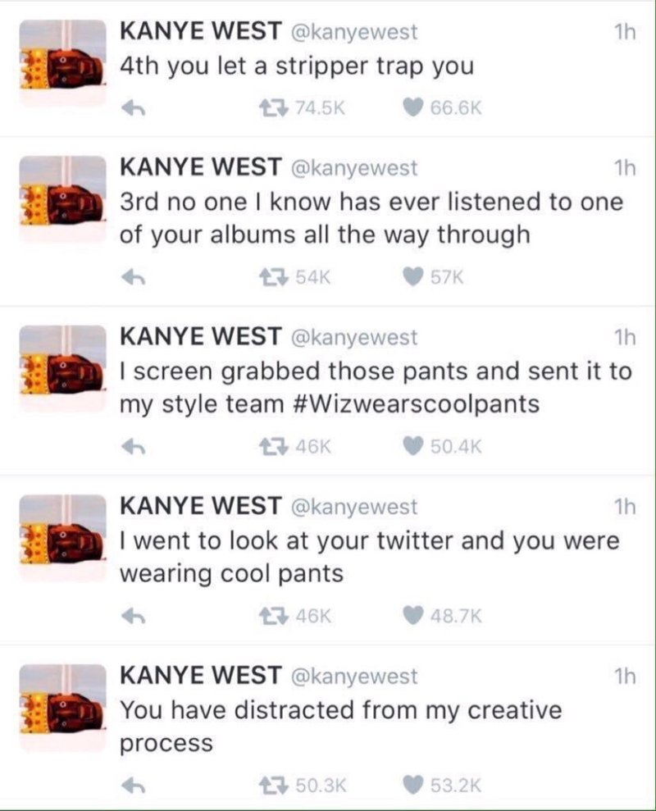
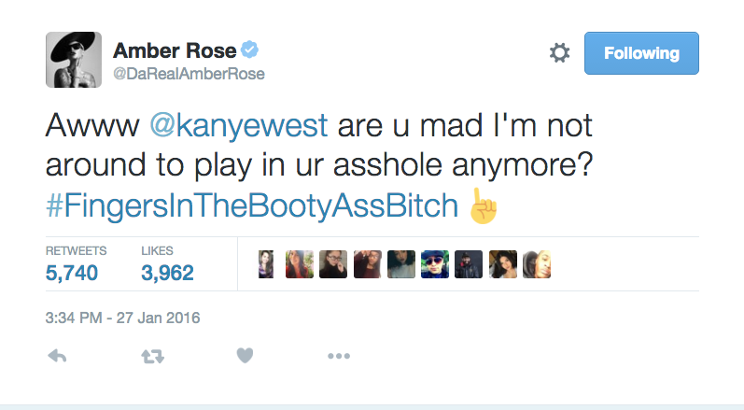
Sam Burke
2/1/2016
Controlled
Uncontrolled
Explanation: Kanye West released the messages on the left as part of a deliberate attempt to slam rapper Wiz Khalifa by insulting their shared ex, Amber Rose. However, West did not anticipate that Amber Rose would chime in on this, and she retaliated (as shown on the right) to his remarks by releasing details about their former sex life that he did not want the public to know.

