Slide 1
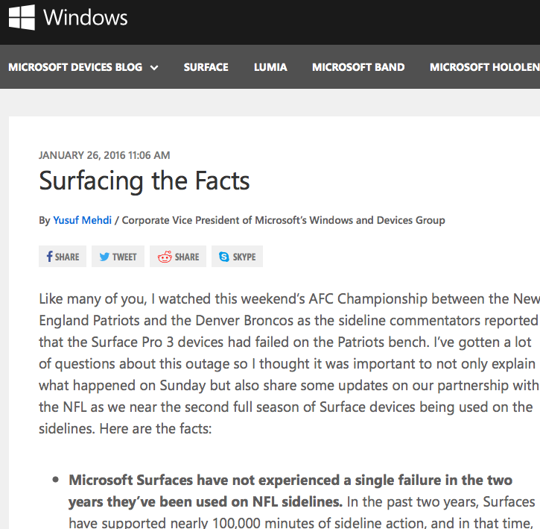
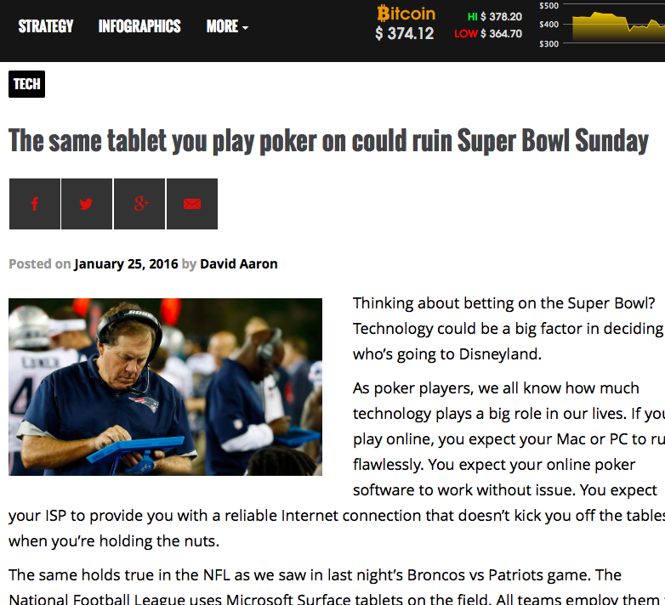
Microsoft Tablets
Controlled
Uncontrolled
Tara Conklin, PR 103, Sec 21268, February 1, 2016

